Slide 1

AD Menus
JAL Inflight Media
FY2026 Edition
Inflight Magazine
Inflight Entertainment
Media Guide
© JAL Brand Communications. All Rights Reserved.

Slide 2


SKYWARD
The JAL Group in-flight magazine,
read by approx. 3.64 million passengers monthly.
Form of publication | - Monthly (placed on board from the first to the last day of each month, published on the 27th of the preceding month) ^{*2}
Distribution method | - JAL Group in-flight seat pockets^{*3}
Format | - 297 mm (height) x 210 mm (width)/perfect binding/all color (4-color offset printing)
Application deadline | - 50 days before publication
Material deadline | - Approximately 35 days before publication
Number of potential readers per month^{*1}
Domestic flights
3,180,000 readers
International flights
660,000 readers
* 1: JAL Group monthly report average from April 2024 – March 2025
* The number of copies of the in-flight magazine is not disclosed due to its circular nature where one copy is read by passengers who sit in the same seat
*2: The onboard start and end dates may change for various reasons such as late aircraft arrivals.
*3: May not be deployed onboard on some flights due to flight schedules, late aircraft arrivals, etc.
Units: yen/tax not required
Domestic Edition
Japanese Page | Domestic | International | Both | Ad size (height x width)
Inside front cover spread | 2,900,000 | 2,350,000 | 4,550,000 | 297×420
Second inside front cover spread | - | - | 4,400,000 | 297×420
FP, Facing Content | 1,600,000 | 1,250,000 | 2,600,000 | 297×210
FP, Facing Editorial | 1,550,000 | 1,200,000 | 2,350,000 | 297×210
Spread | 2,650,000 | 2,150,000 | 4,150,000 | 297×420
FP (Foreign language page) | 1,100,000 | 1,100,000 | 2,000,000 | 297×210
Spread (Foreign language page) | 2,150,000 | 2,150,000 | 3,700,000 | 297×420
Inside back cover | - | 1,250,000 | - | 297×210
Outside back cover | - | 1,800,000 | - | 297×200
Pages of
JAL SHOP
(mm)
Pages in Japanese/ foreign languages
Japanese text
Cover
Back cover
(JAL SHOP
Cover)
International Edition
Pages in Japanese
Pages in foreign languages
(mm)
Japanese text
Cover
Back cover
(AD)
* The above are rates for the ad spaces.
* As a general rule, we will create space for the second inside front cover only when an ad is published in both domestic and international editions of the magazine. This space is not regularly available.
Main contents include overseas special feature, domestic special feature, interviews, columns, essays, JAL Group information, and flight map.
Foreign language pages are in English and Chinese (Simplified).

Slide 3
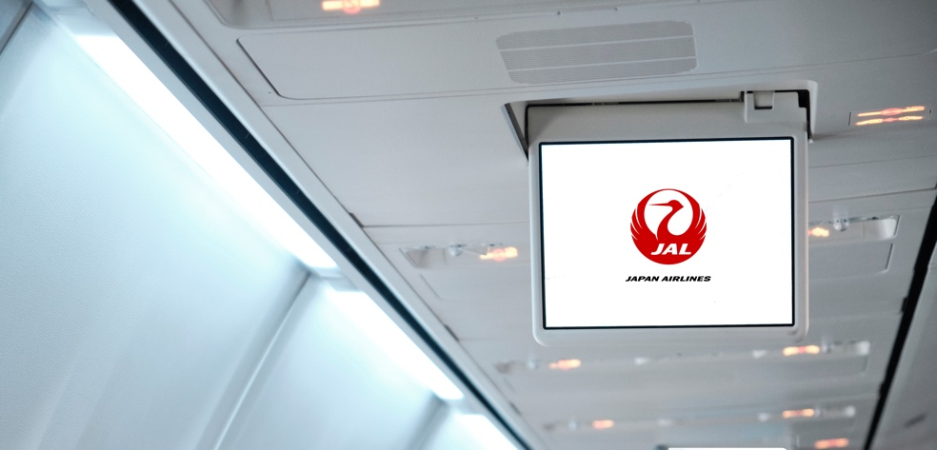

Front Monitor CF (Domestic flights)
Appeal to many customers by showing a commercial within JAL original program on the monitors at the front of the cabin aisle
Screening media | - Front monitors on domestic flights
Screening period | - 1 month (from the 1st to the last day of each month) * The start and end dates of screening may change due to circumstances such as late aircraft arrivals.
Length of commercial (Number of seconds on screen) | - 15 sec/30 sec/60 sec/90 sec * The screening order will be decided at our discretion.
Number of flights screened on | About 8,300 flights/month*¹ * Separately to the above, CF can be shown on some extra flights including charter flights.
Screening routes | - Domestic routes operated by JAL*²
Material deadline | - 35 days before the start of screening
* We don’t distribute earphones on board.
Number of potential viewers per month
Approximately
1,330,000 passengers on domestic flights*¹
Visibility Rate
per month
Approximately
64 % on domestic flights*³
Rate table | 15 seconds | 30 seconds | 60 seconds | 90 seconds
Rates(yen) /slot/month *tax not required | 1,200,000 | 1,800,000 | 2,640,000 | 3,240,000
* The above is for illustrative purposes
The flow up to the screening of commercials on domestic flights (shown twice after takeoff)
The first and second rounds of the CF use the same commercial materials and broadcast order.
Applicable period of the rate | From April 2026 to March 2027
*1：Monthly average from April 2025 to March 2026 (JAL’s inner data)
*2：(1)Commercials may not be shown in some cases on routes with a flight time of 70 minutes or less (Haneda=Itami, Kansai, Akita, Komatsu, Okayama, Tokushima, Takamatsu, about 1,390 flights/month in total) due to available service time.
(2)Commercials will not be shown on aircraft without screening equipment (including Airbus A350-900 and Boeing 787-8 aircrafts).
(3) Commercials will not be shown if the flight is operated by a group airline even if the flight number is JAL name.
*3：JAL In-House Survey (JMB Members), November 2026
takeoff (about 10 minutes after)
Before takeoff
Safety
video
screening
Seat
belt
sign
etc.
Commercials
#1
JAL
Information
Commercials
#2
JAL
Information
"For Your
Own Safety"

Slide 4
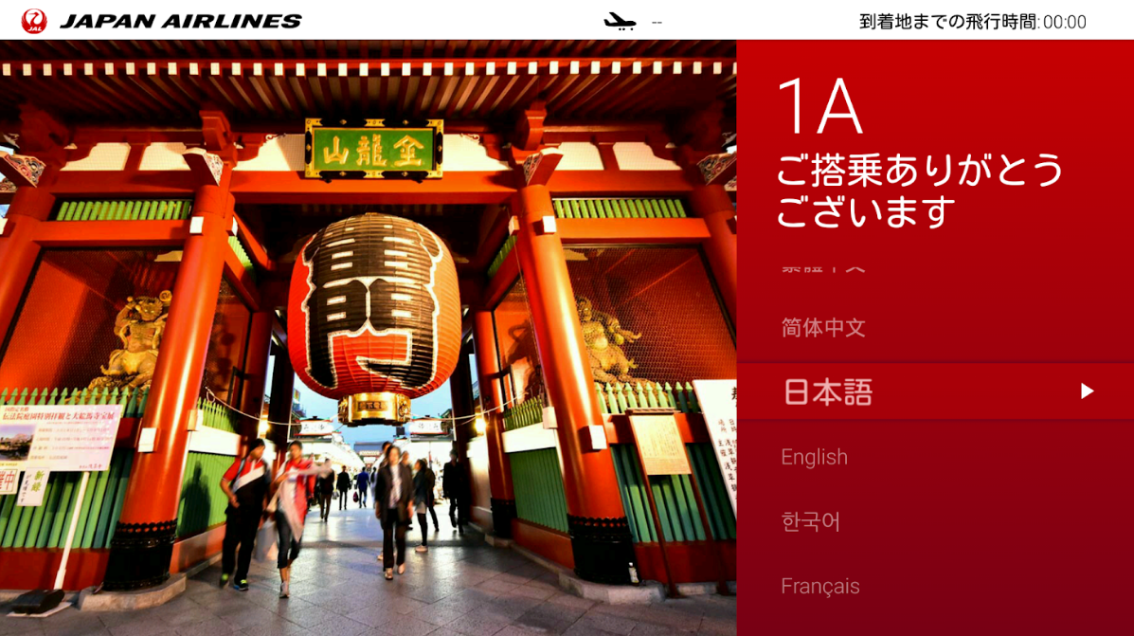



Welcome Screen Ads (Domestic flights / Airbus A350-900・Boeing 787-8 )
Ads displayed on individual monitors.
Effectively promotes your products or services, displayed on the first screen passengers see when they are seated.
Screening media | Individual monitors on domestic flights Applicable aircrafts: Airbus A350-900・Boeing 787-8 Applicable seats: ：ALL Class / All languages
Number of flights screened on | Airbus A350-900 , Boeing 787-8. About 2,700 flights/month *1 *CF can also be screened in the case of operating international aircrafts on domestic flight routes, and on some extra flights including charter flights.
Screening routes | Haneda = Itami, New Chitose, Fukuoka, Naha Itami=Naha
Length of commercial | About 8 seconds/slot *total 6 images, including 3 ads and 3 photos of the arrival location, are looped for approx. 50 seconds. The loop repeats until the passenger selects a language.
Sales slots | 3 slots
Screening period | 1 month (from the 1st to the last day of each month) * The start and end dates of screening may change due to circumstances such as late aircraft arrivals.
Rate | 900,000 yen / slot / month (tax not required )
Applicable period of rate | From April 2026 to March 2027
Application deadline | Booking deadline: around 80 days prior to screening Material deadline : around 60 days prior to screening
Notes | Cannot be transferred to external websites on the monitor. The number of impression cannot be count.
Number of potential viewers per month
Approximately
857,000 passengers *¹
※Airbus A350-900
Individual monitors
*Below photos are samples. Photos differs on every flight routes.
AD ①
AD ②
AD ③
*1：Monthly average from April 2025 to March 2026 (JAL’s inner data)
*If there is no operation for a while, the monitor will go into sleep mode (go dark).
*Timing of image switching may shift from seat to seat (the length displayed is not affected).
*The delivery size is special. Please refer to “Guidelines for advertisement submission (3)”

Slide 5
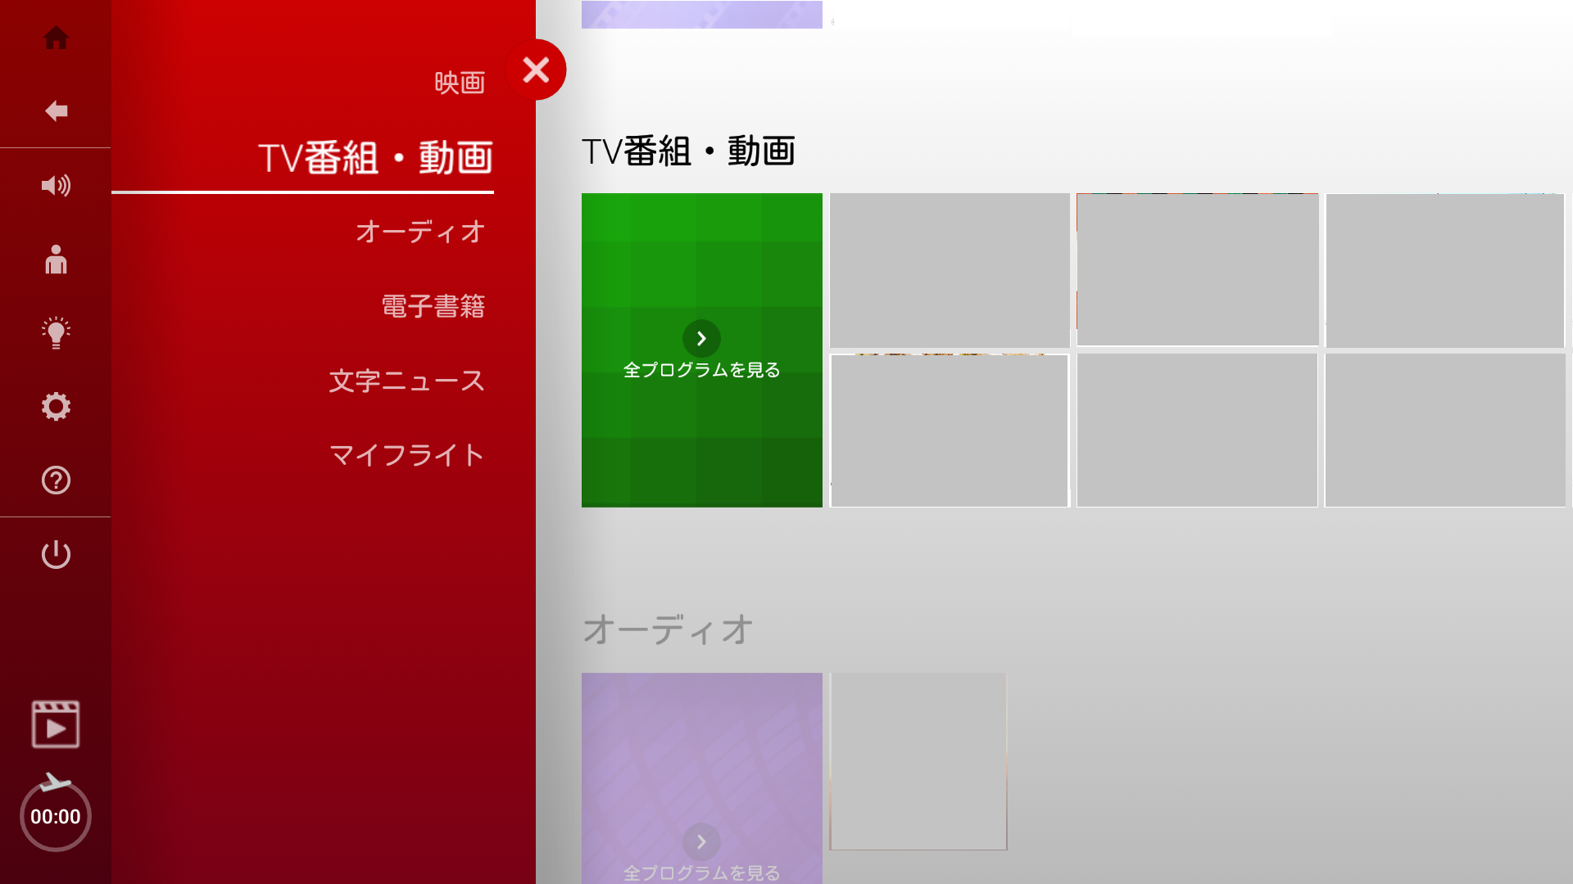
Welcome Interstitial Video Ads – First Class and Class J
(Domestic flights / Airbus A350-900・Boeing 787-8 )
Language Targeting Option is Applicable
Please refer to the "Option Guide."
Interstitial video ads after selecting languages on the individual monitors, screened by all passengers using IFE.
Screening media | Individual monitors on domestic flights Applicable aircrafts: Airbus A350-900・Boeing 787-8 Applicable seats: ：First Class and Class J / All languages
Number of flights screened on | Airbus A350-900 , Boeing 787-8. About 2,700 flights/month*¹ *CF can also be screened in the case of operating international aircrafts on domestic flight routes, and on some extra flights including charter flights.
Screening routes | Haneda = Itami, New Chitose, Fukuoka, Naha Itami=Naha
Length of commercial | 15 seconds
Sales slots | 2 slots * Maximum slots one client can book is two/month.
Screening period | 1 month (from the 1st to the last day of each month) * The start and end dates of screening may change due to circumstances such as late aircraft arrivals.
Rate *tax not required | 1st slot (unskippable for 15sec) : 2,800,000 yen / slot / month 2nd slot (unskippable for 6sec) : 2,350,000 yen / slot / month *Even if there is no application for the 1st slot , “X” button will be displayed on the advertisement if applied at the rate of 2nd slot.
Applicable period of rate | From April 2026 to March 2027
Application deadline | Booking deadline: around 80 days prior to screening Material deadline : around 60 days prior to screening
Notes | “✕” button will be shown after the 2nd slot is screened for about 6sec. Cannot be transferred to external websites on the monitor.
Number of potential viewers per month
Approximately
210,000 passengers *¹
Number of potential views per month
Approximately
200,000 views *²
※Airbus A350-900
Individual monitors
The flow up to screening
*Below photos are samples. Photos differs on every flight routes.
Welcome Screen
Main Menu
CF①～②slots
*1：Monthly average from April 2025 to March 2026 (JAL’s inner data)
*2 : JAL’s inner data ( Just a reference. Not guaranteed. )
* CF can stop during in-flight announcement is proceeding.

Slide 6
Welcome Interstitial Video Ads – Economy Class
(Domestic flights / Airbus A350-900・Boeing 787-8 )
Language Targeting Option is Applicable
Please refer to the "Option Guide."
Interstitial video ads after selecting languages on the individual monitors, screened by all passengers using IFE.
Screening media | Individual monitors on domestic flights Applicable aircrafts: Airbus A350-900・Boeing 787-8 Applicable seats: ：Economy / All languages
Number of flights screened on | Airbus A350-900 , Boeing 787-8. About 2,700 flights/month*¹ *CF can also be screened in the case of operating international aircrafts on domestic flight routes, and on some extra flights including charter flights.
Screening routes | Haneda = Itami, New Chitose, Fukuoka, Naha Itami=Naha
Length of commercial | 15 seconds
Sales slots | 2 slots * Maximum slots one client can book is two/month.
Screening period | 1 month (from the 1st to the last day of each month) * The start and end dates of screening may change due to circumstances such as late aircraft arrivals.
Rate *tax not required | 1st slot (unskippable for 15sec) : 3,000,000 yen / slot / month 2nd slot (unskippable for 6sec) : 2,500,000 yen / slot / month *Even if there is no application for the 1st slot , “X” button will be displayed on the advertisement if applied at the rate of 2nd slot.
Applicable period of rate | From April 2026 to March 2027
Application deadline | Booking deadline: around 80 days prior to screening Material deadline : around 60 days prior to screening
Notes | “✕” button will be shown after the 2nd slot is screened for about 6sec. Cannot be transferred to external websites on the monitor.
Number of potential viewers per month
Approximately
647,000 passengers *¹
Number of potential views per month
Approximately
850,000 views *²
※Airbus A350-900
Individual monitors
The flow up to screening
Welcome Screen
Main Menu
CF①～②
slots
*1：Monthly average from April 2025 to March 2026 (JAL’s inner data)
*2 : JAL’s inner data. ( Just a reference. Not guaranteed. )
* CF can stop during in-flight announcement is proceeding.

Slide 7
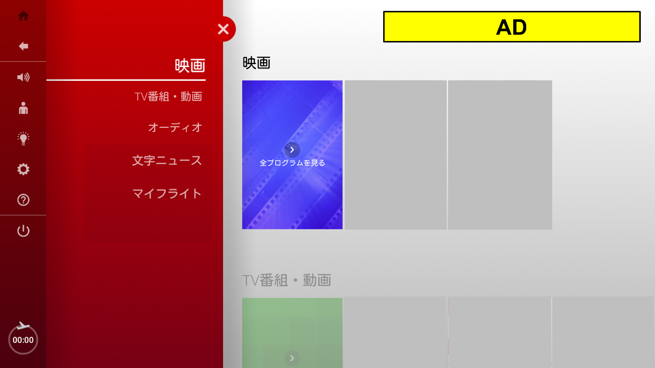
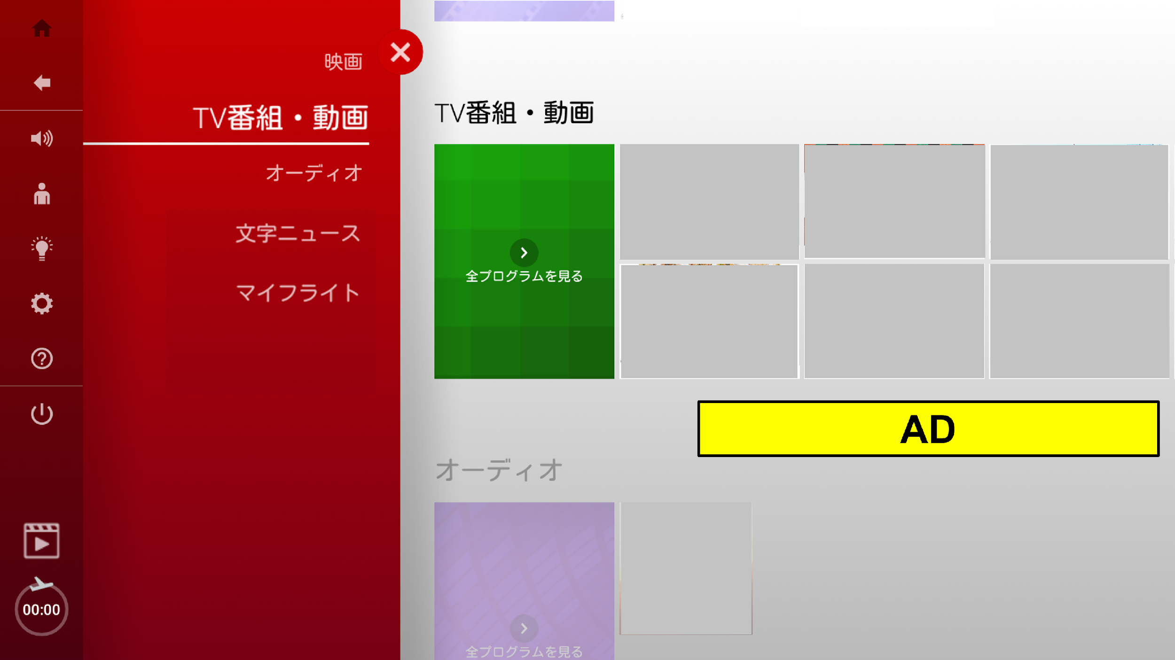
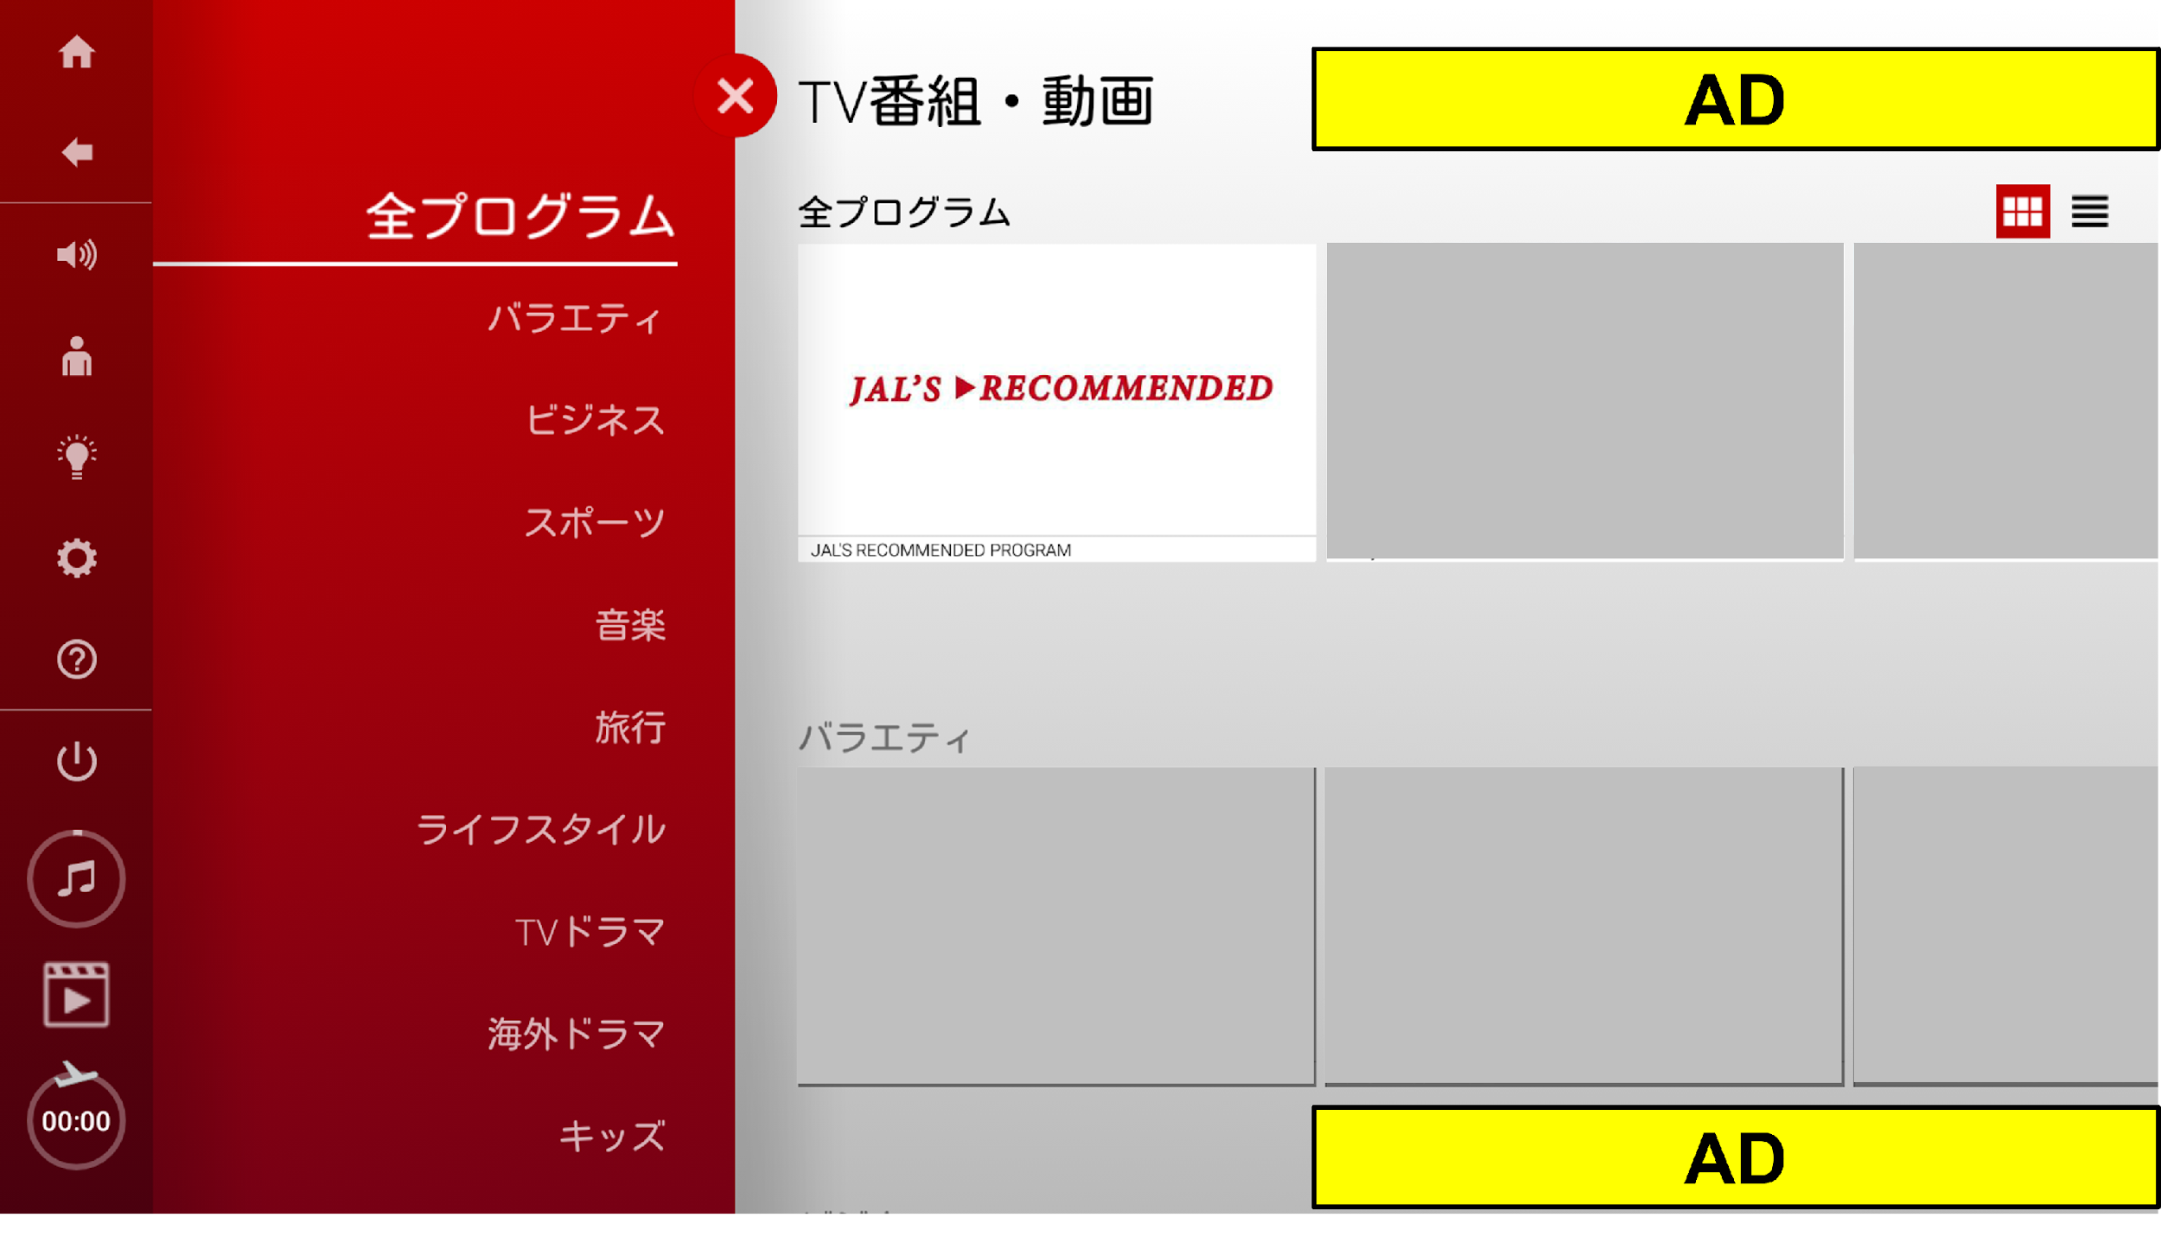
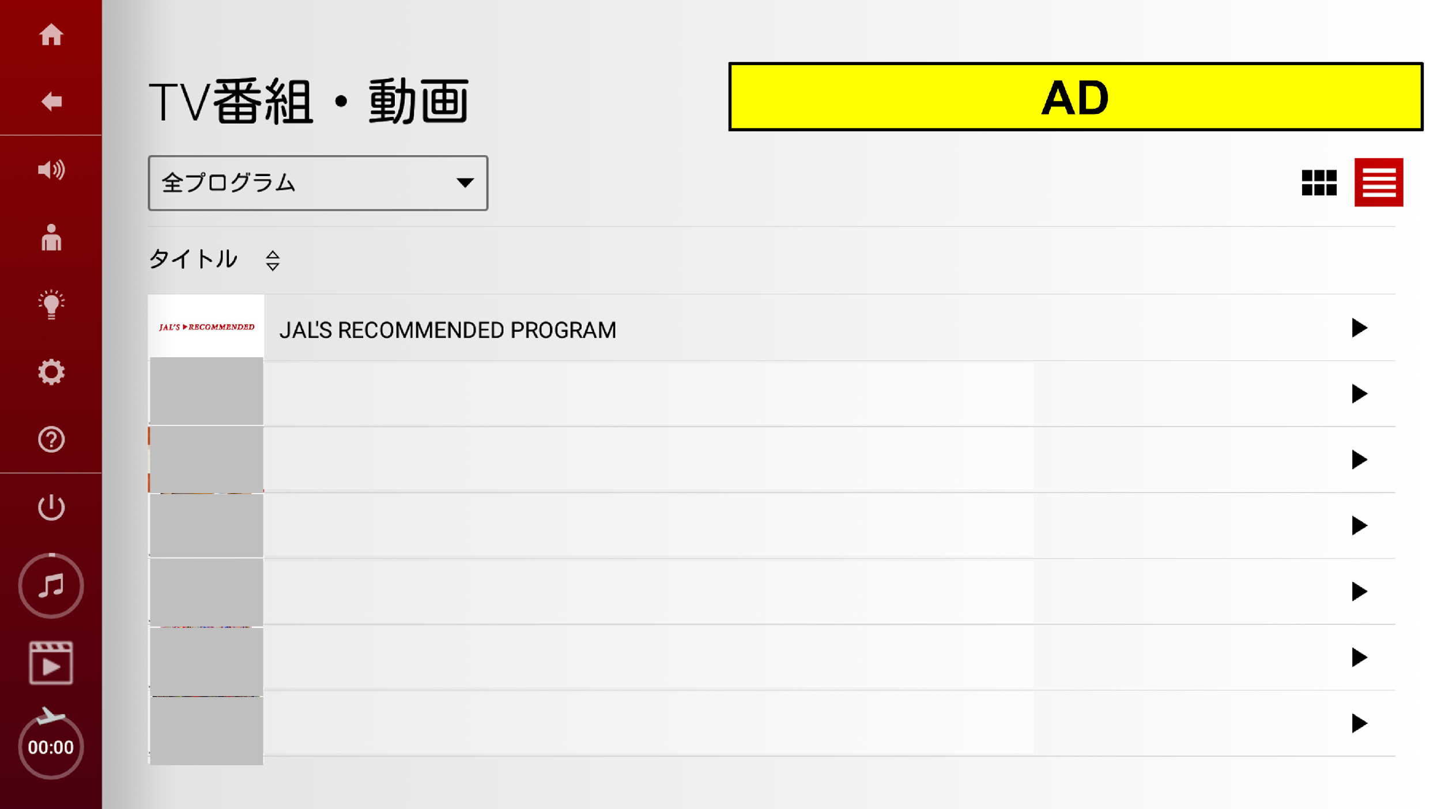

Banner Ads (Domestic flights / Airbus A350-900・Boeing 787-8 )
Language Targeting Option is Applicable
Please refer to the "Option Guide."
Banners shown on multiple spots on the individual monitor,
boosting your brand recognition, making repetitive approach to
passengers.
Screening media | Individual monitors on domestic flights Applicable aircrafts: Airbus A350-900・Boeing 787-8 Applicable seats: ：All Class / All languages
Number of flights screened on | Airbus A350-900 , Boeing 787-8. About 2,700 flights/month*¹ *CF can also be screened in the case of operating international aircrafts on domestic flight routes, and on some extra flights including charter flights.
Screening routes | Haneda = Itami, New Chitose, Fukuoka, Naha Itami=Naha
Banner spots ・ Specification | Total approx. 14 spots. * The number of spots can change depends on month. Banner visual is only 1. Same banner will be shown on all spots. Please select which to show after banners tapped, 15sec to 3 min or one still-picture.
Screening period | 1 month (from the 1st to the last day of each month) * The start and end dates of screening may change due to circumstances such as late aircraft arrivals.
Rate | 700,000 yen / slot / month (tax not required) *Separately, announcements from JAL Group or others will be displayed at the same time.
Applicable period of rate | From April 2026 to March 2027
Application deadline | Booking deadline: around 80 days prior to screening Material deadline : around 60 days prior to screening
Notes | “✕” button will be shown from the start of showing as for 15sec CF or a still-picture shown after banners tapped . Cannot be transferred to external websites on the monitor.
Number of potential viewers per month
Approximately
857,000 passengers *¹
Number of potential impression per month
Approximately
6,000,000 imp *²
Individual monitors
Examples of Banner spots
Tap Banners
15sec to 3 min
CF
or
One still-picture
*1：Monthly average April 2025 to March 2026 (JAL’s inner data)
*2 : JAL’s inner data ( Just a reference. Not guaranteed. )
* CF can stop during in-flight announcement is proceeding.

Slide 8
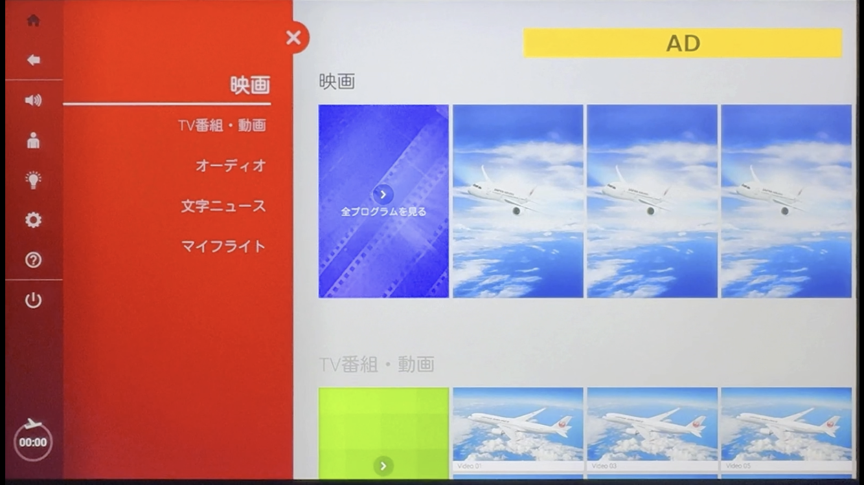

Pop-up Banner Ads (Domestic flights / Airbus A350-900・Boeing 787-8 )
Banners showing up on specific screens. Eye-catching and encouraging taps by keeping displayed even while scrolling.
Screening media | Individual monitors on domestic flights Applicable aircrafts: Airbus A350-900・Boeing 787-8 Applicable seats: ：All Class / All languages
Number of flights screened on | Airbus A350-900 , Boeing 787-8. About 2,700 flights/month*¹ *CF can also be screened in the case of operating international aircrafts on domestic flight routes, and on some extra flights including charter flights.
Screening routes | Haneda = Itami, New Chitose, Fukuoka, Naha Itami=Naha
Length of commercial | Total 5 spots. Same banner design is shown on all spots. Please select which to show after banners tapped, 15sec to 3 min or one still-picture.
Sales slots | 1 month (from the 1st to the last day of each month) * The start and end dates of screening may change due to circumstances such as late aircraft arrivals.
Screening period | 200,000 yen / month *One client only.
Rate | From April 2026 to March 2027
Applicable period of rate | Booking deadline: around 80 days prior to screening Material deadline : around 60 days prior to screening
Application deadline | Banners keep displayed for about 10 seconds. If the user navigates to another screen from the screen shown on the left while the banner is displayed, the banner remains displayed. "✕" button is always shown next to each banner. Even after once hidden, the banner reappears when screens ② or ③ are selected again. It does not reappear on screen ①. “✕” button will be shown from the start of showing as for 15sec CF or a still-picture shown after banners tapped. Cannot be transferred to external websites on the monitor.
Number of potential viewers per month
Approximately
857,000 passengers *¹
Number of potential impression per month
Approximately
1,600,000 imp *²
Examples of Banner spots
The following 5 spots
①Main Menu
②Movies – All Programs
③TV Programs - All Programs
④Audio – All Programs
⑤Text News - Browse All News
Tap Banners
15sec to 3 min
CF
One still-picture
or
*1：Monthly average April 2025 to March 2026 (JAL’s inner data)
*2 : JAL’s inner data ( Just a reference. Not guaranteed. )
* CF can stop during in-flight announcement is proceeding.

Slide 9

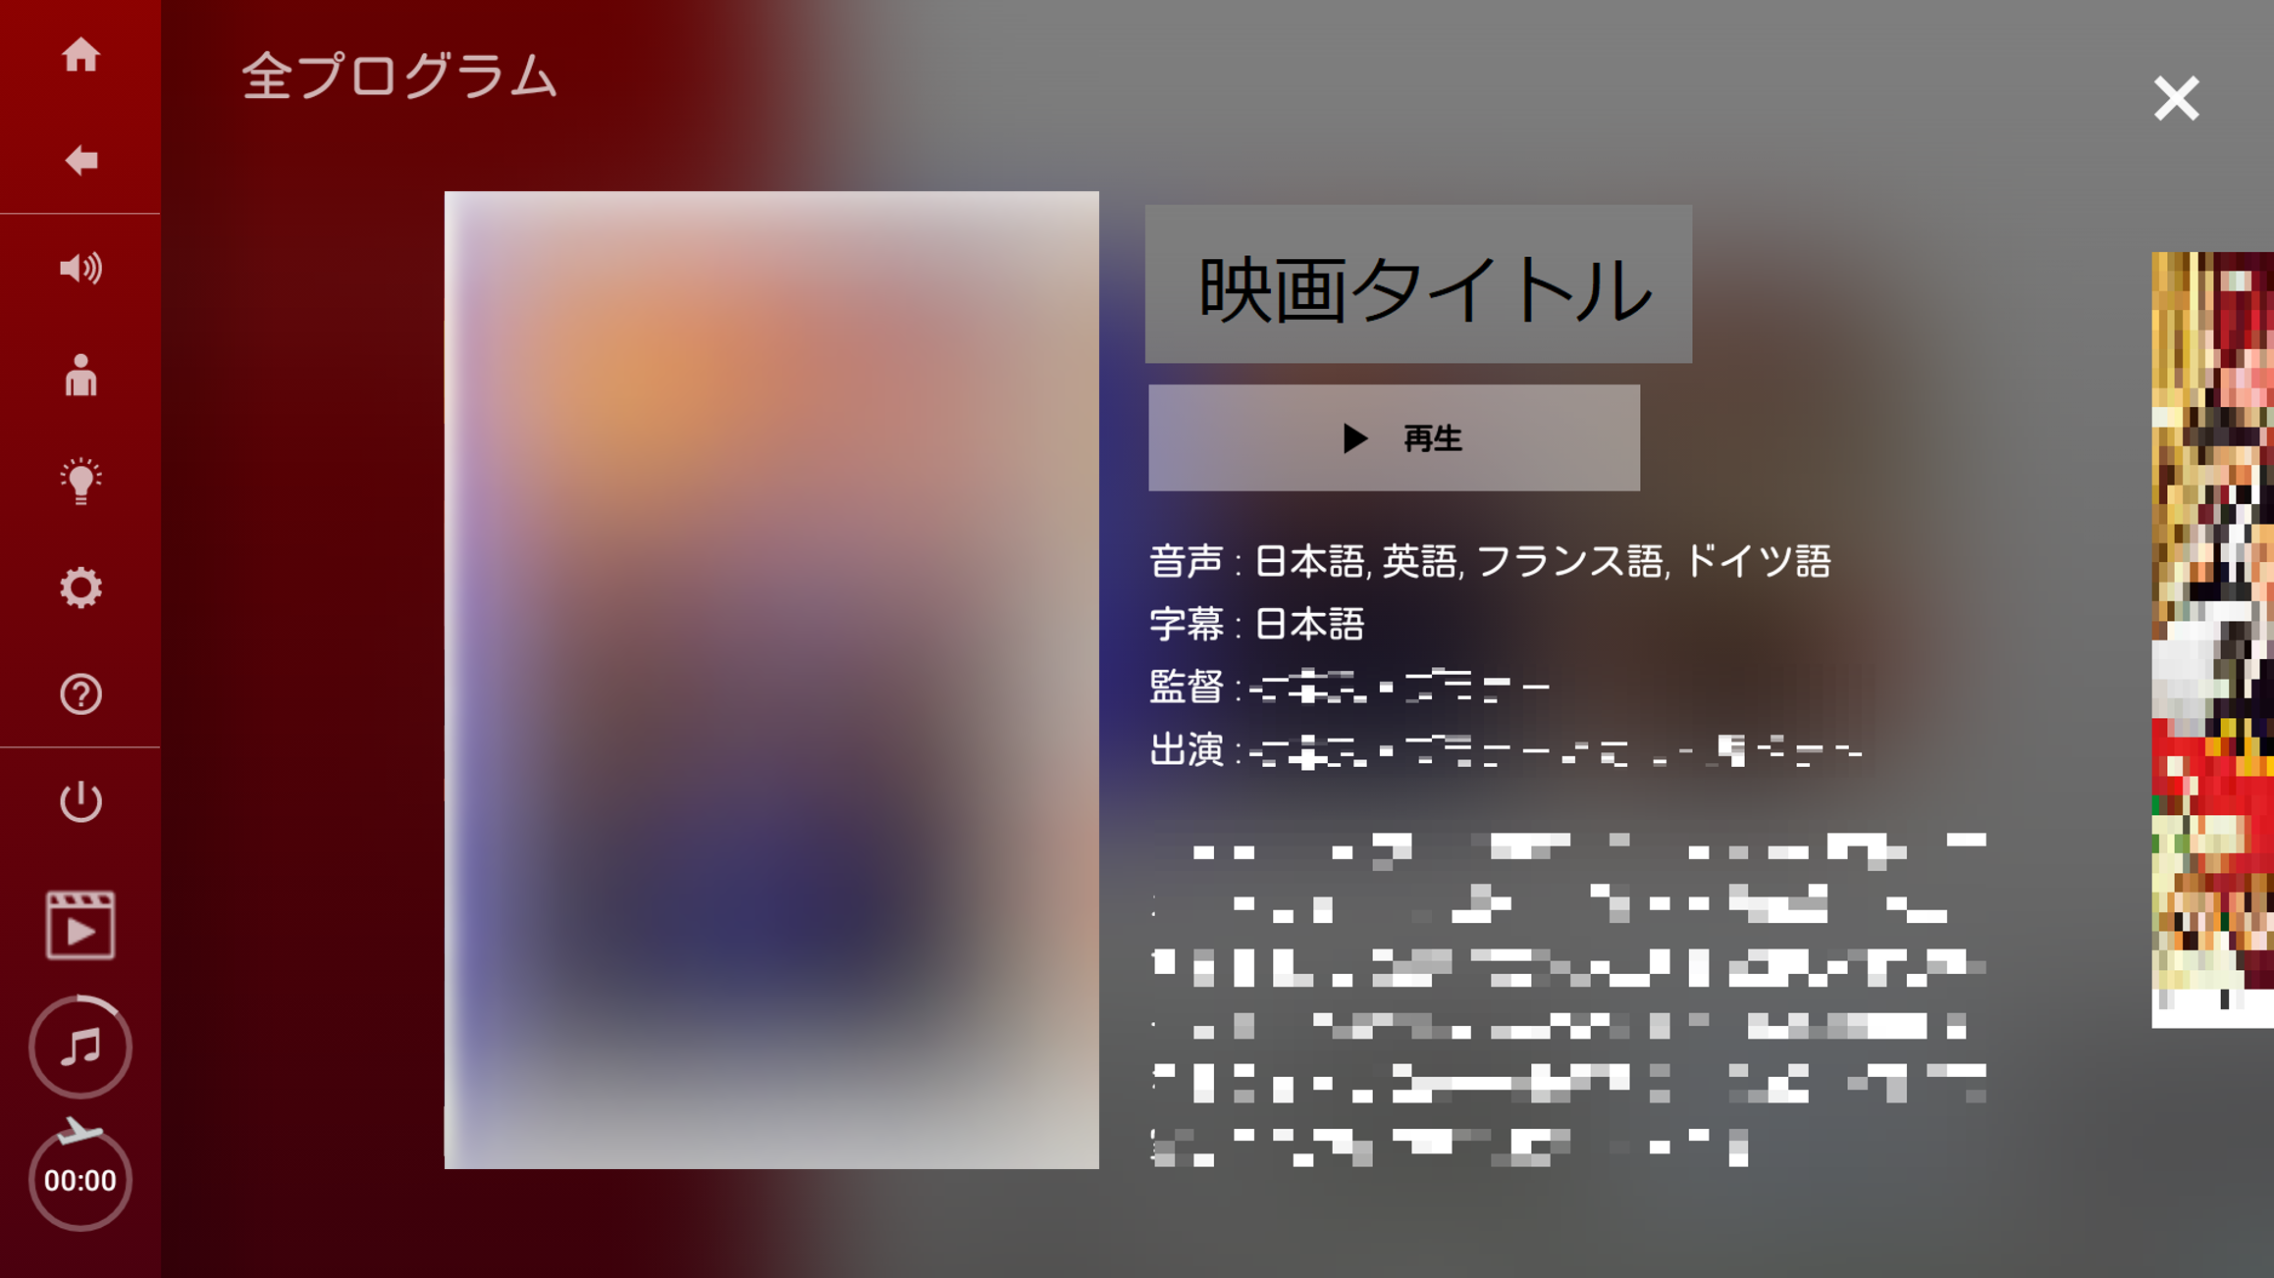
CF Before Movies (Domestic flights / Airbus A350-900・Boeing 787-8 )
Outstanding Target Reach. Get your message across before movies most customers will watch.
Total number of programs: approx. 25 programs *^{2,3}
Screening media | Individual monitors on domestic flights Applicable aircrafts: Airbus A350-900・Boeing 787-8 Applicable seats: ：All Class / All languages
Number of flights screened on | About 3,200 flights/month*¹ *CF may not be screened on some aircrafts. *CF can also be screened in the case of operating international aircrafts on domestic flight routes, and on some extra flights including charter flights.
Screening routes | Haneda = Itami, New Chitose, Fukuoka, Naha Itami=Naha
Length of commercial | 15 seconds * The screening order will be decided at our discretion.
Sales slots | 5 slots * Maximum slots one client can book is two/month.
Screening period | 1 month (from the 1st to the last day of each month) * The start and end dates of screening may change due to circumstances such as late aircraft arrivals.
Rate | 2,500,000 yen / slot / month (tax not required)
Applicable period of rate | From April 2026 to March 2027
Application deadline | Booking deadline: around 80 days prior to screening Material deadline : around 60 days prior to screening
Notes | - CF can be skipped by the viewers. - Cannot be transferred to external websites on the monitor.
Number of potential viewers per month
Approximately
922,000 passengers *¹
Number of potential views per month
Approximately
460,000 views imp *³
Individual monitors
※Airbus A350-900
The flow up to screening
Main Menu
Select a movie and play
…
CF
①~⑤ slots
Seatbelt signs etc
↓
Movie starts
* When playing or skipping, a window (displaying play/skip) will appear over the screen for a few seconds. CF can stop during in-flight announcement is proceeding.
*1：Monthly average from April 2025 to March 2026 (JAL’s inner data)
*2：Total number of movies differs every month.
The number of movies varies on the flights served by international aircraft.
*3：JAL’s inner data ( Just a reference. Not guaranteed. )

Slide 10
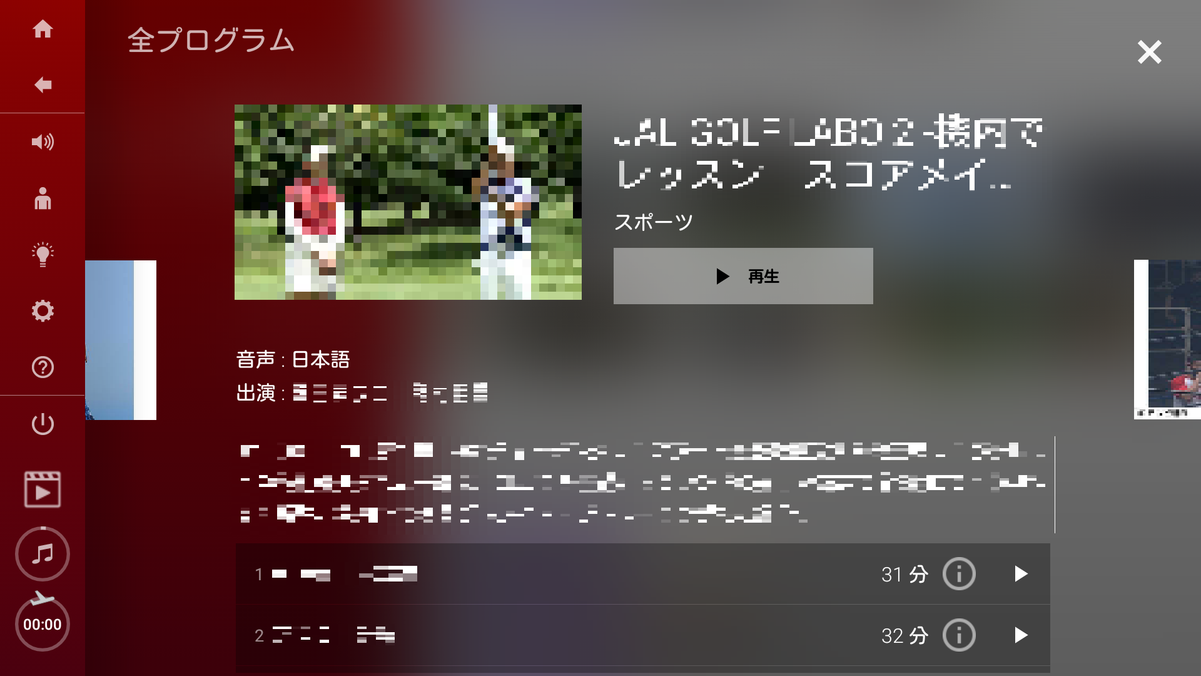
CF Before Videos (Domestic flights / Airbus A350-900・Boeing 787-8 )
CFs before video programs including abundant titles such as domestic travel programs can appeal to people traveling Japan. Total number of programs: approx. 220 programs*^{2,3}
Screening media | Individual monitors on domestic flights Applicable aircrafts: Airbus A350-900・Boeing 787-8 Applicable seats: ：All Class / All languages
Number of flights screened on | About 3,200 flights/month*¹ *CF may not be screened on some aircrafts. *CF can also be screened in the case of operating international aircrafts on domestic flight routes, and on some extra flights including charter flights.
Screening routes | Haneda = Itami, New Chitose, Fukuoka, Naha Itami=Naha
Length of commercial | 15 seconds * The screening order will be decided at our discretion.
Sales slots | 5 slots * Maximum slots one client can book is two/month.
Screening period | 1 month (from the 1st to the last day of each month) * The start and end dates of screening may change due to circumstances such as late aircraft arrivals.
Rate | 2,300,000 yen / slot /month (tax not required)
Applicable period of rate | From April 2026 to March 2027
Application deadline | Booking deadline: around 80 days prior to screening Material deadline : around 60 days prior to screening
Notes | - CF can be skipped by the viewers. - Cannot be transferred to external websites on the monitor.
Number of potential viewers per month
Approximately
922,000 passengers *¹
Number of potential views per month
Approximately
460,000 views imp *³
※Airbus A350-900
Individual monitors
The flow up to screening
Main Menu
Select a video and play
…
CF
①～⑤ slots
Seatbelt signs etc
↓
Video starts
* When playing or skipping, a window (displaying play/skip) will appear over the screen for a few seconds. CF can stop during in-flight announcement is proceeding.
*1： Monthly average from April 2025to March 2026 (JAL’s inner data)
*2： Total number of movies differs every month.
Some video programs do not allow commercial screening. The number of movies varies on the flights served by international aircraft.
*3： JAL’s inner data (Reference only; frequency not guaranteed)

Slide 11
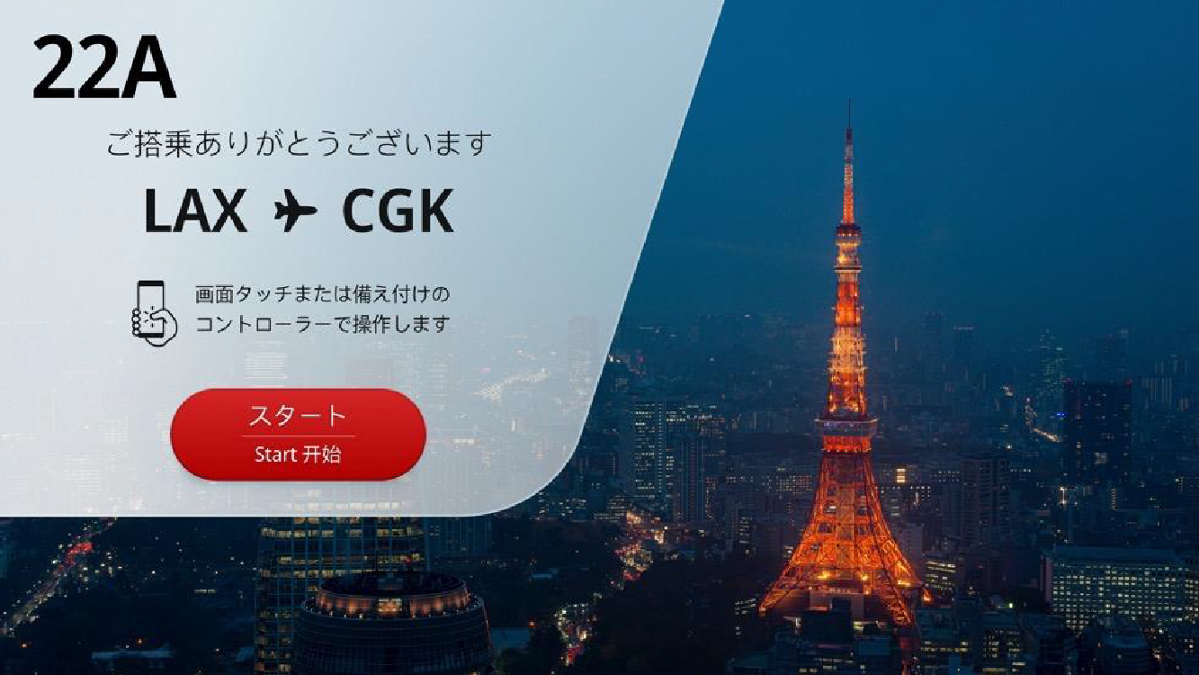
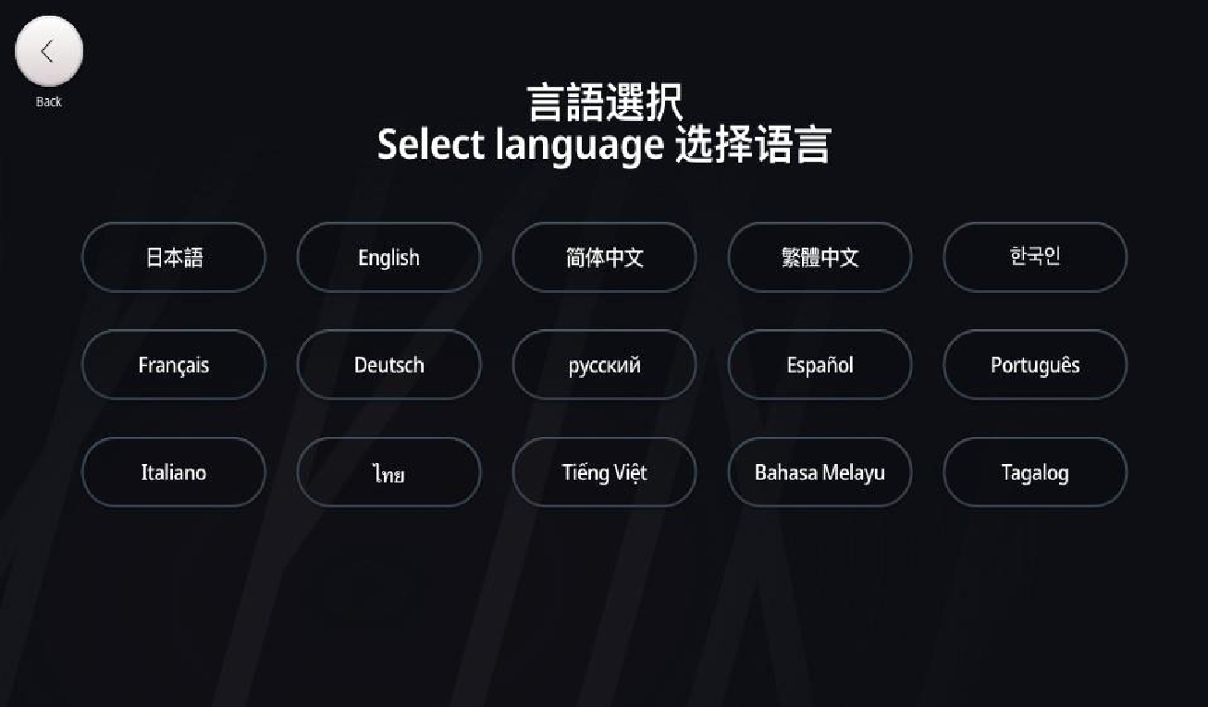
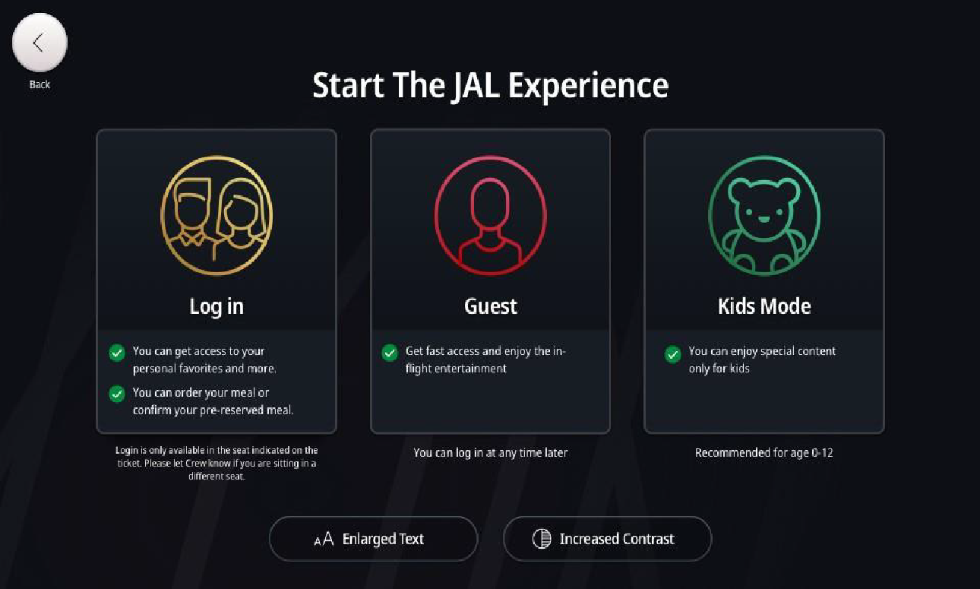
Welcome Interstitial Video Ads – First Class
(International flights / Airbus A350-1000)
Language Targeting Option is Applicable
Please refer to the "Option Guide."
Interstitial video ads after selecting languages on the individual monitors, screened by all passengers using IFE.
Screening media | Individual monitors on international flights Applicable aircrafts: Airbus A350-1000 Applicable seats: ：First Class / All languages
Number of flights screened on | About 340 flights*¹ out of about 3,800 flights*³, the total International flights / month *CF can also be screened on some extra flights including charter flights.
Screening routes | Haneda = Los Angeles, New York, Dallas, London, Paris (As of July 2025)
Length of commercial | 15 seconds
Sales slots | 2 slots *Maximum slots one client can book is two/month.
Screening period | 1 month (from the 1st to the last day of each month) * The start and end dates of screening may change due to circumstances such as late aircraft arrivals.
Rate *tax not required | 1,400,000 yen / slot / month for both 1st and 2nd slot * Screening order is on a first-come-first-served basis.
Applicable period of rate | From April 2026 to March 2027
Application deadline | Booking deadline: around 80 days prior to screening Material deadline : around 60 days prior to screening
Notes | Fully unskippable for 15sec for both 1st and 2nd slot. Cannot be transferred to external websites on the monitor.
Number of potential viewers per month
Approximately
1,800 passengers *¹
Number of potential views per month
2,500 views *²
*Below screens are image.
Indivisual monitors
Welcome Screen
Select Language
Welcome Interstitial video ads
Select the Mode
CM①～② slots
* 1：Average for March and April 2026 (JAL’s inner data)
* 2：JAL’s inner data ( Just a reference. Not guaranteed.)
* 3：JAL group’s monthly report, average from April 2025 to March 2026.
* CF can stop during in-flight announcement is proceeding.

Slide 12
Welcome Interstitial Video Ads – Business Class
(International flights / Airbus A350-1000)
Language Targeting Option is Applicable
Please refer to the "Option Guide."
Interstitial video ads after selecting languages on the individual monitors, screened by all passengers using IFE.
Screening media | Individual monitors on international flights Applicable aircrafts: Airbus A350-1000 Applicable seats: ：Business Class / All languages
Number of flights screened on | About 340 flights*¹ out of about 3,800 flights*³, the total International flights / month *CF can also be screened on some extra flights including charter flights.
Screening routes | Haneda = Los Angeles, New York, Dallas, London, Paris (As of July 2025)
Length of commercial | 15 seconds
Sales slots | 2 slots *Maximum slots one client can book is two/month.
Screening period | 1 month (from the 1st to the last day of each month) * The start and end dates of screening may change due to circumstances such as late aircraft arrivals.
Rate *tax not required | 1,000,000 yen / slot / month for both 1st and 2nd slot * Screening order is on a first-come-first-served basis.
Applicable period of rate | From April 2026 to March 2027
Application deadline | Booking deadline: around 80 days prior to screening Material deadline : around 60 days prior to screening
Notes | Fully unskippable for 15sec for both 1st and 2nd slot. Cannot be transferred to external websites on the monitor.
Number of potential viewers per month
Approximately
16,000 passengers *¹
Number of potential views per month
25,000 views *²
*Below screens are image.
Indivisual monitors
Welcome Screen
Select Language
Welcome Interstitial video ads
Select the Mode
CM①～② slots
* 1：Average for March and April 2026 (JAL’s inner data)
* 2：JAL’s inner data ( Just a reference. Not guaranteed.)
* 3： JAL group’s monthly report, average from April 2025 to March 2026.
* CF can stop during in-flight announcement is proceeding.

Slide 13
Welcome Interstitial Video Ads – Premium Economy and Economy Class
(International flights / Airbus A350-1000)
Language Targeting Option is Applicable
Please refer to the "Option Guide."
Interstitial video ads after selecting languages on the individual monitors, screened by all passengers using IFE.
Screening media | Individual monitors on international flights Applicable aircrafts: Airbus A350-1000 Applicable seats: ： Premium Economy and Economy Class / All languages
Number of flights screened on | About 340 flights*¹ out of about 3,800 flights*³, the total International flights / month *CF can also be screened on some extra flights including charter flights.
Screening routes | Haneda = Los Angeles, New York, Dallas, London, Paris (As of July 2025)
Length of commercial | 15 seconds
Sales slots | 2 slots *Maximum slots one client can book is two/month.
Screening period | 1 month (from the 1st to the last day of each month) * The start and end dates of screening may change due to circumstances such as late aircraft arrivals.
Rate *tax not required | 1,700,000 yen / slot / month for both 1st and 2nd slot * Screening order is on a first-come-first-served basis.
Applicable period of rate | From April 2026 to March 2027
Application deadline | Booking deadline: around 80 days prior to screening Material deadline : around 60 days prior to screening
Notes | Fully unskippable for 15sec for both 1st and 2nd slot. Cannot be transferred to external websites on the monitor.
Number of potential viewers per month
Approximately
54,000 passengers *¹
Number of potential views per month
62,000 views *²
*Below screens are image.
Indivisual monitors
Welcome Screen
Select Language
Welcome Interstitial video ads
Select the Mode
CM①～② slots
* 1：Average for March and April 2026 (JAL’s inner data)
* 2：JAL’s inner data ( Just a reference. Not guaranteed. )
* 3： JAL group’s monthly report, average from April 2025 to March 2026.
* CF can stop during in-flight announcement is proceeding.

Slide 14
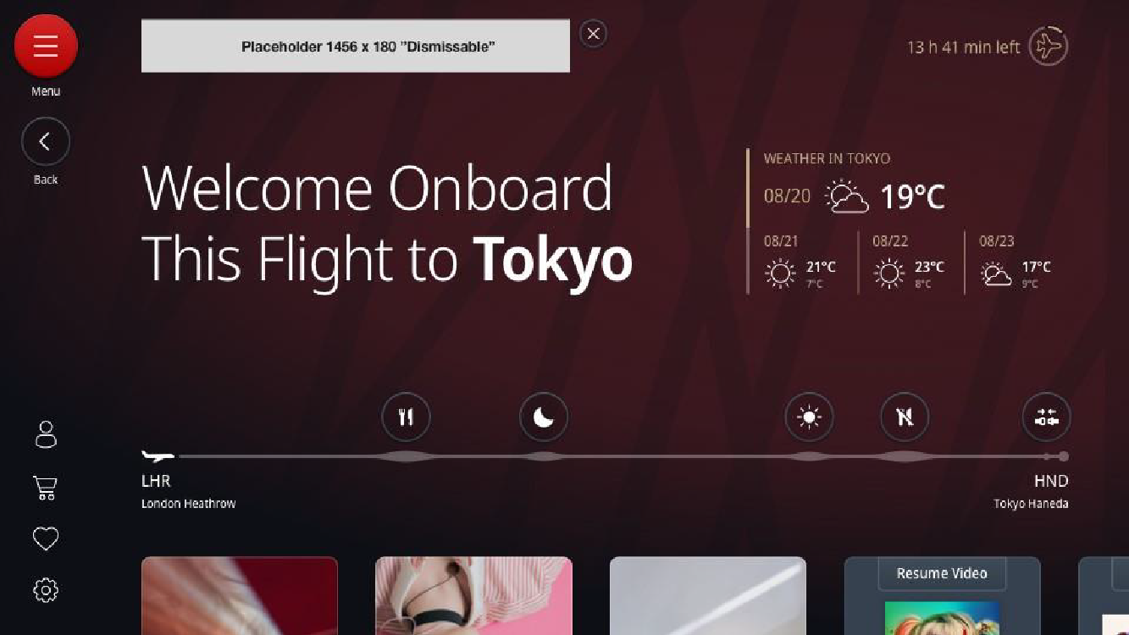
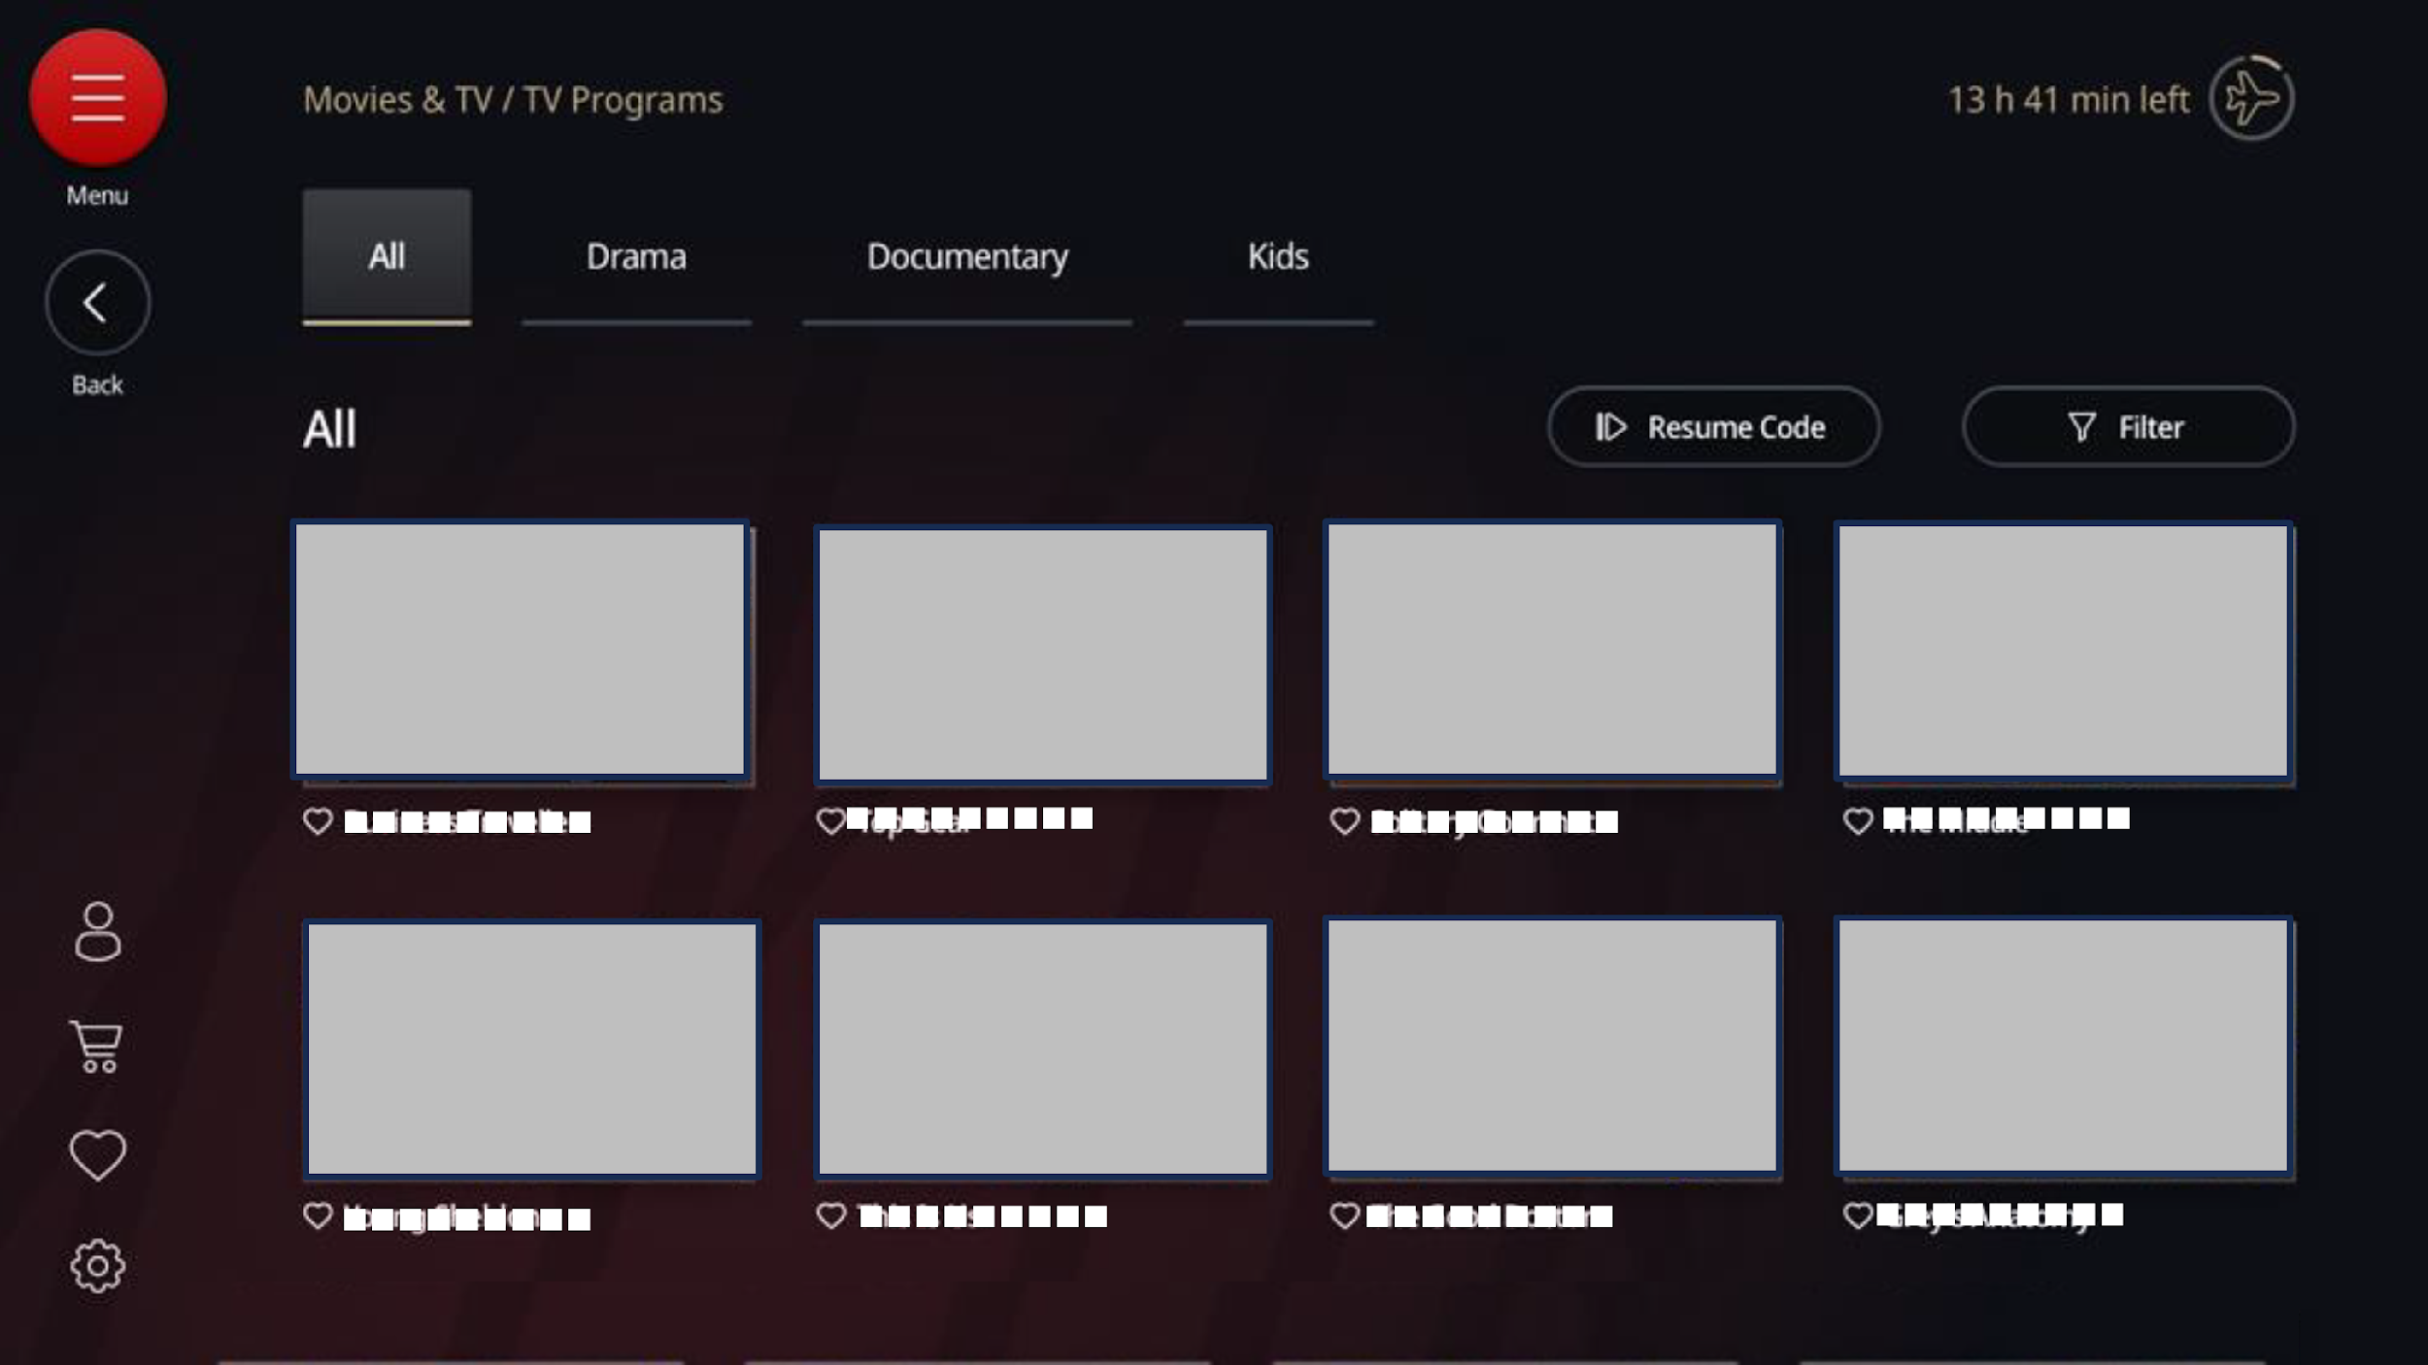


Banner Ads (International flights / Airbus A350-1000)
Language Targeting Option is Applicable
Please refer to the "Option Guide."
Banners shown on multiple spots on the individual monitor,
boosting your brand recognition, making repetitive approach
to passengers.
Screening media | Individual monitors on international flights Applicable aircrafts: Airbus A350-1000 Applicable seats: ：All Class / All languages
Number of flights screened on | About 340 flights*¹ out of about 3,800 flights*³, the total International flights / month *CF can also be screened on some extra flights including charter flights.
Screening routes | Haneda = Los Angeles, New York, Dallas, London, Paris (As of July 2025)
Banner spots ・ Specification | Banners are shown on the upper left of the main menu, and also shown at regular intervals on the selection screen of each Movies, TV program, and audio program. Banner visual is only 1. Same banner will be shown on all spots. Please select which to show after banners tapped, 15sec to 2 min or one still-picture. * The number of spots can change depends on month.
Screening period | 1 month (from the 1st to the last day of each month) * The start and end dates of screening may change due to circumstances such as late aircraft arrivals.
Rate | 700,000 yen / month *One client only.
Applicable period of rate | From April 2026 to March 2027
Application deadline | Booking deadline: around 80 days prior to screening Material deadline : around 60 days prior to screening
Notes | The word“AD” will be shown below each banners (as indicated left). Close button will be shown from the start of showing as for the CF or the still-picture shown after banners tapped . Cannot be transferred to external websites on the monitor.
Number of potential viewers per month
Approximately
68,000 passengers *¹
Number of potential views per month
105,000 views *²
*Below screens are image.
Indivisual monitors
Examples of Banner spots
AD
AD
Tap Ads
Tap ads
15sec to 2 min
CF
One still-picture
or
* 1：Average for March and April 2026 (JAL’s inner data)
* 2：JAL’s inner data ( Just a reference. Not guaranteed. )
* 3： JAL group’s monthly report, average from April 2025 to March 2026.

Slide 15
Poster Ads (International flights / Airbus A350-1000)
Language Targeting Option is Applicable
Please refer to the "Option Guide."
Eeffective appealing ad place that makes passengers want to tap, blending in In-flight entertainment posters on personal monitors.
Screening media | Individual monitors on international flights Applicable aircrafts: Airbus A350-1000 Applicable seats: ：All Class / All languages
Number of flights screened on | About 340 flights*¹ out of about 3,800 flights*³, the total International flights / month *CF can also be screened on some extra flights including charter flights.
Screening routes | Haneda = Los Angeles, New York, Dallas, London, Paris (As of July 2025)
Banner spots ・ Specification | Banners are shown at regular intervals on the selection screen of Movies, TV programs, Audio programs. Banner visual is only 1. Please prepare three images of different sizes. Please select which to show after banners tapped, 15sec to 2 min CF or one still-picture. * The number of spots can change depends on month.
Screening period | 1 month (from the 1st to the last day of each month) * The start and end dates of screening may change due to circumstances such as late aircraft arrivals.
Rate | 500,000 yen / month *One client only.
Applicable period of rate | From April 2026 to March 2027
Application deadline | Booking deadline: around 80 days prior to screening Material deadline : around 60 days prior to screening
Notes | The word “AD” will be shown below each banners Close button will be shown from the start of showing as for the CF or the still-picture shown after banners tapped . Cannot be transferred to external websites on the monitor.
Number of potential viewers per month
Approximately
68,000 passengers *¹
Number of potential views per month
1,500,000 views *²
*Below screens are image.
Indivisual monitors
Movie Selection Screen
TV Program Selection Screen
Audio Program
Selection Screen
A poster ad will be displayed on each of the screens listed above.
Tap Ads
15sec to 2 min
CF
One still-picture
or
* 1：Average for March and April 2026 (JAL’s inner data)
* 2：JAL’s inner data ( Just a reference. Not guaranteed. )
* 3：JAL group’s monthly report, average from April 2025 to March 2026.
* The above is a reference image. The actual monitor size is different.

Slide 16
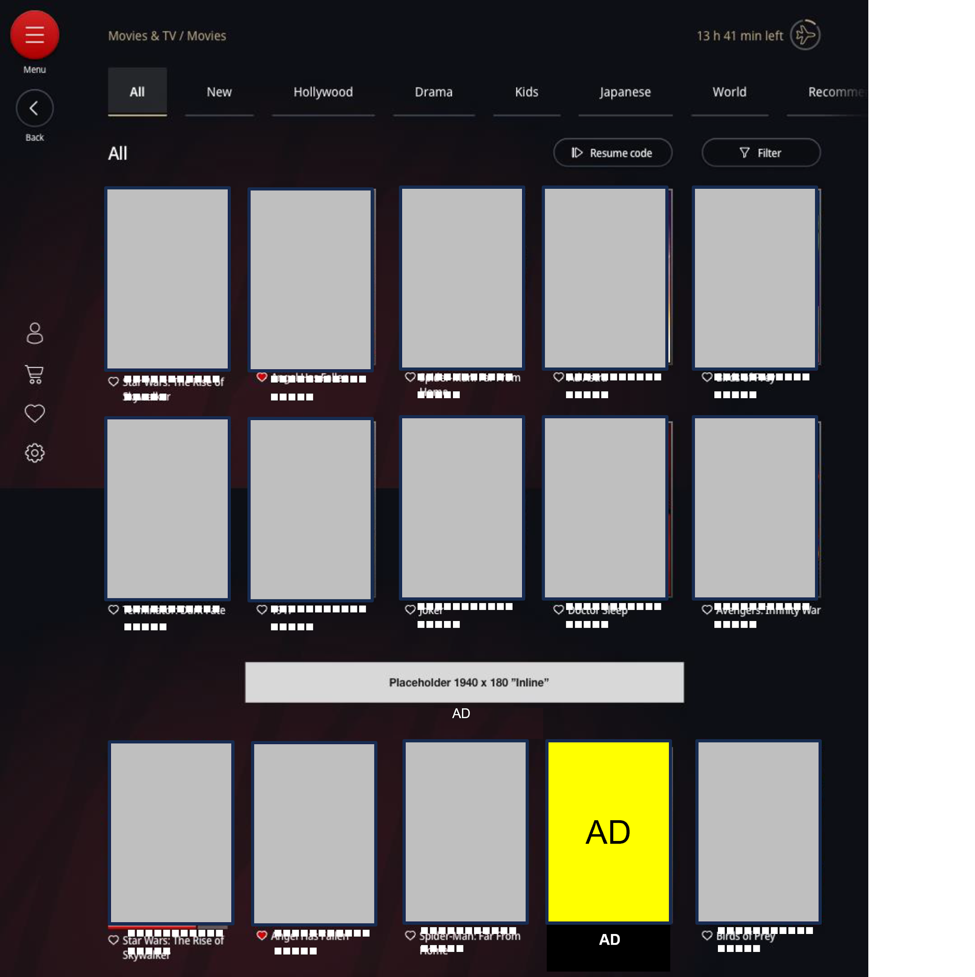
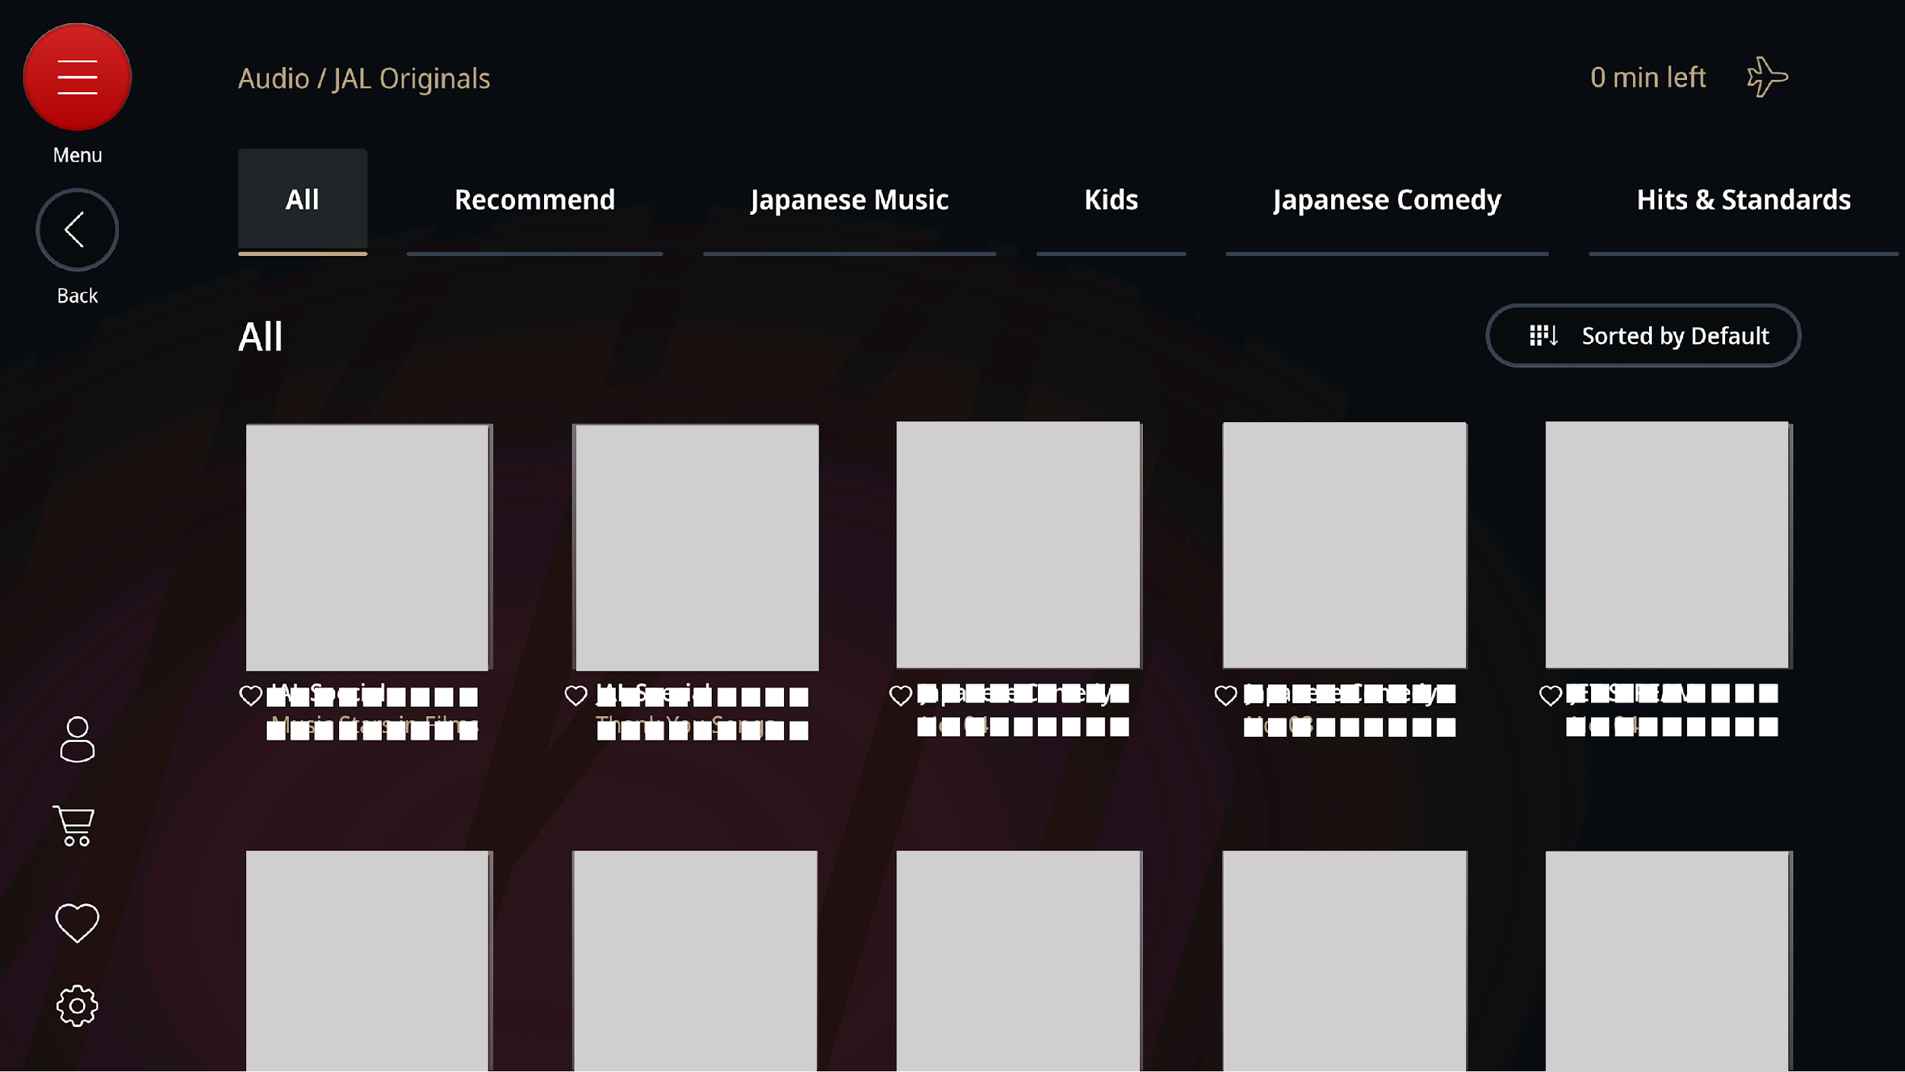
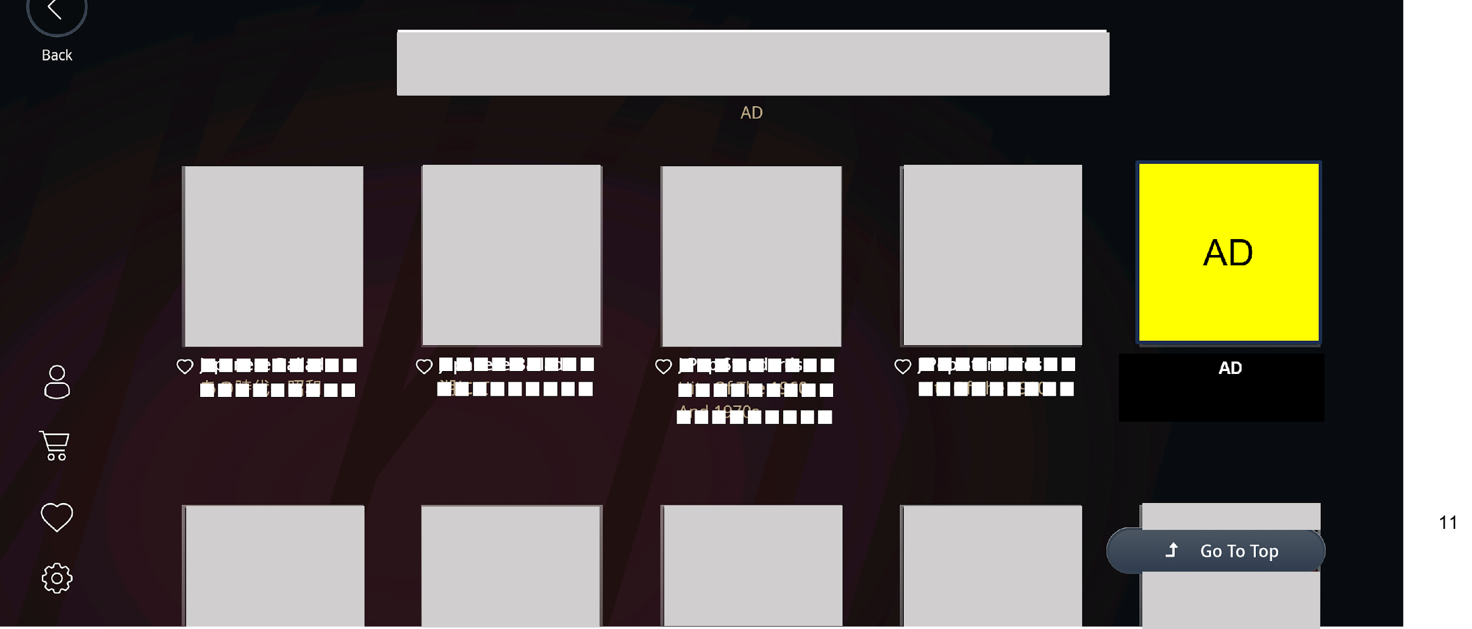
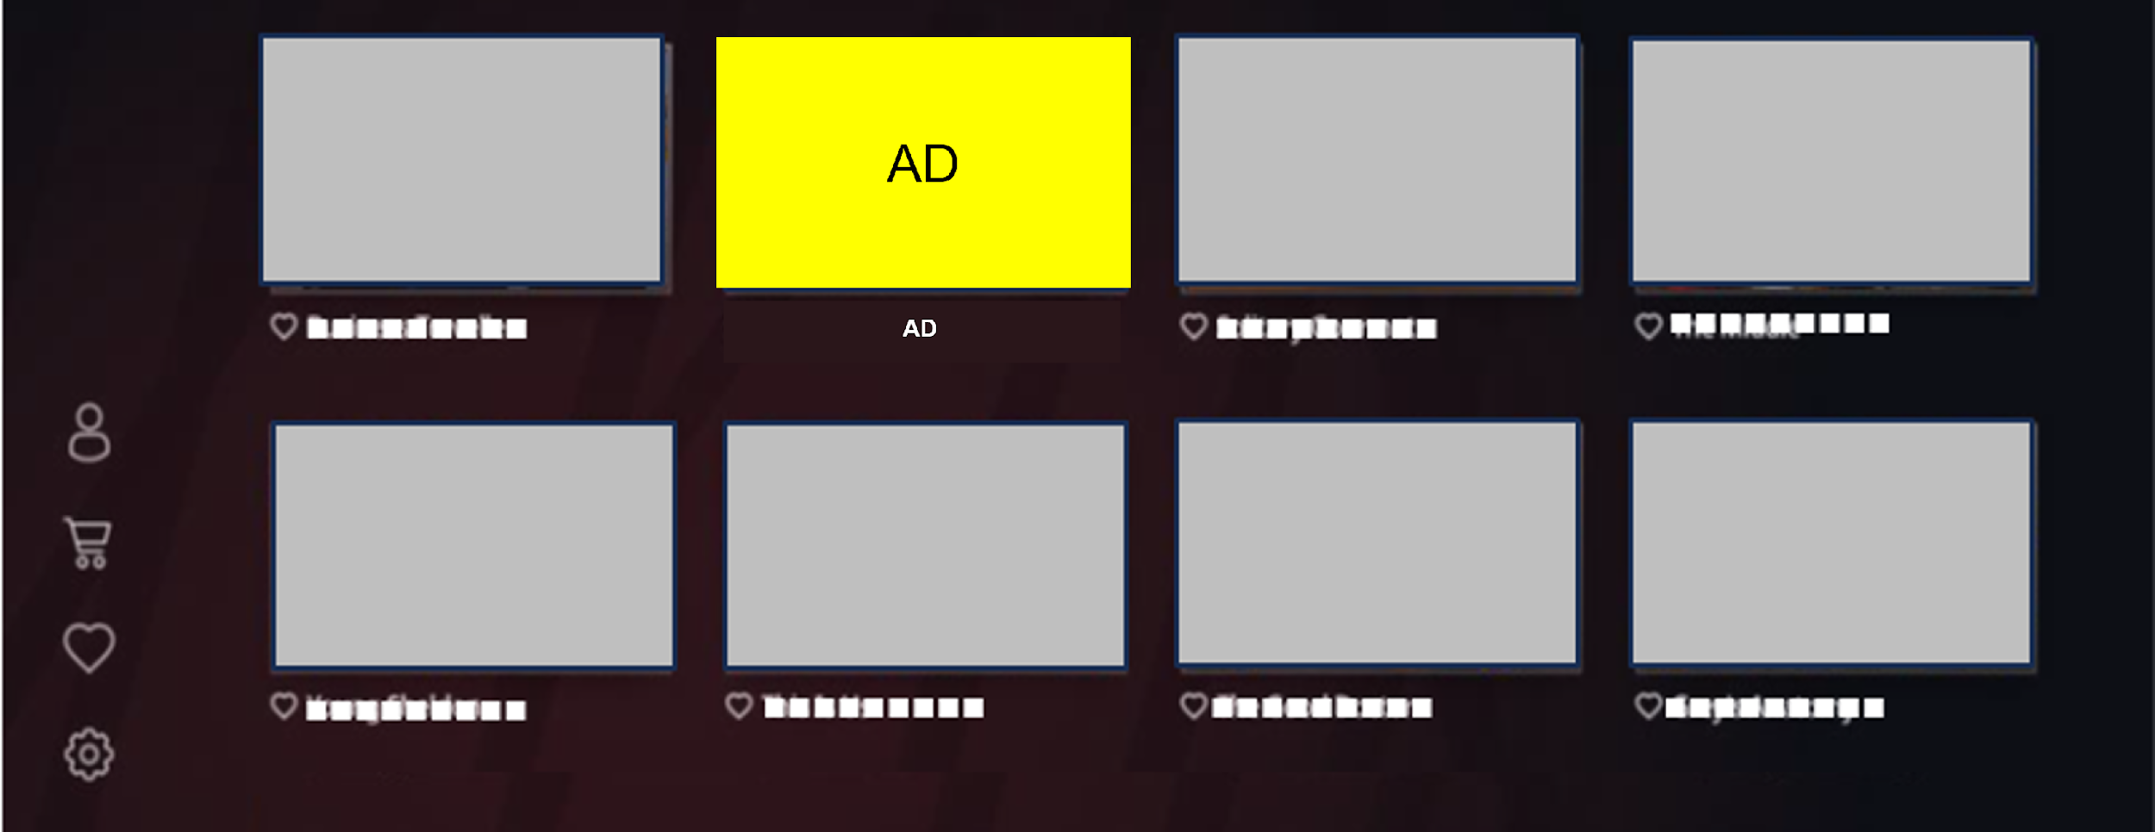
Poster Ads (International flights / Airbus A350-1000)
● Advertisement display reference
*The following is a reference image. The actual monitor size is different.
Movie Selection Screen
TV Program Selection Screen
Audio Program
Selection Screen
…
…
…
…
…
*One poster ad will be displayed approximately once for every 10-14 posters of the films.
*One poster ad will be displayed approximately once for every 8-11 posters of the programs.
*One poster ad will be displayed approximately once for every 10-14 posters of the programs.

Slide 17
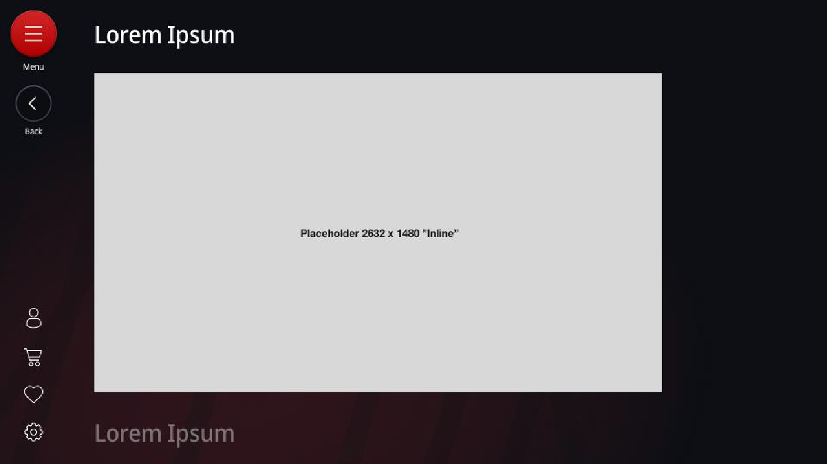
Wide Screen Ads (International flights / Airbus A350-1000)
Language Targeting Option is Applicable
Please refer to the "Option Guide."
Making big impact by the large banners.
Screening media | Individual monitors on international flights Applicable aircrafts: Airbus A350-1000 Applicable seats: ：All Class / All languages
Number of flights screened on | About 340 flights*¹ out of about 3,800 flights*³, the total International flights / month*1 *CF can also be screened on some extra flights including charter flights.
Screening routes | Haneda = Los Angeles, New York, Dallas, London, Paris (As of July 2025)
Banner spots ・ Specification | Banners are shown on the bottoms of Main Menu, and each category page of “Movies & TV programs”, “Audio”, “ebooks & News”. Total 4 spots. Banner visual is only 1. Same banner will be shown on all spots. Please select which to show after banners tapped, 15sec to 2 min or one still-picture. * The number of spots can change depends on month.
Screening period | 1 month (from the 1st to the last day of each month) * The start and end dates of screening may change due to circumstances such as late aircraft arrivals.
Rate | 500,000 yen / month *One client only.
Applicable period of rate | From April 2026 to March 2027
Application deadline | Booking deadline: around 80 days prior to screening Material deadline : around 60 days prior to screening
Notes | The word “AD” will be shown above each banners Close button will be shown from the start of showing as for the CF or the still-picture shown after banners tapped . Cannot be transferred to external websites on the monitor.
Number of potential viewers per month
Approximately
68,000 passengers *¹
Number of potential views per month
50,000 views *²
Main Menu
Category page of Movies & TV programs
Category page of Audio
Category page of ebooks & News
Below Wide screen banner will be displayed after scrolling .
AD
Tap Ads
15sec to 2 min
CF
or
One still-picture
* 1：Average for March and April 2026 (JAL’s inner data)
* 2： JAL’s inner data ( Just a reference. Not guaranteed. )
* 3： JAL group’s monthly report, average from April 2025 to March 2026.

Slide 18
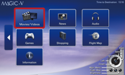
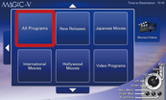
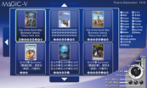
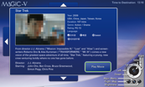
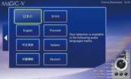
CF Before Movies (International flights)
Outstanding Target Reach. Get your message across before movies most customers will watch.
Total number of programs: approx. 130 programs*^{2,3}
Screening media | Individual monitors on international flights Applicable seats: ：All Class / All languages
Number of flights screened on | About 3,800 flights*¹ /month * Separately to the above, CF can be shown on some extra flights including charter flights.
Screening routes | International routes operated by JAL
Length of commercial | 15 seconds * The screening order and group will be decided at our discretion.
Sales slots | 12 slots : A group 15 sec x 6 slots, B group 15 sec x 6 slots A and B is played randomly on A350-1000. On other aircrafts, A and B will be each fixed for about half of all films. *Maximum slots one client can book is two/month.
Screening period | 1 month (from the 1st to the last day of each month) * The start and end dates of screening may change due to circumstances such as late aircraft arrivals.
Rate | 2,800,000 yen / slot /month (tax not required)
Applicable period of rate | From April 2026 to March 2027
Application deadline | Booking deadline: around 80 days prior to screening Material deadline : around 60 days prior to screening
Notes | - CF can be fast-forwarded by the viewers. - Cannot be transferred to external websites on the monitor.
Number of potential viewers per month
Approximately
667,000 passengers on international flights*¹
* The photo for illustrative purposes only
Individual monitors
The flow up to screening
Od
Even
Odd
Select "Movies/Videos"
Select
a category
Even
Odd
Even
Select
a movie title*
Select
"Play Movie"
Select
a language
* The screen image may be different depending on the aircraft.
* CFs will be shown in two groups, A and B, The group will be decided by our discretion.
* The movie program for each month can be found on the JAL website under International Flights > In-flight & Lounge > In-flight Entertainment (Program Information).
CF
A
①～⑥ slots
B
① ～⑥ slots
*1： JAL group’s monthly report, average from April 2025 to March 2026 (JAL’s inner data)
*2：Total number of videos differs every month.
*3：JAL’s inner data ( Just a reference. Not guaranteed. )
* When playing or skipping, a window (displaying play/skip) will appear over the screen for a few seconds. CF can stop during in-flight announcement is proceeding.

Slide 19
CF Before Videos (International flights)
Commercials appearing before video programs that include an abundance of titles such as domestic travel programs can appeal to people visiting Japan.
Total number of programs: approx. 220 programs*^{2,3}
Screening media | Individual monitors on international flights Applicable seats: ：All Class / All languages
Number of flights screened on | About 3,800 flights*¹ /month * Separately to the above, CF can be shown on some extra flights including charter flights.
Screening routes | International routes operated by JAL
Length of commercial | 15 seconds * The screening order will be decided at our discretion.
Sales slots | 5 slots * Maximum slots one client can book is two/month.
Screening period | 1 month (from the 1st to the last day of each month) * The start and end dates of screening may change due to circumstances such as late aircraft arrivals.
Rate | 1,800,000 yen / slot / month (tax not required)
Applicable period of rate | From April 2026 to March 2027
Application deadline | Booking deadline: around 80 days prior to screening Material deadline : around 60 days prior to screening
Notes | - CF can be fast-forwarded by the viewers. - Cannot be transferred to external websites on the monitor.
Number of potential viewers per month
Approximately
667,000 passengers on international flights*¹
* The photo for illustrative purposes only
Individual monitors
The flow up to screening
Select "Movies/Videos"
Select
a category
Select
a video title
Select
“Play”
Select
a language
CF ①～⑤ slots
* The screen image may be different depending on the aircraft
* The movie program for each month can be found on the JAL website under International Flights > Inf-light/Lounge > In-flight Entertainment (Program Information).
*1： JAL group’s monthly report, average from April 2025 to March 2026 (JAL’s inner data)
*2：Total number of videos differs every month.Some video programs do not allow commercial screening.
*3：JAL’s inner data ( Just a reference. Not guaranteed. )
* When playing or skipping, a window (displaying play/skip) will appear over the screen for a few seconds. CF can stop during in-flight announcement is proceeding.
.

Slide 20
Language Targeting Option Guide ※ Some menu items only
Paid Option
It is possible to differentiate the advertising material displayed
according to the language selected on the language selection screen of the individual monitor.
Language Selection Screen
Domestic Flights / A350-900, B787-8
Select Language
Display two different types of advertising materials depending on the selected language
Japanese
Advertising material (1)
Advertising materials for passengers who selected Japanese
International Flights / A350-1000
All languages other than Japanese
Advertising material (2)
Advertising materials for passengers who select all languages other than Japanese
※The maximum number of advertising materials we can display is two as above.
●Important Notice
If you submit advertising materials created in languages other than Japanese or English, you must also submit a Japanese translation for material censorship. Please refer to the next page for the applicable menus and optional fees.

Slide 21
Language Targeting Option Guide ※ Limited to certain menus
Paid Option
● List of applicable menus and optional fees
※ We charge 20% of each space fee (list rate) as below.
Applicable Menus | Space fee/slot/month tax not required)( | Optional fee/slot/month (tax not required
)Domestic Welcome Interstitial Video Ads – First Class and Class J 1st slot | 2,800,000 yen | 560,000 yen
Domestic Welcome Interstitial Video Ads – First Class and Class J 2nd slot | 2,350,000 yen | 470,000 yen
Domestic Welcome Interstitial Video Ads – Economy Class 1st slot | 3,000,000 yen | 600,000 yen
Domestic Welcome Interstitial Video Ads – Economy Class 2nd slot | 2,500,000 yen | 500,000 yen
Domestic Individual Monitor Banner Ads | 700,000 yen | 140,000 yen
International Welcome Interstitial Video Ads – First Class | 1,400,000 yen | 280,000 yen
International Welcome Interstitial Video Ads – Business Class | 1,000,000 yen | 200,000 yen
International Welcome Interstitial Video Ads – Premium Economy and Economy Class | 1,700,000 yen | 340,000 yen
International Individual Monitor Banner Ads | 700,000 yen | 140,000 yen
International Poster Ads | 500,000 yen | 100,000 yen
International Wide Screen Ads | 500,000 yen | 100,000 yen

Slide 22
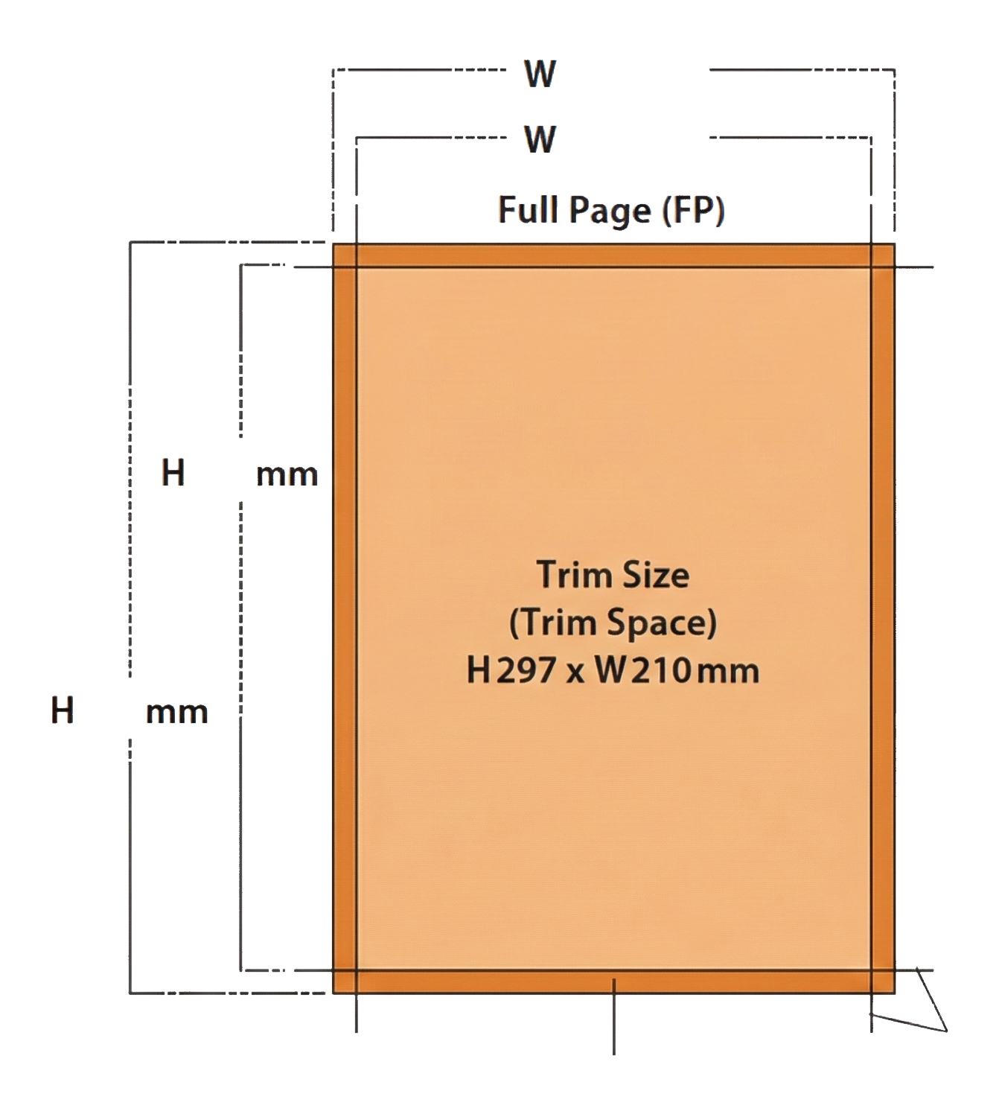
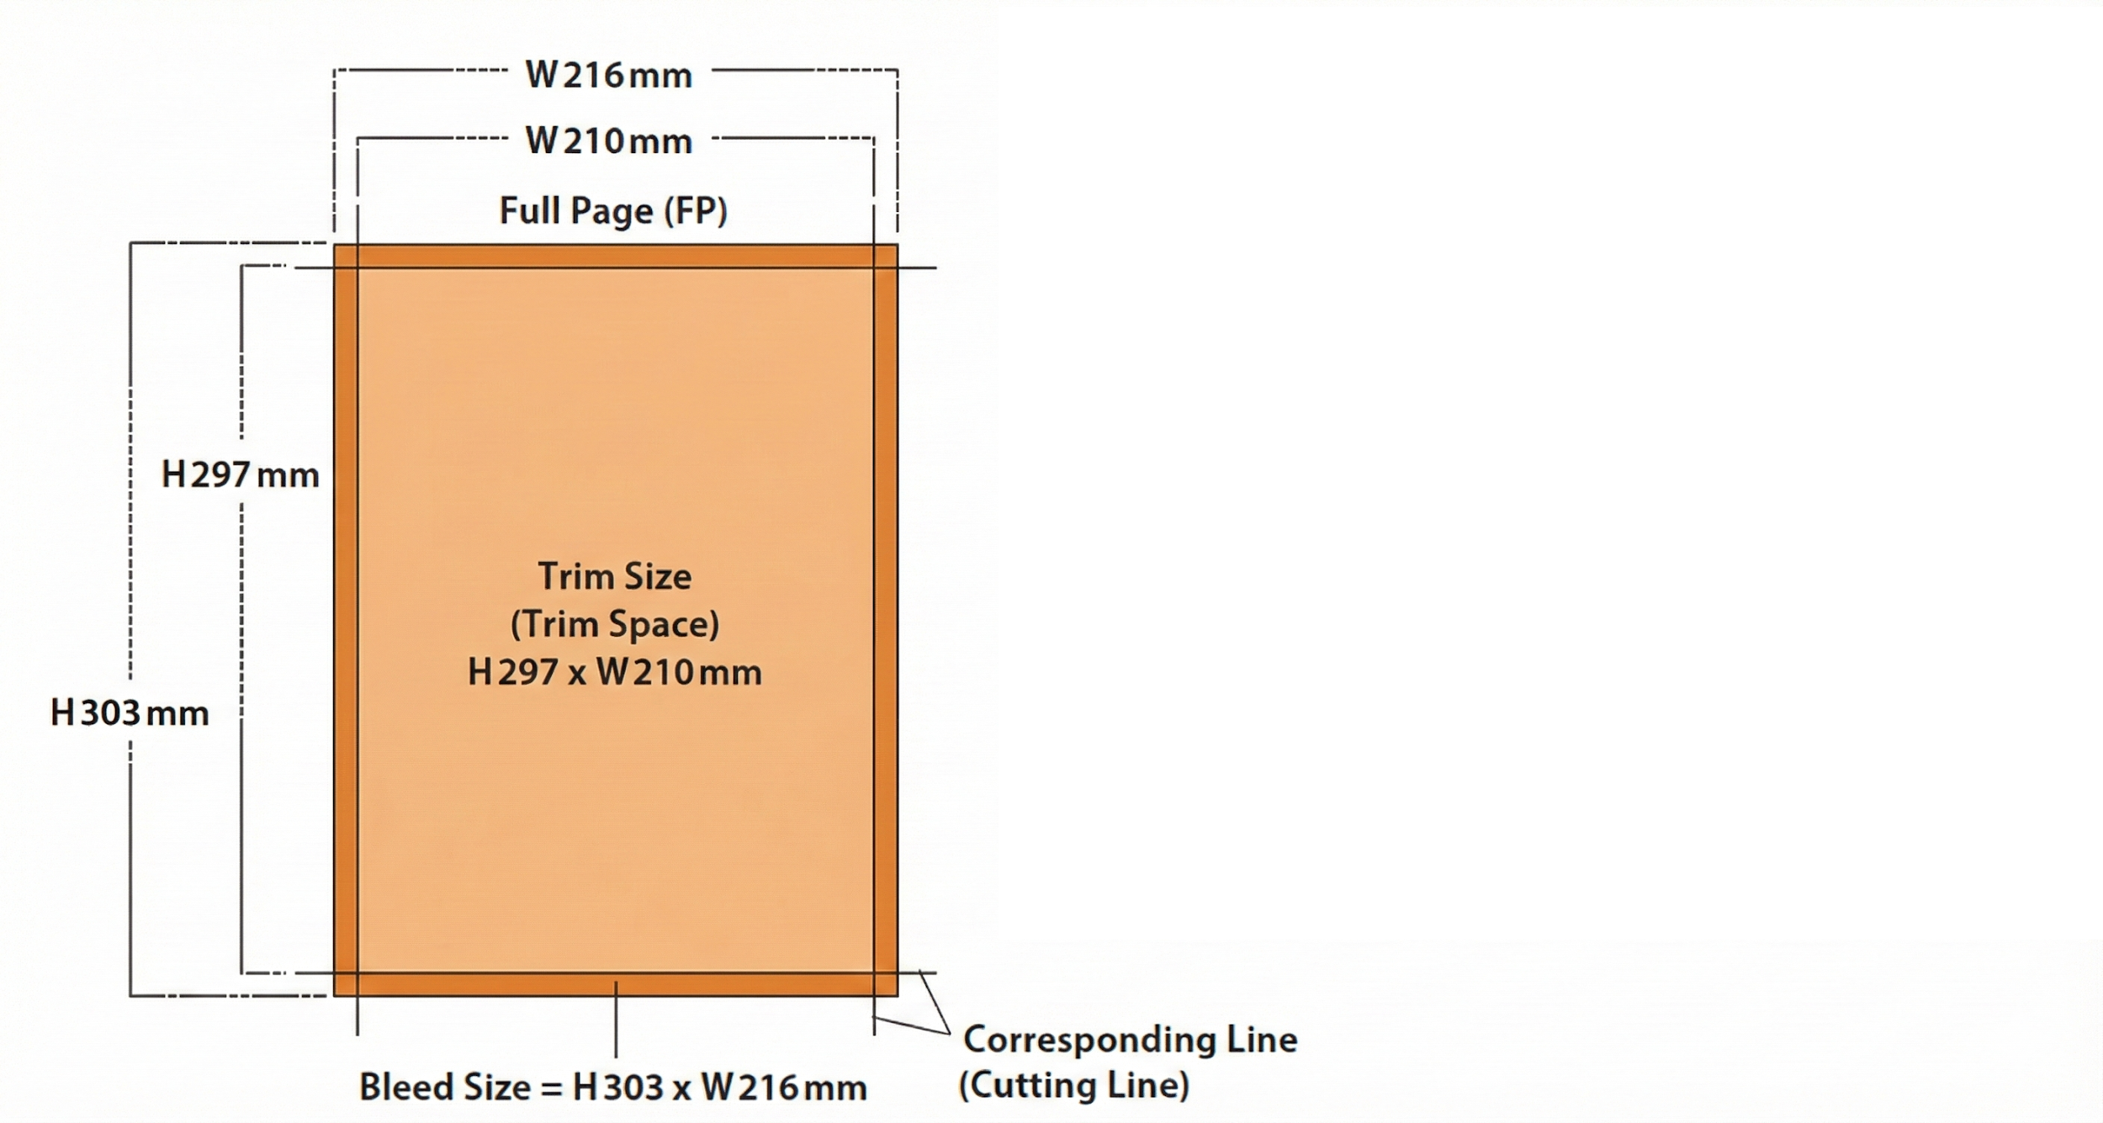
MATERIAL FORMAT for MAGAZINES
Material Format
Please refer to the material specifications below when submitting ad data for SKYWARD:
Full Page (FP) and Double Page Spread (DPS).
216mm
FP: Standard A4 297mm (H) x 210mm (W)
DPS: Standard A3 297mm (H) x 420mm (W)
Publishing Date: First (1st) day of each issued month
Printing: 4-Color Offset, CMYK
FP: Must add at least 3mm of **bleed outside the Trim Space**.
DPS: Must add 3mm + 3mm of gutter, if the design will appear in the center.
210mm
Material Specifications
All materials should be Print-Optimized with font-embedded PDF files.
Resolution should be within the range of 330–350 dpi.
All graphics and images in the document must be saved in 4-color, CMYK mode.
Total area coverage must be under 320%.
All fonts must be outlined when saving the file.
All materials should be on Mac format and delivered via email.
For page bleed advertisement, bleed size is located 3 mm outside the trim area.
Trim marks must appear on all files.
Type area should be 10mm inside the trim size.
The magazine size after trimming is 297mm(H) x 210mm(W).
All ads supplied must be accompanied by a standard color proof which is generated from the same PDF file.
If the color proof is not generated from the PDF file and colors cannot be matched on press,
the Publisher will not take any responsibility for the incorrect reproduction of the advertisement insert.
297
303

Slide 23
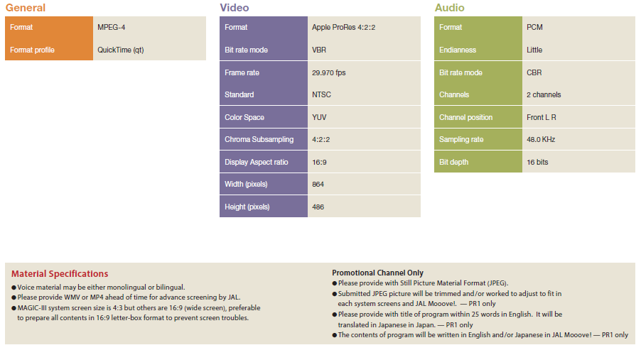
MATERIAL FORMAT for CF or Promotion Channels
Material Format

Slide 24
Guidelines for advertisement submission (1)
Overview of common standards for advertisement media submission
Notes regarding advertisement expression
Common to All Print Media
Guidelines for advertisement submission
Please be advised of the following items when making submissions to this media program, due to the nature of the JAL in-flight environment.
Please note the following standards regarding advertising expression. Expressions or content that do not meet these standards will not be published.
Your understanding is appreciated.
Ad Space Reservation Policy
Except for premium positions (such as the cover) and facing-editorial requests, specific page placement cannot be designated.
Unless a facing-editorial position is reserved, your advertisement may be placed facing another advertisement. Thank you for your understanding.
For all media submissions, we carry out screenings of the company, products, and expression (ad content).
Advertisements that compete with the sales activities of the JAL Group and its affiliates (including information on airlines outside the JAL Group) may be rejected.
Because JAL Media is part of customer service provided by an airline to its customers, we reserve the right to reject content or visuals that might cause anxiety, discomfort, or disadvantage to our customers.
There are various conditions that must be compiled with in accordance with the Airports Act and the Civil Aeronautics Act with regard to advertising media and services provided in restricted areas of airports and on board aircraft.
Please inquire separately regarding restrictions on the types of businesses and products that may be advertised.
In addition, please consult with us regarding the content of your advertisement at the production stage.
Please note that media services may become unavailable due to unavoidable circumstances such as inclement weather and force majeure, .
Please note that the start and end dates of publication and screening may be moved forward or backward due to various circumstances such as aircraft availability. Routes and cabin classes can not be specified for ad placements, except for the domestic flight new aircraft menu and part of the ZIPAIR menu.
For advertisement submissions for all media, there is no limit of one company per industry.
No refunds or rate reductions will be given in the event of flight cancellations or reductions due to force majeure and other unavoidable circumstance.
As a general rule, cancellations will not be accepted after an application has been submitted.
In the event of cancellation, a cancellation fee will be charged.
The first transaction for each customer must be paid in advance.
These media are offered on a term contract. No additional charges, refunds, or rate reductions will be made due to an increase or decrease in the number of flights operating.
Advertisements for which responsibility is unclear
Advertisements with unclear content or purpose
Advertisements that violate or may violate the relevant laws or regulations such as the Act against Unjustifiable Premiums and Misleading Presentations (e.g., "superlative" expressions), the Pharmaceutical Affairs Act (formerly the Pharmaceuticals Act), food labeling, and other related laws and industry guidelines.
False, exaggerated, or inaccurate information that may mislead the public
Inappropriate expression involving comparisons with other companies to emphasize one's own superiority
Content that may discriminate or alienate people based on nationality, race, ethnicity, social status, position, region, occupation, gender, illness, disability, etc., infringe on privacy, or constitute sexual harassment or other violation of human rights
Content that may be defamatory, libelous, or slanderous toward another company
Content that may damage the credibility of a business or obstruct business operations of another company
Content that is antisocial, immoral, or otherwise disruptive
Content that is violent or grotesque and offends public order and morals
Content that is fraudulent or involves bad business practices
Content that is misleading to readers because it is unscientific or superstitious
Content that causes readers (viewers), including those on board an airplane, feel uneasy
Unauthorized use of another party's name, photograph, discourse, trademark, symbol, copyright, patent, etc.
Content with considerable risk of encouraging speculation, gambling, etc.
Content that may hinder the sound development of youth
Content that is involved in judicial trials or disputes, or has the potential to become the subject of future legal disputes
Content with the purpose of political publicity or religious proselytizing
Content intended to promote mail-order sales
Content that is likely to damage the JAL Group brand or lower the quality of the magazine
Expressions that, contrary to the facts, appear to imply that the JAL Group recommends or guarantees the advertiser or their product or service
Advertisements that might disadvantage the JAL Group as a result of their publication
Other advertisements that the JAL Group deems inappropriate
Notes on advertisement productions
Total Area Coverage (TAC): For 4-color elements (including images), please ensure that the total ink limit is 320% or less.
Spot colors cannot be used. (Please convert all colors to CMYK.)
The final trim sizes are as follows: SKYWARD(Standard Page: H297mm x W210mm, Double Page Spread: H297mm x W420mm, Outside Back Cover: H297mm x W200mm).
Please keep essential elements (logos, copy, etc.) at least 10mm inside the trim edge. Please add at least 3mm of bleed on all four sides.
Due to perfect binding, the gutter (center spine) may not open flat. Please avoid placing text, products, or faces across the center gutter area.
As a general rule, we do not provide color proofs.
Submissions from overseas are accepted on the condition that the final print result (color accuracy) is left to the publisher's discretion.
Submission Format
Standard format is J-PDF only (must be JMPA Color 2018 compliant).
J-PDF: PDF data compliant with JMPA Color standards, created using Illustrator CS6 or later, InDesign CS6 or later, or Acrobat Professional XI or later.
Required Items for Submission
(1) Digital Ad Data (PDF)
* Please submit via online file transfer / digital transmission.
(2) PDF Specification Sheet (Verification Sheet)
(3) Preflight Report

Slide 25
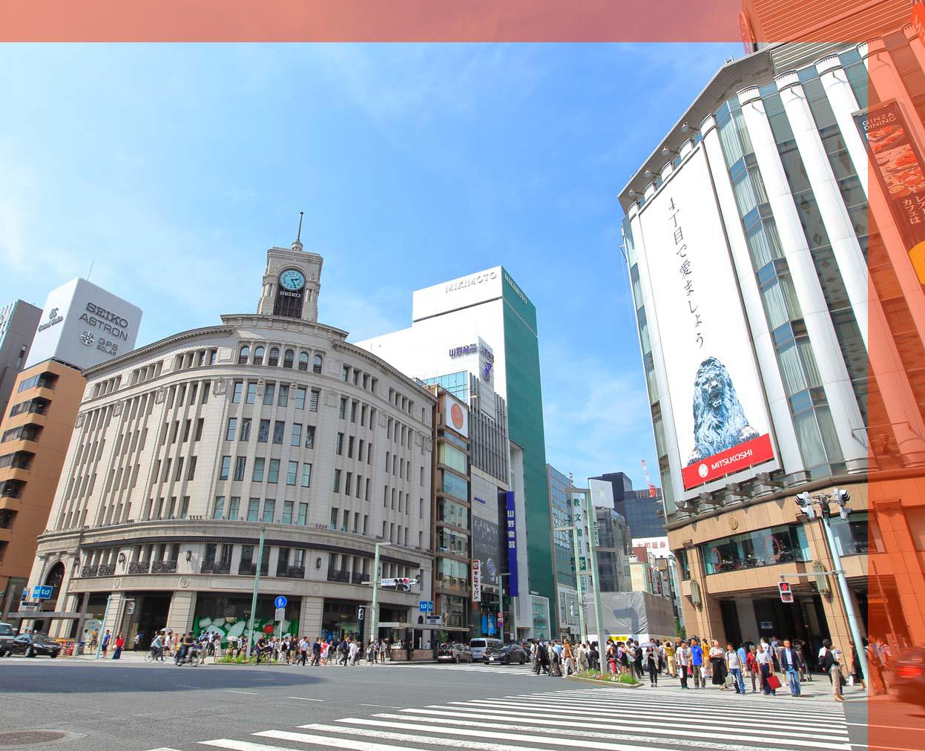
Guidelines for advertisement submission (2)
Common to all video media
Domestic Welcome Screen Ads
Guidelines for advertisement submission
Points to keep in mind when reserving an ad spot
Submission Format
Submission Format
You cannot request a screening order of commercials.
Commercials are screened only on Japan Airlines flights (flights marked JL on the timetable). Nonscheduled flights are not included.
Screening periods are set as the first to last day of each month, but are subject to change for various reasons.
Your understanding is appreciated.
(1) Domestic flight commercials
- Data file for delivery
- WMV or MP4 file for inspection
(2) Movie/video pre-roll commercials
- Data file for delivery
- WMV or MP4 file for inspection
(3) Promotional (PR) programs
- Data file for delivery
- WMV or MP4 file for inspection
(4) Video programs
- Data file for delivery or 1 HD camera
- WMV or MP4 file for inspection
Ad image size, format
・Size:1247 × 1012 pixels
・Horizontal resolution: 350 dpi
・Vertical resolution: 350 dpi
・Bit depth: 24-bit color
・minimum 4MB
・Format: JPEG
Notes on advertisement productions
Notes on advertisement productions
The ratio of the front screens will be 4:3 with the exception of some aircraft. 16:9 images will have black margins at the top and bottom
Individual monitors will be 4:3 with the exception of some aircraft. 4:3 images will have black margins at the top and bottom.
Audio can be mono or stereo, but must be a single-audio track.
Please submit a job sheet that includes the title, language, length, time code, size, etc. along with the material.
(unnecessary when delivering by tape)
Please contact us as there are format specifications for data and tapes to be delivered.
If a commercial is not shown due to a situation such as a malfunction of the in-flight entertainment system, no refund, rate reduction, or compensation will be provided. Your understanding is appreciated.
When inserting a 2D code into the post-tap creative, ensure the code area itself is at least 150x150 pixels and keep the code as simple as possible. Please note that passengers can only access external sites after connecting their devices to the onboard Wi-Fi. Additionally, please be aware that 2D codes may not be scannable on certain older aircraft (such as MAGIC IV) due to screen resolution limitations.
The actual display area is about 1170 x 955.
As shown in the figure below, the red area will be
automatically trimmed when installed in the aircraft. Therefore, please place important information and design within the 1170 x 955 area.
When inserting a 2D code into the post-tap creative, ensure the code area itself is at least 150x150 pixels and keep the code as simple as possible. Please note that passengers can only access external sites after connecting their devices to the onboard Wi-Fi.
1247
955
1012
1170

Slide 26
Guidelines for advertisement submission (3)
Domestic Flights / Banner Ads, Pop-up banner Ads
Guidelines for advertisement submission
Submission Format
Notes on advertisement productions
Please submit materials for BOTH before tapping banners and after tapping banners.
White or gray background color is not recommended for banner because it won’t stand out on the monitor.
Over 30 pixel is recommended for the size of letters on banner.
Some phrase suggesting to tap banner is recommended to insert on banner.
When inserting a 2D code into the post-tap creative, ensure the code area itself is at least 150x150 pixels and keep the code as simple as possible. Please note that passengers can only access external sites after connecting their devices to the onboard Wi-Fi.
Before tapping | Menu | Banner size（pixel） *JPEG format
 | Banner Ads (Domestic flights) Pop-up Banner Ads (Domestic flights) | 970 × 90
After tapping | In case of one still-picture, | 1920 × 1080
 | In case of 15sec to 3 min CF, | We will provide you with a “File spec” sheet separately. Please refer to it.
International Flights / Banner Ads , Poster Ads , Wide Screen Ads
Submission Format
Notes on advertisement productions
Please submit materials for BOTH before tapping banners and after tapping banners.
Black background color is not recommended for banner because it won’t stand out on the monitor.
Over 30 pixel is recommended for the size of letters on banner.
Some phrase suggesting to tap banner is recommended to insert on banner.
When inserting a 2D code into the post-tap creative, ensure the code area itself is at least 150x150 pixels and keep the code as simple as possible. Please note that passengers can only access external sites after connecting their devices to the onboard Wi-Fi.
Before tapping | Menu | Banner size（pixel） *JPEG format
 | Banner Ads (International Flights) *Please submit in two sizes. | 1456 × 180
 |  | 1940 × 180
 | Poster Ads (International Flights) *Please submit in three sizes. | Movie Selection Screen：504 × 756
 |  | TV Program Selection Screen：692 × 388
 |  | Audio Program Selection Screen：504 × 504
 | Wide Screen Ads(International Flights) | 2632 × 1480
After tapping | In case of one still-picture, | 3840 × 2160
 | In case of 15sec to 3 min CF, | We will provide you with a “File spec” sheet separately. Please refer to it.
If you have any other questions, please feel free to contact us.

Slide 27


JAL Brand Communications Co., Ltd.
2-4-11 Higashi Shinagawa, Shinagawa-ku,
Tokyo 140-8637
Nomura Tennozu Building
Email: jbc_ad@jal.com
CONTACT
We have a designated agent system for overseas clients.
For inquiries from overseas, please contact one of the designated agents below.
Inquiries Applications | •Americas [CA] Brightbox Global Media Inc. / TEL: 929 277 1986/ https://www.brightboxglobal.media/ [HNL] PacRim Marketing Group Inc. / TEL: 1 808 949 4592 / www.pacrimmarketing.com [HNL] Lighthouse Hawaii / TEL: 1 808 926 0022 / lighthouse-hawaii.com •Europe [LON] IMM International, UK Brand / TEL: 44 203 585 1300 / www.imm-international.com [PAR] Inflight Media Marketing France / TEL: 33 1 4013 7901 / www.imm-international.com [GVA] Inflight Media Marketing, AG / TEL: 41 22 310 80 51 / www.imm-international.com [ITA] Inflight Media Marketing International SARL / TEL: 39 02 46712521 / www.imm-international.com [ESP] IMM Spain / TEL:34 91 57 67 895 / www.imm-international.com | •Asia (excluding Japan) [SEL] First Media Service Corp. / TEL: 82 2 363 3591 [TPE] TOP TAIWAN MEDIA FACTORY / TEL: 886 2 2368 9128 / https://toptaiwanmedia.web.fc2.com [SHA] Jalux Shanghai Co., Ltd. / TEL: 86 21 34060663 / www.sh.jalux.com [HKG] IMM Asia HK Ltd. / TEL: 852 60 98 8454/ www.imm-international.com [MFM] Age of Discovery News & Publishing Company Limited /TEL:853 6273 0555/ www.macaushimbun.com/aboutus [BKK] JPP Thailand Ltd. / TEL: 66 02 051 4694 [SIN] NewBase Content Pte. Ltd. / www.newbase360.com [SIN] Spafax Airline Network Pte. Ltd. / TEL: 65 6531 2682 / www.spafax.com [IDN] Jet Set Media / TEL: 65 8189 4783 [BOM] Mediascope Representation India LLP / TEL: 91 22 68468500 / https://mediascope.co.in/

