Slide 1

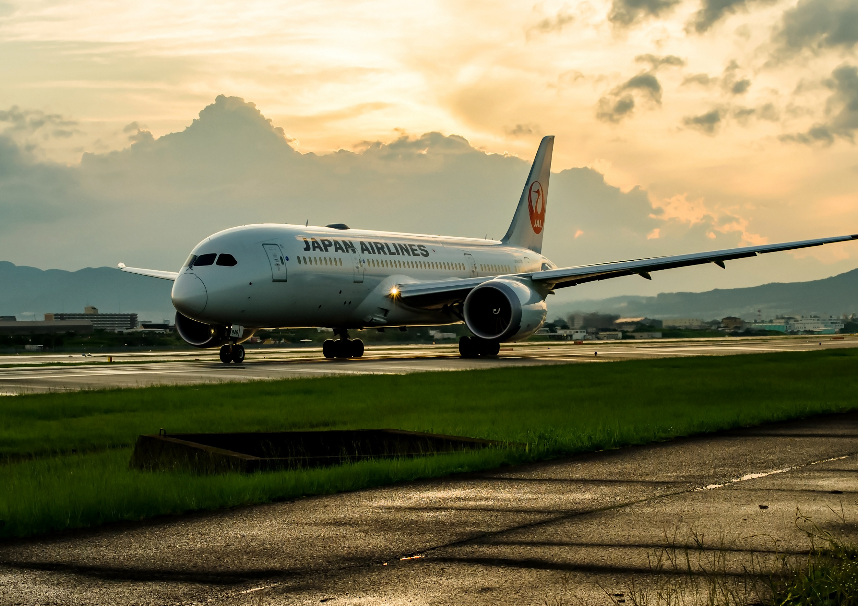
JAPAN AIRLINES GROUP
JAL Group
The JAL Group Network Spans the Globe.
We offer a variety of advertising media for more than 36.12 million* annual passengers on domestic flights and more than 7.58 million annual passengers on international flights who fly with the JAL Group.
Please take advantage of our advertising media as part of your company's promotional activities.
© JAL Brand Communications. All Rights Reserved.
* FY2024 JAL Monthly Report annual total
* The numbers are for JAL flights and do not include ZIPAIR

Slide 2
01
Characteristics of JAL Media
Appealing to various advertising targets
It is possible to effectively appeal to a variety of customers, such as domestic and international business travelers and tourists, based on their usage characteristics and the time of the year.
02
Media Features
Characteristics of JAL Group Media
It is possible to reach more than 3.01 million^{*1} customers per month on JAL domestic flights and more than 630,000^{*1} customers per month on JAL international flights.
Unparalleled
Reach
JAL Group Media has a unique feature of providing aviation media, enabling promotion implementation from a variety of touchpoints, such as airports and onboard the airplanes.
03
JAL's
Brand Power
SKYTRAX has named JAL as a certified 5-Star Airline for the 6th straight year ^{*2}.And JAL is named the Best Airline in Japan^{*3} for four consecutive years.
04
JAL's customers are mainly men in their 40s to 50s and women in their 30s to 40s, which are the leading generations in terms of consumer spending. In addition, around 30% have annual incomes of 10 million yen or more^{*4}.
The ability to approach business leaders
*1: FY2024 JAL Monthly Report monthly average *2:SKYTRAX “World Airline Star Rating” as of February 2023 *3: Tripadvisor® "Travelers' ChoiceTM World's Best Airlines 2020" *4: JAL research

Slide 3
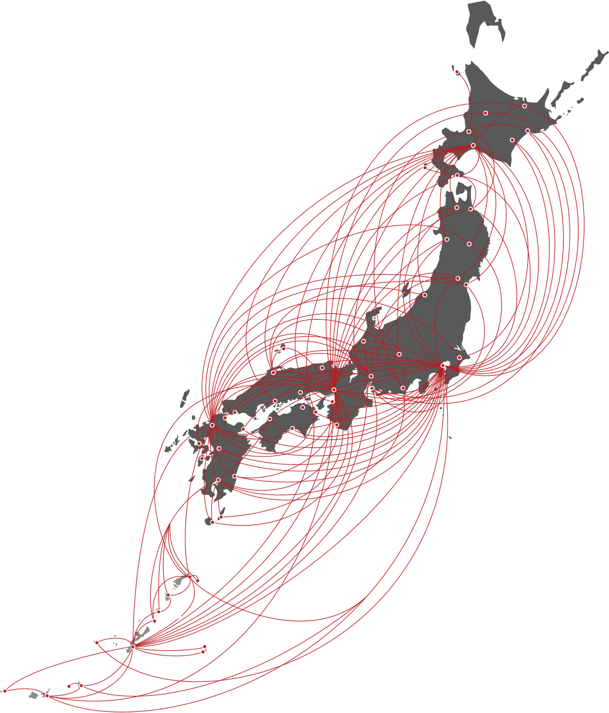
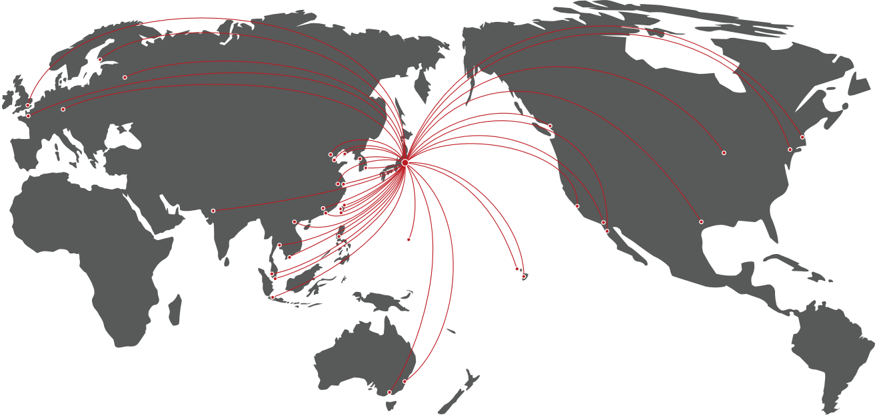
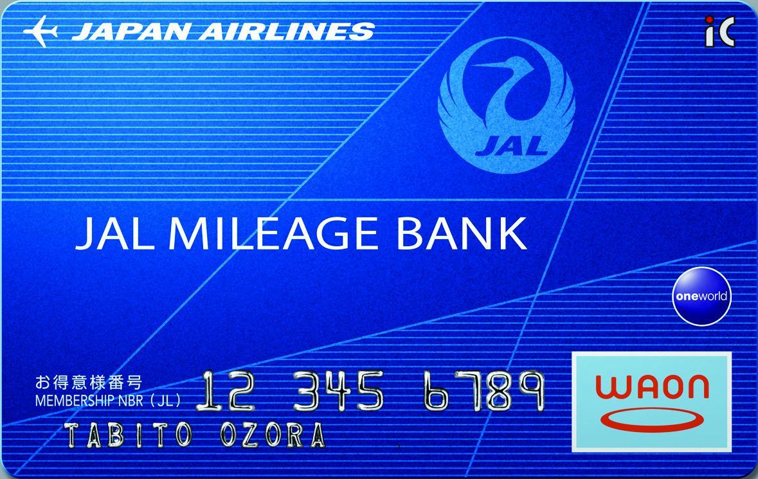


JAL Group Overview
JAL Group Overview
JAL Group Overview
Number of routes operated by the JAL Group (domestic flights)
Number of routes operated by the JAL Group (international flights)
Built a highly convenient domestic network
Built a network that connects Japan to the world
Number of airports and routes for domestic flights
Number of international countries/regions,airports, and routes
64 Airports 131 Routes
68 countries/regions 395 Airports 66 Routes
Domestic flight route map (as of June 2019)
* Some routes may not be in
operation during certain
periods.
International route map
(as of June 2019)
* Cities with direct flights from Japan
* The map is for illustrative purposes only
Number of JAL Card Mileage Bank members and JAL Card members
Number of JAL Card Mileage Bank members
Number of JAL Card members
* The map is for illustrative purposes only
30 million people
3.47 million people
New design in February 2024!
* Routes: JAL website, number of routes (March 2025)/countries and regions served by the JAL Group (March 2025) Includes code sharing flights (excluding ZIPAIR)
* From data held by Japan Airlines Co. Ltd. (as of Feb 2024)

Slide 4


JAL User Profiles
User profiles
JAL Group (excluding ZIPAIR) user profiles
Gender ratio
Age composition
Household income
Male
Male
20s
60s
20s
30s
Don’t know
10 million yen or more
Don’t know
10 million yen or more
Female
60s
5%
30s
5%
5%
5%
11%
Female
11%
11%
9%
11%
9%
9%
69%
9%
69%
24%
24%
22%
70%
22%
70%
25%
30%
25%
30%
23%
31%
23%
31%
23%
23%
22%
Domestic flights
International flights
Domestic flights
22%
International flights
Domestic flights
International flights
40%
40s
40%
40%
40s
40%
67%
67%
64%
50s
50s
64%
Less than 10 million yen
Less than 10 million yen
Passengers on both domestic and international flights are 70% male and 30% female
Passengers on both domestic and international flights are mainly in their 40s to 60s, the leading generations in terms of consumer spending
More than 20% of passengers on both domestic and international flights have incomes of 10 million yen or more
Profession
Purpose of use
Unemployed
Company employee
Unemployed
Company employee
Other
(ceremonial occasions/
visiting family)
Other
(ceremonial occasions/
visiting family)
Other
Other
Business
Business
5%
Student
Student
5%
4%
4%
2%
3%
2%
3%
Part time worker
3%
5%
3%
5%
31%
56%
31%
Part time worker
56%
8%
8%
57%
57%
30%
30%
45%
8%
45%
8%
47%
Housewife
Househusband
47%
Housewife
Househusband
11%
Domestic flights
11%
8%
International flights
Domestic flights
International flights
8%
2%
2%
2%
Freelance
2%
4%
Freelance
3%
Self-employed
4%
3%
3%
Self-employed
4%
3%
4%
39%
6%
39%
Manager/executive
6%
8%
6%
8%
Manager/executive
6%
Civil servant
Civil servant
Tourism
Tourism
Use by all occupations,
including company employees, civil servants, executives, self-employed, housewives (husbands), and students
Business 30%, tourism 50% on domestic flights
Business 20%, tourism 70% on international flights
* From JAL's own survey in 2022 (Survey participants were limited to Japanese nationals aged 20-69, mainly JMB members)

Slide 5
Time on Board and Feeling
How passengers spend their in-flight time, what they feel while on board
Conclusion: Interest in in-flight entertainment and in-flight magazines is particularly high, and the special feeling of travel increases passengers' attention towards hobbies and shopping
How do you spend your in-flight time?
Do you feel "special and uplifted" while flying?
How passengers spend their in-flight time and what they feel
Work
Sleep
86.7%
■ Yes
■ Yes, to some extent
■ Not particularly
■ No
Use in-flight Wi-Fi
In-flight entertainment
Customers who answered "Yes" or
"Yes, to some extent"
Read in-flight magazines
Read in-flight sales catalog
Other
0
20
40
60
80
(%)
Do you look forward to any part of the in-flight experience?
What is on your mind while on board?
In-flight entertainment
Work
In-flight magazine
Family
Sleep
Hobbies
Work
Shopping
Use in-flight Wi-Fi
Travel
In-flight meals, drink service
The future
Other
Other
0
20
40
60
80
0
20
40
60
80
(%)
(%)
* 2021 survey on in-flight magazines and in-flight entertainment for JMB members

Slide 6
Response to In-Flight Media
Response to In-Flight Media
Response to In-Flight Media Ad
Conclusion: In-flight experiences and ads tend to remain in the mind of the users and definitely lead to the next action
What are the things you saw in-flight that you remember more compared to other media and magazines?
Have you ever become interested in a product or service featured in an in-flight advertisement
(i.e., in-flight entertainment, in-flight magazines)?
In-flight magazine
■ I have become interested in a product or service
■ I have never become interested
In-flight entertainment
87.1%
In-flight reading materials
Have become
interested
Other
Nothing comes to mind
0
20
40
60
80
(%)
Have you ever researched a product or service that you became interested in after seeing an in-flight advertisement (i.e., in-flight entertainment, in-flight magazines)?
Have you ever purchased or used any products or services featured in in-flight advertisement?
■ I have researched
a product or service
■ I have never researched a product or service
71.6%
■ I have purchased or used
■ I have not purchased or used
82.7%
Have researched
Have purchased
or used
* 2021 survey on in-flight magazines and in-flight entertainment for JMB members

Slide 7

JAL Brand Communications Co., Ltd.
2-4-11 Higashi Shinagawa, Shinagawa-ku,
Tokyo 140-8637
Nomura Tennozu Building
Email: jbc_ad@jal.com
CONTACT
We have a designated agent system for overseas clients.
For inquiries from overseas, please contact one of the designated agents below.
Inquiries Applications | •Americas (Hawaii Islands) [HNL] PacRim Marketing Group Inc. / TEL: 1 808 949 4592 / www.pacrimmarketing.com [HNL] Lighthouse Hawaii / TEL: 1 808 926 0022 / lighthouse-hawaii.com •Europe (Europe) [LON] IMM International, UK Brand / TEL: 44 203 585 1300 / www.imm-international.com [PAR] Inflight Media Marketing France / TEL: 33 1 4013 7901 / www.imm-international.com [GVA] Inflight Media Marketing, AG / TEL: 41 22 310 80 51 / www.imm-international.com [ITA] Inflight Media Marketing International SARL / TEL: 39 02 46712521 / www.imm-international.com [ESP] IMM Spain / TEL:34 91 57 67 895 / www.imm-international.com | •Asia (excluding Japan) [SEL] First Media Service Corp. / TEL: 82 2 363 3591 [TPE] TOP TAIWAN MEDIA FACTORY / TEL: 886 2 2368 9128 / https://toptaiwanmedia.web.fc2.com [SHA] Jalux Shanghai Co., Ltd. / TEL: 86 21 34060663 / www.sh.jalux.com [HKG] IMM Asia HK Ltd. / TEL: 852 2639 3635 / www.imm-international.com [BKK] JPP Thailand Ltd. / TEL: 66 02 051 4694 [SIN] NewBase Content Pte. Ltd. / TEL: 65 9047 3181/ www.newbase360.com [SIN] Spafax Airline Network Pte. Ltd. / TEL: 65 6531 2682 / www.spafax.com [IDN] Jet Set Media / TEL: 65 8189 4783 [BOM] Mediascope Representation India LLP / TEL: 91 22 68468500 / https://mediascope.co.in/

