Slide 1
JAL GROUP MEDIA
JAL Brand Communications
Introduction to the Media We Offer
Feb07 , 2024

Slide 2
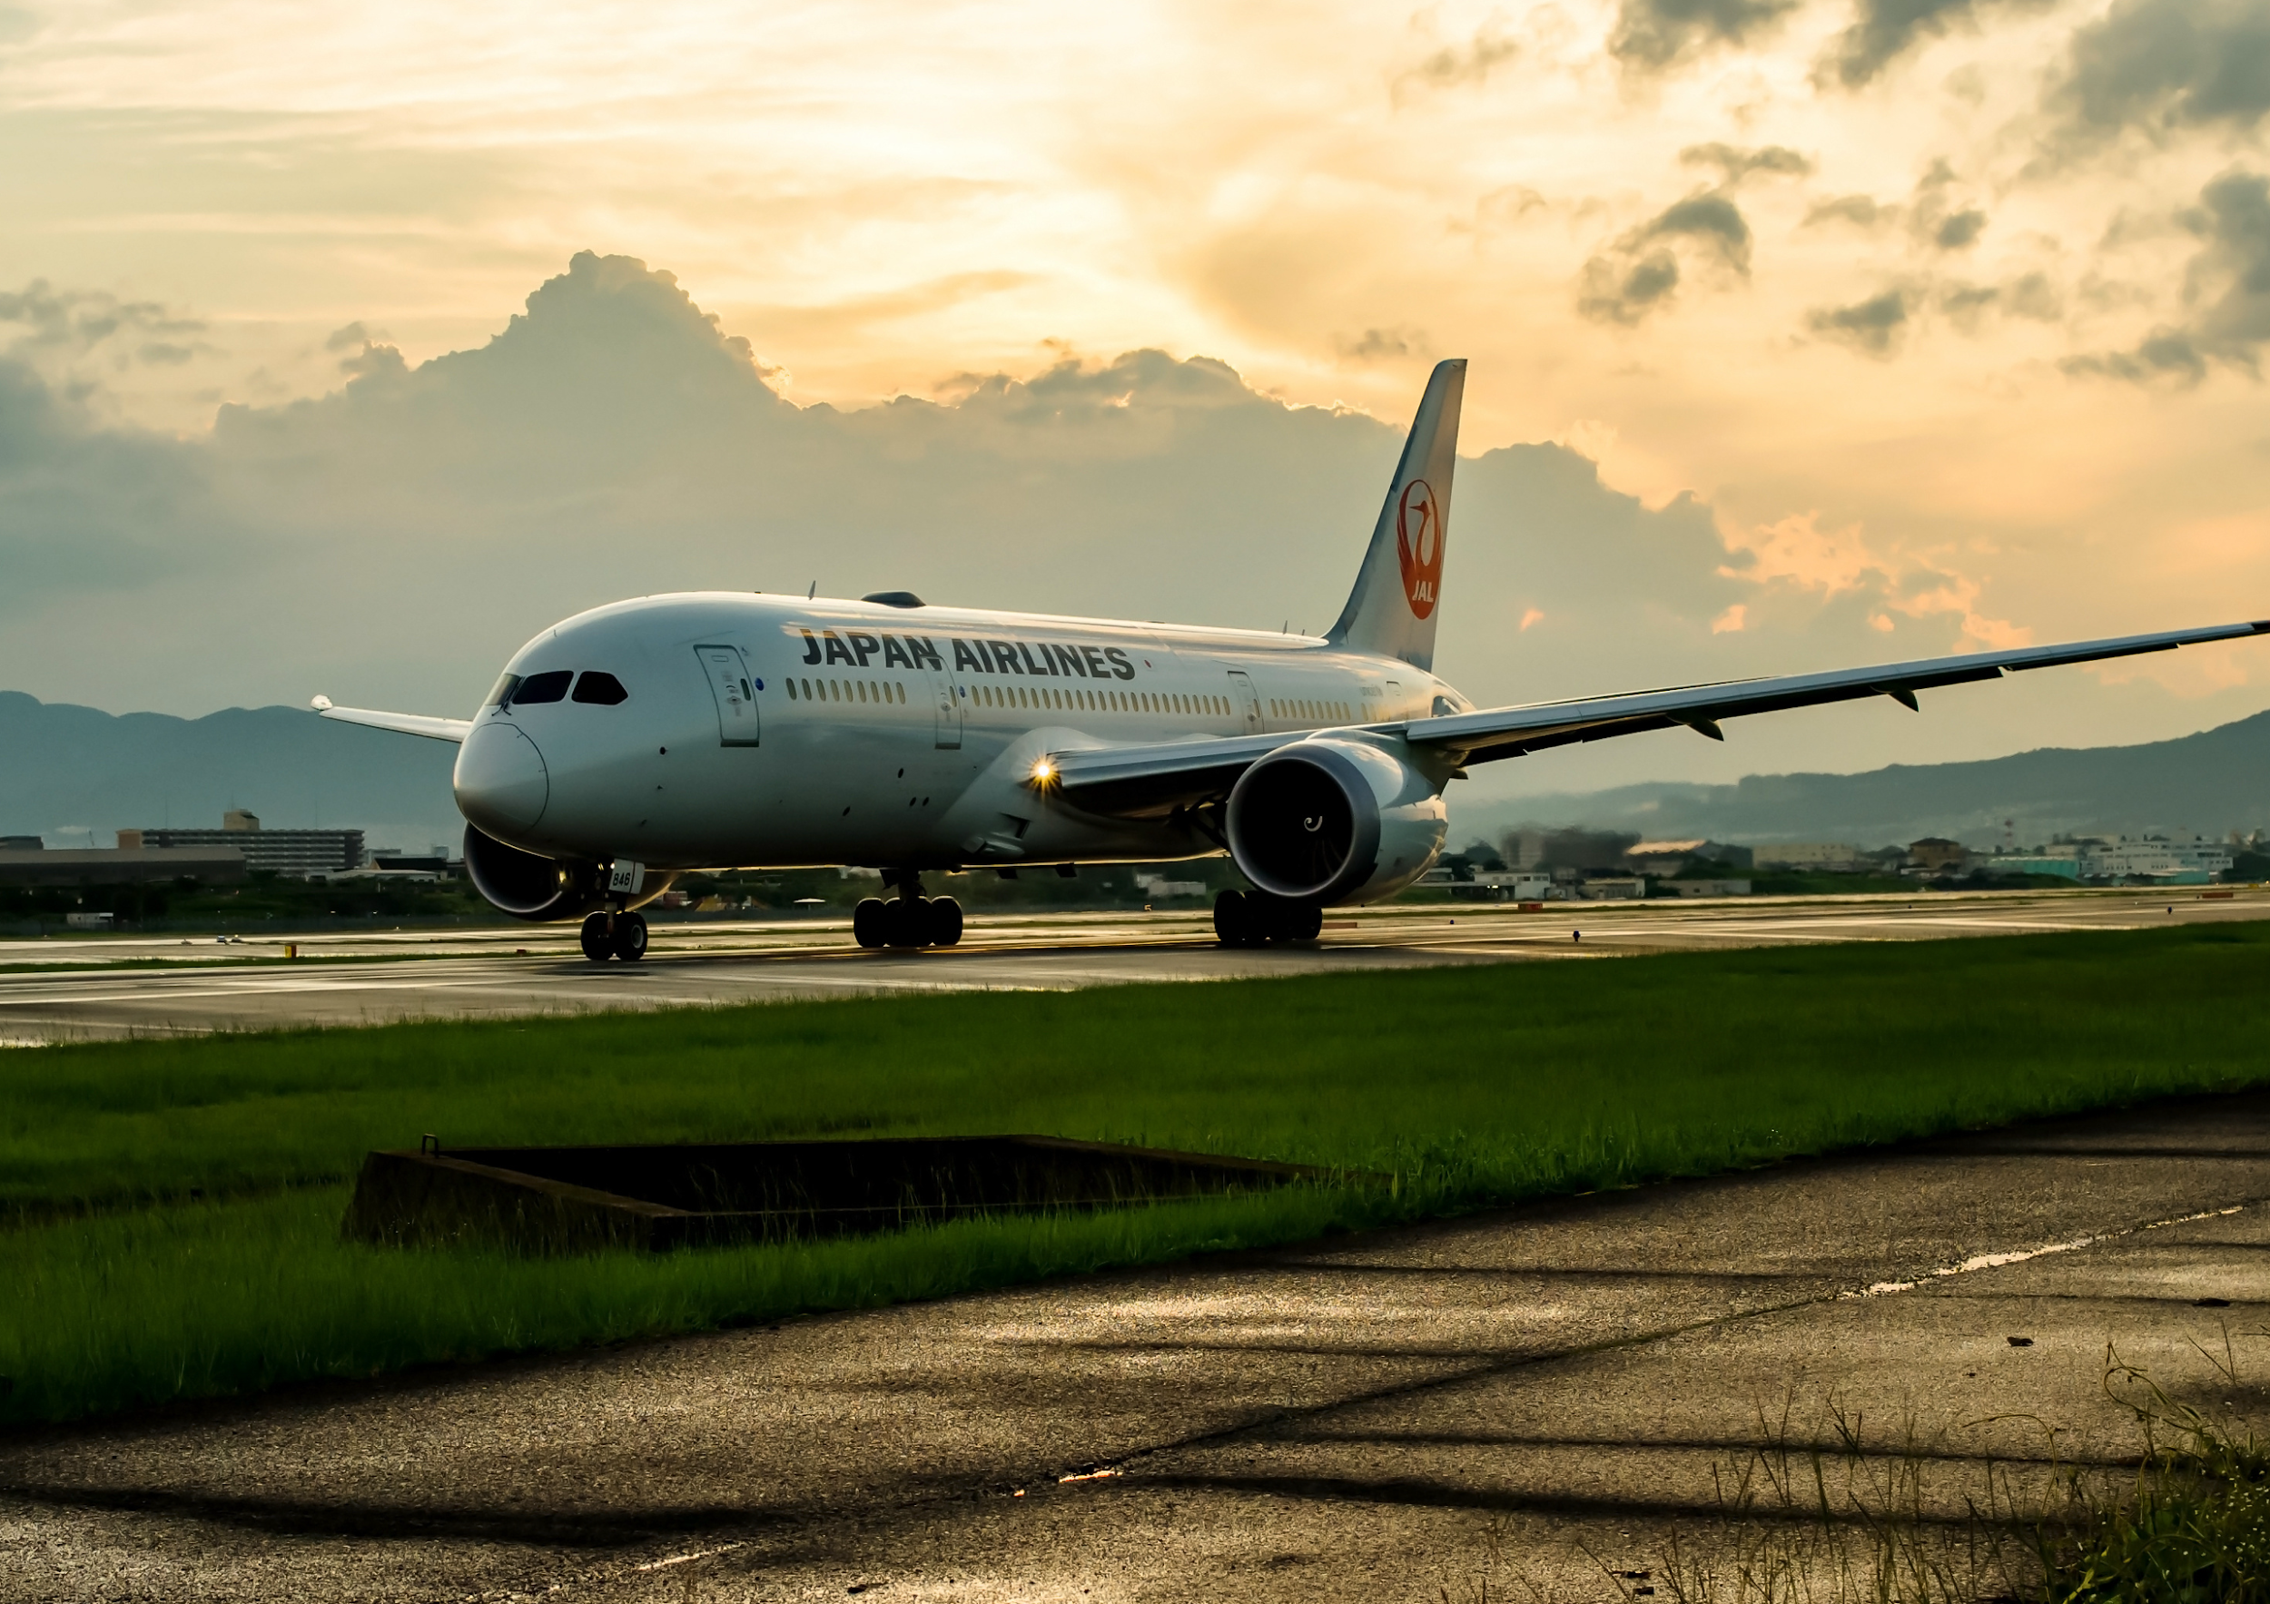
JAPAN AIRLINES GROUP
JAL Group
The JAL Group Network Spans the Globe. We offer a variety of advertising media for more than 30.10 million* annual passengers on domestic flights and more than 4.34 million annual passengers on international flights who fly with the JAL Group.
Please take advantage of our advertising media as part of your company's promotional activities.
© JAL Brand Communications. All Rights Reserved.
* FY2022 JAL Monthly Report annual total
* The numbers are for JAL flights and do not include ZIPAIR

Slide 3
JAL Group Contents
1
2
3
4
5
6
7
8
9
10
11
12
13
14
15
JAL Group Media Touchpoints
JAL Group In-Flight Media
About JAL Media
Characteristics of JAL Media
JAL Group Overview
Toward the Realization of JAL Vision 2030
User profiles
How passengers spend their in-flight time and what they feel
Response to In-Flight Media
JAL Media Advertising Menu
Material Format
Guidelines for advertisement submission
SKYWARD+ Guide
SKYWARD+ Advertising Menu
Contact for inquiries
P.04
P.05
P.06
P.07
P.08
P.09
P.10
P.11
P.12
P.15
P.28
P.30
P.33
P.34
P.35
CONTENTS

Slide 4
Media Touchpoints
JAL Group Media Touchpoints
We have advertising media along various scenes from at home to onboard the airplane.
JAL Group Media Touchpoints
In-flight
Before departure
International flights
International medium- and long-haul routes
Domestic flights
ZIPAIR
Web media
SKYWARD+ ^{*1}
New
Paper media
New menu option
New menu option
SKYWARD
New menu option
Paper media
SKYWARD
Web media
Video advertisements
Video/Web
SKYWARD+
ZIPAIR
Front monitor commercials
Video advertisements
CF before movies
Video advertisements
CF before movies
Video advertisements
Video advertisements
CF before videos
CF before videos

Slide 5
Simplified Chart
JAL Group In-Flight Media (quick reference chart)
JAL Group Media In-Flight Media
Paper media
SKYWARD (domestic edition)
Domestic flights
Front screen
Front monitor commercials
Visual media
Video advertisements
Personal monitor
CF before Movies (International flights)
CF before Videos (International flights)
Paper media
SKYWARD (international edition)
JAL Group In-Flight Media
CF before Movies (International flights)
International flights
Video advertisements
CF before Videos (International flights)
Visual media
ZIPAIR
Banner Advertisement
ZIPAIR

Slide 6
01
Characteristics of JAL Media
Appealing to various advertising targets
It is possible to effectively appeal to a variety of customers, such as domestic and international business travelers and tourists, based on their usage characteristics and the time of the year.
02
Media Features
Characteristics of JAL Group Media
It is possible to reach more than 2.51 million^{*1} customers per month on JAL domestic flights and more than 360,000^{*1} customers per month on JAL international flights.
Unparalleled
Reach
JAL Group Media has a unique feature of providing aviation media, enabling promotion implementation from a variety of touchpoints, such as airports and onboard the airplanes.
03
JAL's
Brand Power
SKYTRAX has named JAL as a certified 5-Star Airline for the 6th straight year ^{*2}.And JAL is named the Best Airline in Japan^{*3} for four consecutive years.
04
JAL's customers are mainly men in their 40s to 50s and women in their 30s to 40s, which are the leading generations in terms of consumer spending. In addition, around 30% have annual incomes of 10 million yen or more^{*4}.
The ability to approach business leaders
*1: FY2022 JAL Monthly Report monthly average *2:SKYTRAX “World Airline Star Rating” as of February 2023 *3: Tripadvisor® "Travelers' ChoiceTM World's Best Airlines 2020" *4: JAL research

Slide 7
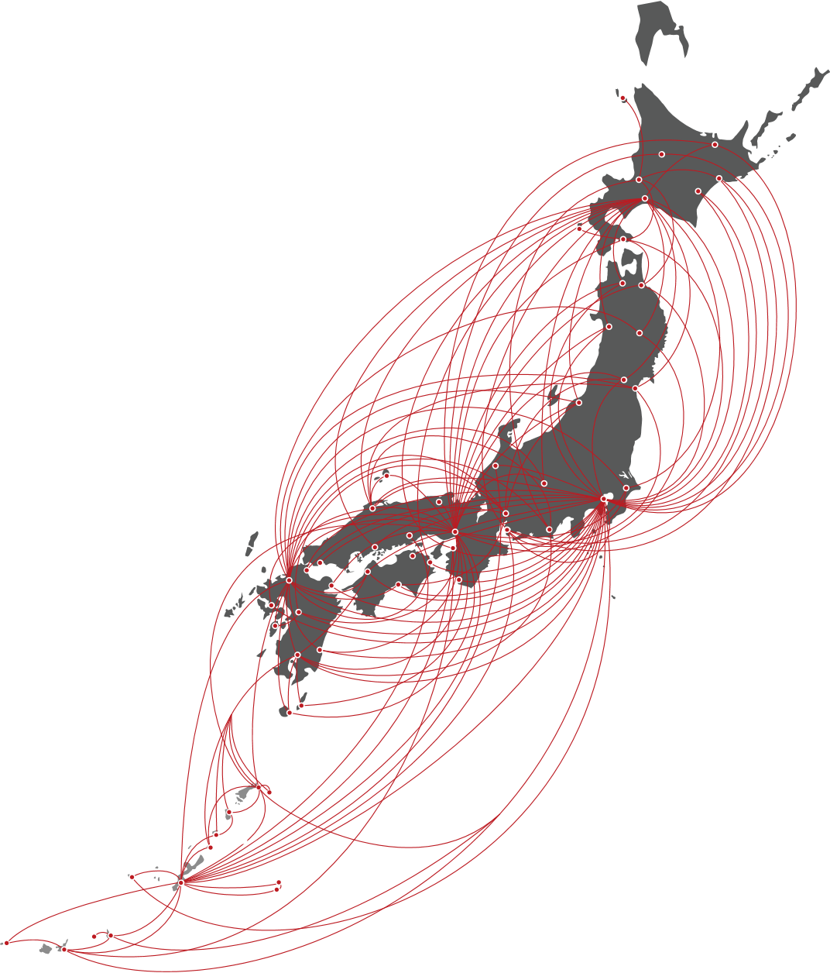
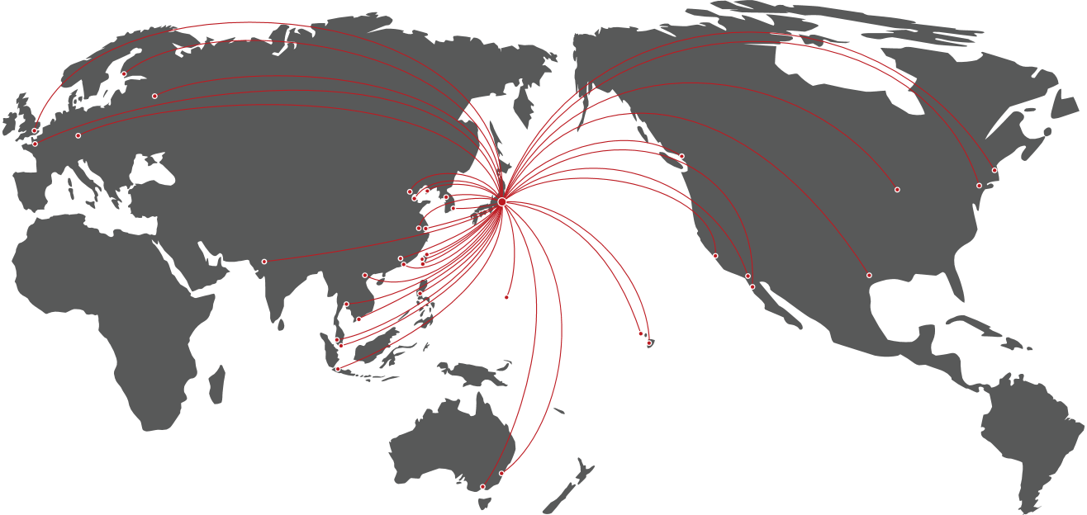
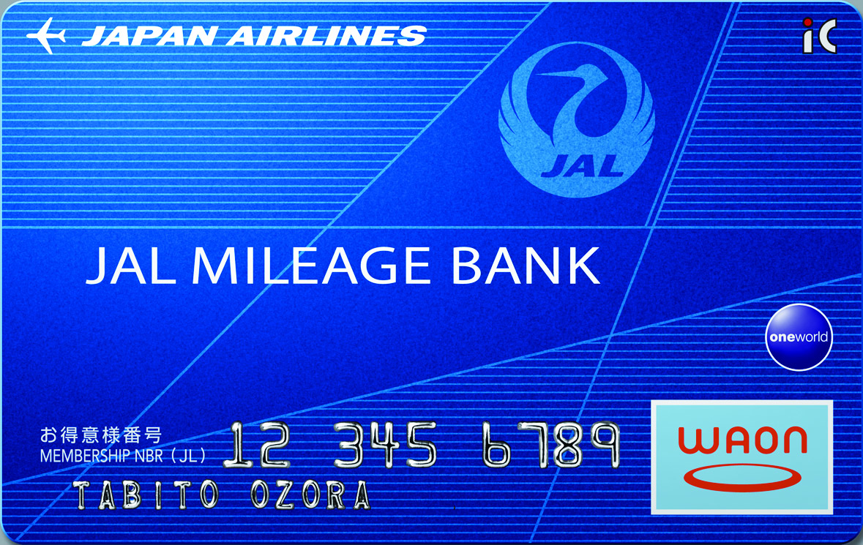
JAL Group Overview
JAL Group Overview
JAL Group Overview
Number of routes operated by the JAL Group (domestic flights)
Number of routes operated by the JAL Group (international flights)
Built a highly convenient domestic network
Built a network that connects Japan to the world
Number of airports and routes for domestic flights
Number of international countries/regions,airports, and routes
65 Airports 133 Routes
64 countries/regions 376 Airports 66 Routes
Domestic flight route map (as of June 2019)
* Some routes may not be in operation during certain periods.
International route map (as of June 2019)
* Cities with direct flights from Japan
* The map is for illustrative purposes only
Number of JAL Card Mileage Bank members and JAL Card members
Number of JAL Card Mileage Bank members
Number of JAL Card members
* The map is for illustrative purposes only
30 million people
3.47 million people
New design in February 2024!
* Routes: JAL website, number of routes (March 2023)/countries and regions served by the JAL Group (March 2023) Includes code sharing flights (excluding ZIPAIR)
* From data held by Japan Airlines Co. Ltd. (as of Feb 2024)

Slide 8
JAL User Profiles
User profiles
JAL Group (excluding ZIPAIR) user profiles
Gender ratio
Age composition
Household income
Male
Male
20s
60s
20s
30s
Don’t know
10 million yen or more
Don’t know
10 million yen or more
Female
60s
5%
30s
5%
5%
5%
11%
Female
11%
11%
9%
11%
9%
9%
69%
9%
69%
24%
24%
22%
70%
22%
70%
25%
30%
25%
30%
23%
31%
23%
31%
23%
23%
22%
Domestic flights
International flights
Domestic flights
22%
International flights
Domestic flights
International flights
40%
40s
40%
40%
40s
40%
67%
67%
64%
50s
50s
64%
Less than 10 million yen
Less than 10 million yen
Passengers on both domestic and international flights are 70% male and 30% female
Passengers on both domestic and international flights are mainly in their 40s to 60s, the leading generations in terms of consumer spending
More than 20% of passengers on both domestic and international flights have incomes of 10 million yen or more
Profession
Purpose of use
Unemployed
Company employee
Unemployed
Company employee
Other
(ceremonial occasions/
visiting family)
Other
(ceremonial occasions/
visiting family)
Other
Other
Business
Business
5%
Student
Student
5%
4%
4%
2%
3%
2%
3%
Part time worker
3%
5%
3%
5%
31%
56%
31%
Part time worker
56%
8%
8%
57%
57%
30%
30%
45%
8%
45%
8%
47%
Housewife
Househusband
47%
Housewife
Househusband
11%
Domestic flights
11%
8%
International flights
Domestic flights
International flights
8%
2%
2%
2%
Freelance
2%
4%
Freelance
3%
Self-employed
4%
3%
3%
Self-employed
4%
3%
4%
39%
6%
39%
Manager/executive
6%
8%
6%
8%
Manager/executive
6%
Civil servant
Civil servant
Tourism
Tourism
Use by all occupations,
including company employees, civil servants, executives, self-employed, housewives (husbands), and students
Business 30%, tourism 50% on domestic flights
Business 20%, tourism 70% on international flights
* From JAL's own survey in 2022 (Survey participants were limited to Japanese nationals aged 20-69, mainly JMB members)

Slide 9
Time on Board and Feeling
How passengers spend their in-flight time, what they feel while on board
Conclusion: Interest in in-flight entertainment and in-flight magazines is particularly high, and the special feeling of travel increases passengers' attention towards hobbies and shopping
How do you spend your in-flight time?
Do you feel "special and uplifted" while flying?
How passengers spend their in-flight time and what they feel
Work
Sleep
86.7%
■ Yes
■ Yes, to some extent
■ Not particularly
■ No
Use in-flight Wi-Fi
In-flight entertainment
Customers who answered "Yes" or "Yes, to some extent"
Read in-flight magazines
Read in-flight sales catalog
Other
0
20
40
60
80
(%)
Do you look forward to any part of the in-flight experience?
What is on your mind while on board?
In-flight entertainment
Work
In-flight magazine
Family
Sleep
Hobbies
Work
Shopping
Use in-flight Wi-Fi
Travel
In-flight meals, drink service
The future
Other
Other
0
20
40
60
80
0
20
40
60
80
(%)
(%)
* 2021 survey on in-flight magazines and in-flight entertainment for JMB members

Slide 10
Response to In-Flight Media
Response to In-Flight Media
Response to In-Flight Media Ad
Conclusion: In-flight experiences and ads tend to remain in the mind of the users and definitely lead to the next action
What are the things you saw in-flight that you remember more compared to other media and magazines?
Have you ever become interested in a product or service featured in an in-flight advertisement (i.e., in-flight entertainment, in-flight magazines)?
In-flight magazine
■ I have become interested in a product or service
■ I have never become interested
In-flight entertainment
87.1%
In-flight reading materials
Have become interested
Other
Nothing comes to mind
0
20
40
60
80
(%)
Have you ever researched a product or service that you became interested in after seeing an in-flight advertisement (i.e., in-flight entertainment, in-flight magazines)?
Have you ever purchased or used any products or services featured in in-flight advertisement?
■ I have researched a product or service
■ I have never researched a product or service
71.6%
■ I have purchased or used
■ I have not purchased or used
82.7%
Have researched
Have purchased or used
* 2021 survey on in-flight magazines and in-flight entertainment for JMB members

Slide 11
article
SKYWARD
The JAL Group in-flight magazine,
read by approx. 2.90 million passengers monthly.
Form of publication | - Monthly (placed on board from the first to the last day of each month, published on the 27th of the preceding month) ^{*2}
Distribution method | - JAL Group in-flight seat pockets^{*3}
Format | - 280 mm (height) x 210 mm (width)/perfect binding/all color (4-color offset printing)
Application deadline | - 60 days before publication
Material deadline | - Approximately 40 days before publication
Number of potential readers per month^{*1}
Domestic flights
2,510,000 readers
International flights
360,000 readers
* 1: JAL Group monthly report average from April 2022 – March 2023
* The number of copies of the in-flight magazine is not disclosed due to its circular nature where one copy is read by passengers who sit in the same seat
Domestic Edition
*2: The onboard start and end dates may change for various reasons such as late aircraft arrivals.
*3: May not be deployed onboard on some flights due to flight schedules, late aircraft arrivals, etc.
Pages in Japanese
Pages in Foreign languages
Units: yen/tax not required
Japanese Page | Domestic | International | Both | Ad size (height x width)
Inside front cover spread | 2,900,000 | 2,350,000 | 4,550,000 | 280×420
Second inside front cover spread | - | - | 4,400,000 | 280×420
FP, Facing Content | 1,600,000 | 1,250,000 | 2,600,000 | 280×210
FP, Facing Editorial | 1,550,000 | 1,200,000 | 2,350,000 | 280×210
Spread | 2,650,000 | 2,150,000 | 4,150,000 | 280×420
FP (Foreign language page) | 1,100,000 | 1,100,000 | 2,000,000 | 280×210
Spread (Foreign language page) | 2,150,000 | 2,150,000 | 3,700,000 | 280×420
Inside back cover | 1,250,000 | 1,250,000 | 2,300,000 | 280×210
Outside back cover | 2,250,000 | 1,800,000 | - | 280×200
(mm)
Japanese text
Cover
Back cover
(advertisement)
International Edition
Pages in Japanese
Pages in foreign languages
Japanese text
Cover
Back cover
(advertisement)
(mm)
Main contents include overseas special feature, domestic special feature, interviews, columns, essays, JAL Group information, and flight map.
Foreign language pages are in English and Chinese (Simplified).
* The above are rates for the ad spaces.
* As a general rule, we will create space for the second inside front cover only when an ad is published in both domestic and international editions of the magazine. This space is not regularly available.

Slide 12
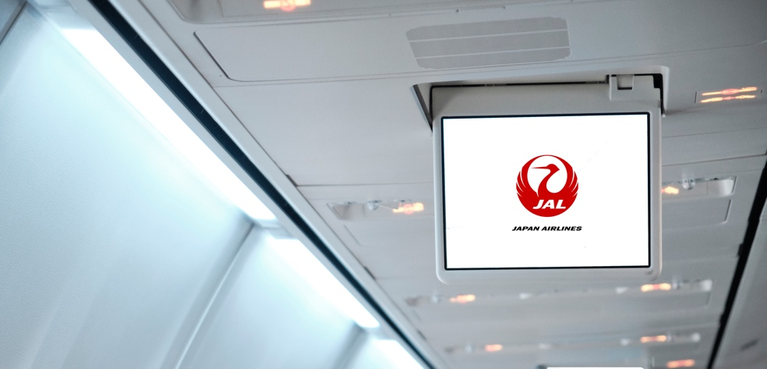
Domestic Flight Commercials
＊Rate for this menu changes
on a regular basis.
Below rate is valid until Sep screening.
Front monitor commercials (Domestic flights)
Appeal to many customers by showing a commercial within JAL original program on the monitors at the front of the cabin aisle
Screening media | - Front monitors on domestic flights
Screening period | - 1 month (from the 1st to the last day of each month) * The start and end dates of screening may change due to circumstances such as late aircraft arrivals.
Length of commercial (Number of seconds on screen) | - 15 sec/30 sec/60 sec/90 sec * The screening order will be decided at our discretion.
Number of flights screened on | - About 8,200 flights/month*¹
Screening routes | - Domestic routes operated by JAL*²
Material deadline | - 35 days before the start of screening
Number of potential viewers per month
Approximately
996,000*¹ passengers on domestic flights
* The above is for illustrative purposes
Rate table | 15 seconds | 30 seconds | 60 seconds | 90 seconds
Rates (yen/tax not required) | 1,800,000 | 2,500,000 | 3,900,000 | 4,900,000
The flow up to the screening of commercials on domestic flights (shown once after takeoff)
takeoff (about 10 minutes after)
*1：Monthly average from April 2022 to March 2023.(JAL’s inner data)
*2：(1)Commercials may not be shown in some cases on routes with a flight time of 70 minutes or less (Haneda–Itami, Kansai, Akita, Komatsu, Okayama, Tokushima, Takamatsu, about 1,390 flights/month in total) due to available service time.
(2)Commercials will not be shown on aircraft without screening equipment (including the new Airbus-900 and Boeing 787-800 aircrafts).
(3) Commercials will not be shown if the flight is operated by a group airline even if the flight number is JAL.
Before takeoff
Safety
video
screening
Seat
belt
sign
etc.
Commercials
JAL
Information
"For Your
Own Safety"
(1)(2)(3)(4)(5)(6)(7)(8)(9)
* We don’t distribute earphones on board.
* We won’t be able to provide any photography or recording of screening your CF on the actual flight.

Slide 13
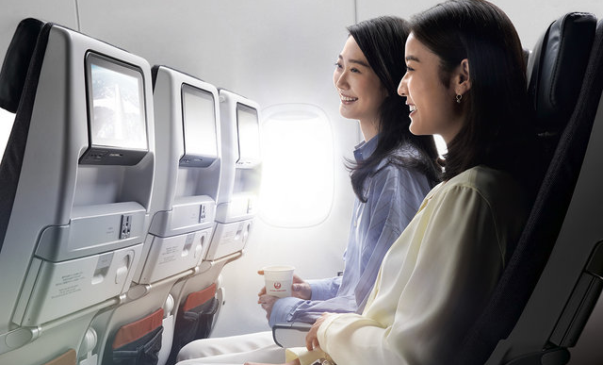
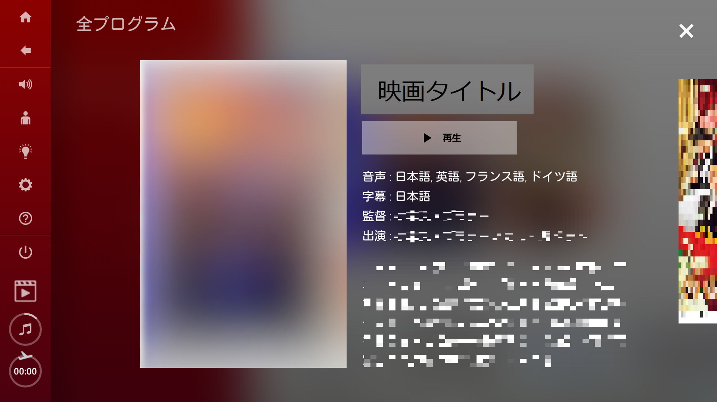
CF before movies (Domestic flights / Airbus A350-900・Boeing 787-800 )
※Rate for this menu changes
on a regular basis.
Outstanding Target Reach. Get your message across before movies most customers will watch.
Total number of programs: 10ch (as of Sep 2023) *²
Screening media | Individual monitors on domestic flights Applicable aircrafts: Airbus A350-900・Boeing 787-800
Screening period | - 1 month (from the 1st to the last day of each month) * The start and end dates of screening may change due to circumstances such as late aircraft arrivals.
Length of commercial | 15 seconds * The screening order will be decided at our discretion.
Number of flights screened on | ・About 2,690 flights/month *¹ *CF can also be screened in the case of operating international aircrafts on domestic flight routs.
Screening routes | Haneda = Itami, New Chitose, Fukuoka, Naha, Itami=Naha
Sales slots | ・5 slots * Maximum slots one client can book is two/month.
Application deadline | Booking deadline: 80 days prior to screening Delivery day: around 60 days prior to screening
Rate | April ~ Sep screening 2024 : 2,100,000 yen / slot / month (tax not required)
Notes | ・CF can be skipped by the viewers.
Number of potential viewers per month
Approximately
677,000 passengers *¹
Number of potential views per month
Approximately
*3 Just a reference.
Not guaranteed
300,000 views
Individual monitors
※Airbus A350-900
The flow up to screening
Main Menu
Select a movie and play
…
CF
①②③④⑤
Seatbelt signs etc
→
Movie starts
* When playing or skipping, a window (displaying play/skip) will appear over about 1/3 of the screen for a few seconds. CF can stop during in-flight announcement is proceeding.
* We will not be able to provide any photography or recording of screening
your CF on the actual flight.
*1：Monthly average from April 2022 to March 2023.(JAL’s inner data)
*2：Total number of movies differs every month.
The number of movies varies on the flights served by international aircraft.
*3：JAL’s inner data

Slide 14
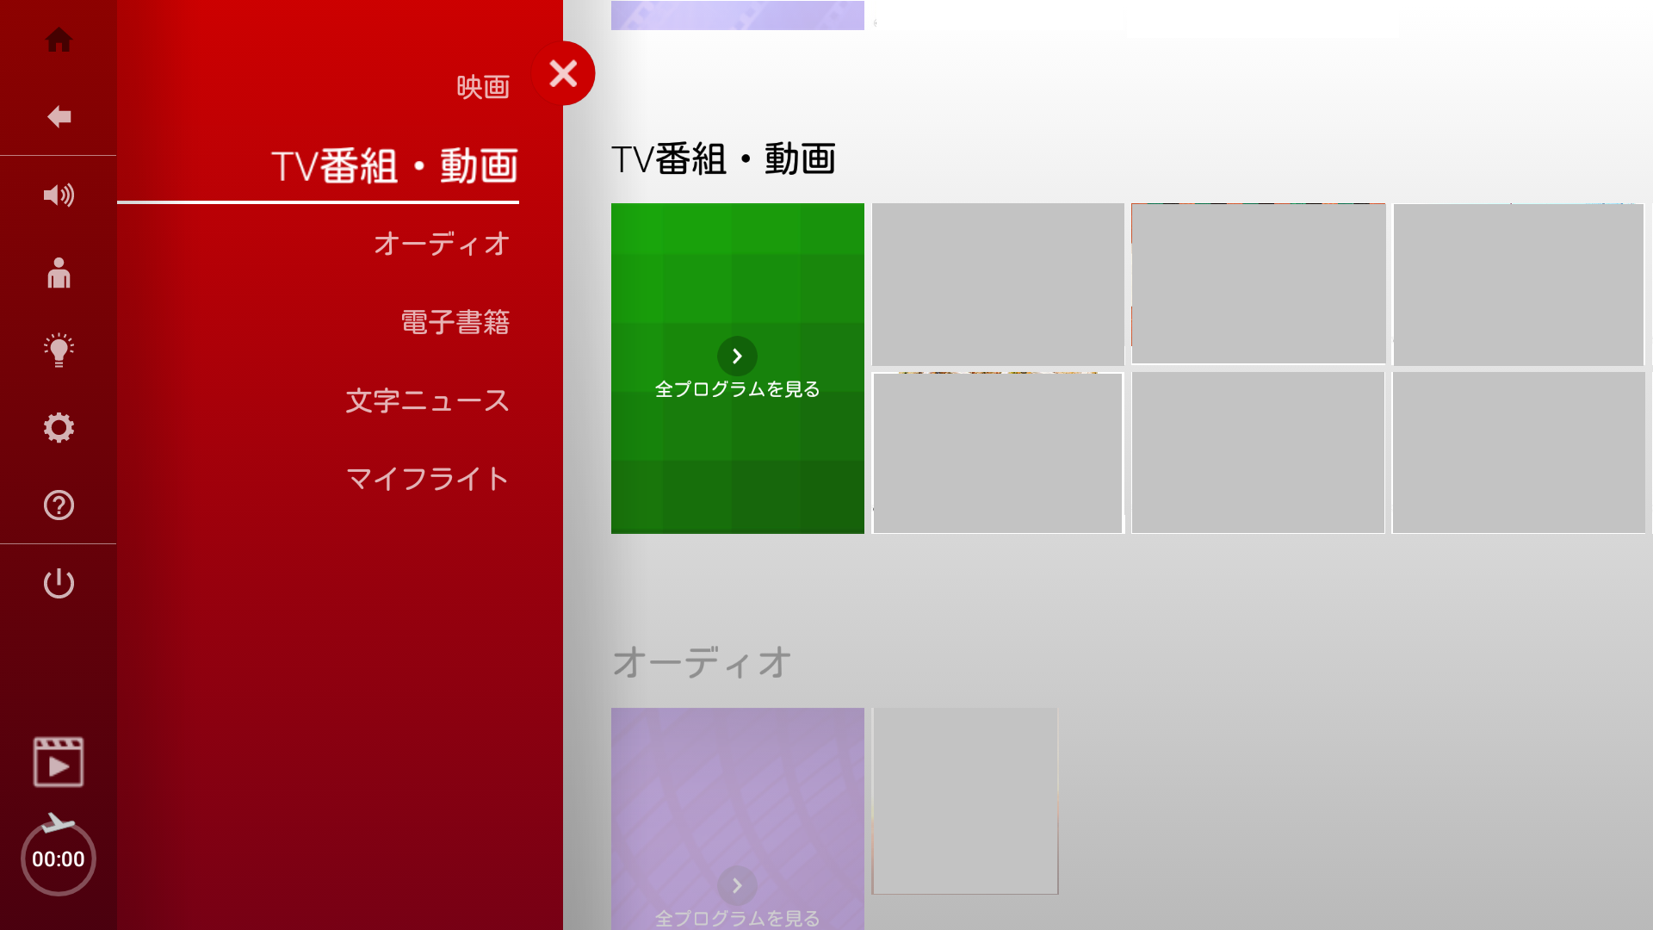
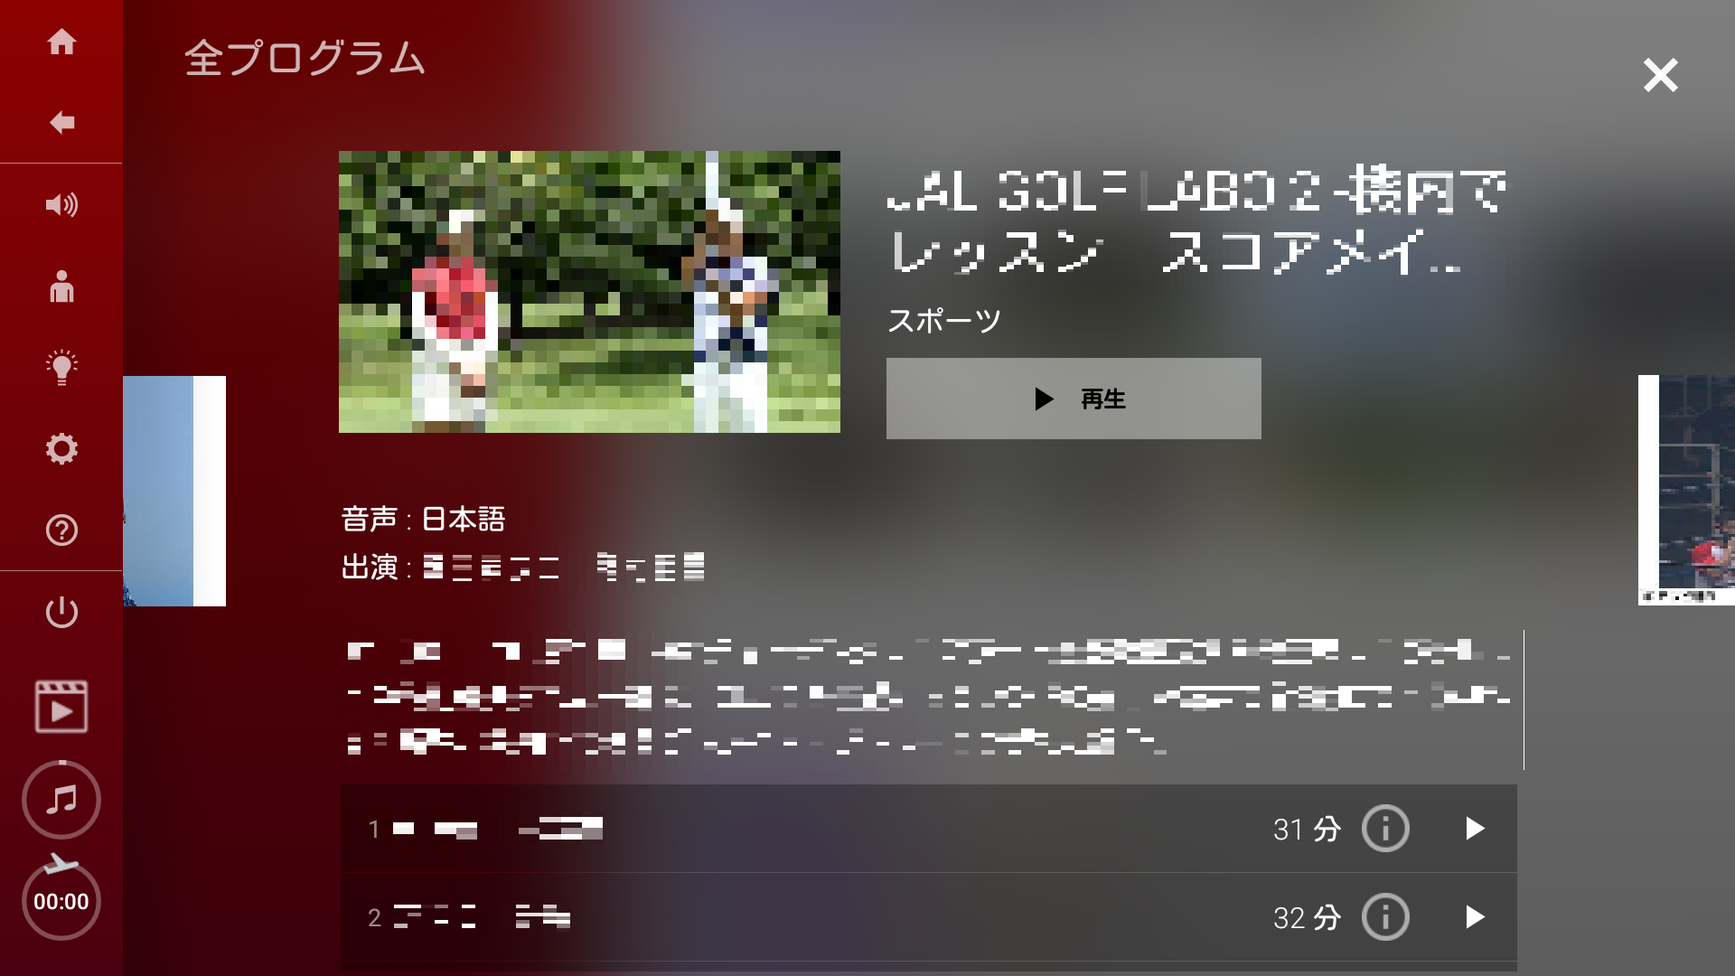
CF before videos (Domestic flights / Airbus A350-900・Boeing 787-800 )
※Rate for this menu changes
on a regular basis.
CFs before video programs including abundant titles such as domestic travel programs can appeal to people traveling Japan. Total number of programs: 87 ch (as of Sep 2023) *²
Screening media | Individual monitors on domestic flights Applicable aircrafts: Airbus A350-900・Boeing 787-800
Screening period | - 1 month (from the 1st to the last day of each month) * The start and end dates of screening may change due to circumstances such as late aircraft arrivals.
Length of commercial | 15 seconds * The screening order will be decided at our discretion.
Number of flights screened on | ・About 2,580 flights/month *1 *CF can also be screened in the case of operating international aircrafts on domestic flight routs.
Screening routes | Haneda = Itami, New Chitose, Fukuoka, Naha Itami=Naha
Sales slots | 5 slots * Maximum slots one client can book is two/month.
Application deadline | Booking deadline: 80 days prior to screening Delivery day: around 60 days prior to screening
Rate | April ~ Sep screening 2024 : 2,250,000 yen / slot / month (tax not required)
Notes | ・CF can be skipped by the viewers.
Number of potential viewers per month
Approximately
677,000 passengers *¹
Number of potential views per month
Approximately
*Just a reference.
Not guaranteed
550,000 views
※Airbus A350-900
Individual monitors
The flow up to screening
Main Menu
Select a video and play
…
CF
①②③④⑤
Seatbelt signs etc
→
Video starts
* When playing or skipping, a window (displaying play/skip) will appear over about 1/3 of the screen for a few seconds. CF can stop during in-flight announcement is proceeding.
* We will not be able to provide any photography or recording of screening your CF on the actual flight.
*1： Monthly average from April 2022 to March 2023.(JAL’s inner data)
*2： Total number of movies differs every month.
Some video programs do not allow commercial screening.
The number of movies varies on the flights served by international aircraft.

Slide 15
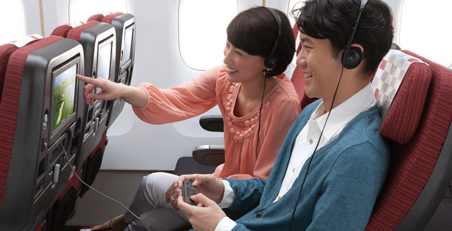
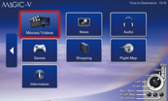
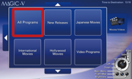
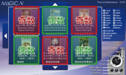
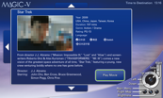
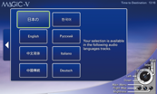
CF before movies (International flights)
※Rate for this menu changes
on a regular basis.
Outstanding Target Reach. Get your message across before movies most customers will watch.
Total number of programs: 101 ch (as of Sep 2023) *²
Screening media | - Individual monitors on international flights
Screening period | - 1 month (from the 1st to the last day of each month) * The start and end dates of screening may change due to circumstances such as late aircraft arrivals.
Length of commercial | 15 seconds * The screening order will be decided at our discretion.
Number of flights screened on | About 2,390 flights/month *1 *CF may not be screened on some aircrafts.
Screening routes | - International routes operated by JAL
Sales slots | 10 ~12 slots (Odd-numbered channel 15 sec x 5 slots, even-numbered channel 15 sec x 5 slots)*2 * Maximum slots one client can book is two/month.
Application deadline | Booking deadline: 80 days prior to screening Delivery day: around 60 days prior to screening
Rate | April~Sep screening 2024 : 2,250,000 yen / slot / month (tax not required)
Notes | ・CF can be fast-forwarded by the viewers.
Number of potential viewers per month
Approximately
360,000 passengers on international flights*¹
* The photo for illustrative purposes only
Individual monitors
The flow up to screening
Odd
Even
Odd
Select "Movies/Videos"
Select
a category
Even
Odd
Even
Select
a movie title*
Select
"Play Movie"
Select
a language
* The screen image may be different depending on the aircraft.
* "Odd" refers to odd-numbered channels, and "even" refers to even-numbered channels. This information is provided for convenience, and will not be shown on the actual screen.
In addition, screening slots will be assigned at our discretion
* The movie program for each month can be found on the JAL website under International Flights > In-flight & Lounge > In-flight Entertainment (Program Information).
*1：JAL Group monthly report average from April 2022-March2023.
*2：Total number of movies differs every month.
“Odd channel" and "Even channel" are tentative names for ease of reading. In actuality, the title of the movies will be listed.
* When playing, fast-forwarding, or rewinding, a window (displaying fast-forward/rewind) will appear over about 1/3 of the screen for a few seconds.
CF
Odd
(1) (2) (3) (4) (5)
Even
(6) (7) (8) (9) (10)
*We won’t be able to provide any photography or recording of screening your CF on the actual flight.

Slide 16
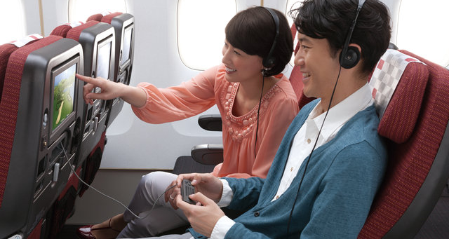
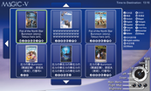
CF before videos (International flights)
※Rate for this menu changes
on a regular basis.
Commercials appearing before video programs that include an abundance of titles such as domestic travel programs can appeal to people visiting Japan.
Total number of programs: 88 ch (as of Sep 2023) *2
Screening media | - Individual monitors on international flights
Screening period | - 1 month (from the 1st to the last day of each month) * The start and end dates of screening may change due to circumstances such as late aircraft arrivals.
Length of commercial | 15 seconds * The screening order will be decided at our discretion.
Number of flights screened on | About 2,390 flights/month*1 *CF may not be screened on some aircrafts.
Screening routes | - International routes operated by JAL
Sales slots | 2 ~ 5 slots * Maximum slots one client can book is two/month.
Application deadline | Booking deadline: 80 days prior to screening Delivery day: around 60 days prior to screening
Rate | April ~ Sep screening 2024 : 1,800,000 yen / slot / month (tax not required)
Notes | ・CF can be fast-forwarded by the viewers.
Number of potential viewers per month
360,000 passengers on international flights*1
Approximately
* The photo for illustrative purposes only
Individual monitors
The flow up to screening
Select "Movies/Videos"
Select
a category
Select a video title
Select
“Play”
Select
a language
CF (1) (2)
* The screen image may be different depending on the aircraft
* The movie program for each month can be found on the JAL website under International Flights > Inf-light/Lounge > In-flight Entertainment (Program Information).
*1：JAL Group monthly report average from April 2022-March2023.
*2：Total number of videos differs every month.
Some video programs do not allow commercial screening.
* When playing, fast-forwarding, or rewinding, a window (displaying fast-forward/rewind) will appear over about 1/3 of the screen for a few seconds.
.
*We won’t be able to provide any photography or recording of screening your CF on the actual flight.

Slide 17
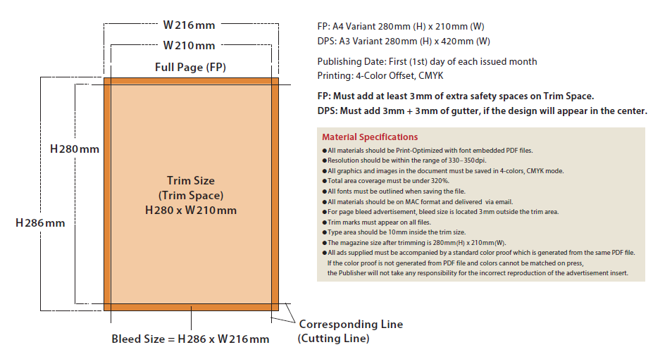
MATERIAL FORMAT for MAGAZINES
Material Format
Refer below material format instructions when submitting printing data for SKYWARD, Full Page (FP) and Double Pages Spread (DPS) .

Slide 18
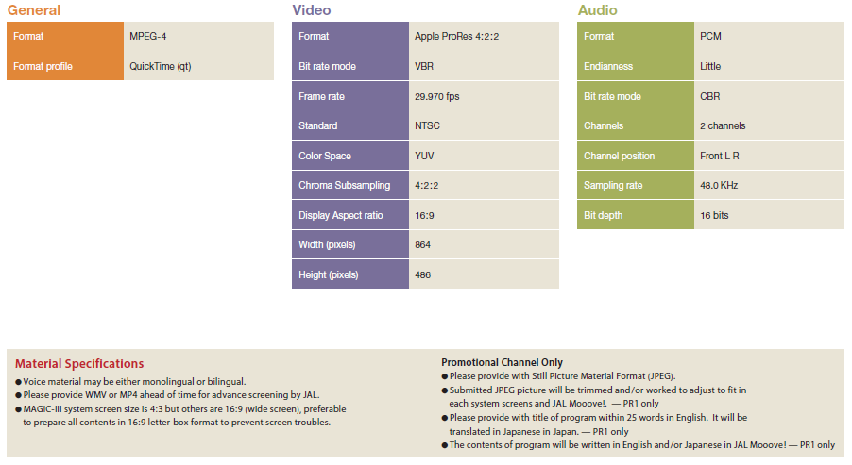
MATERIAL FORMAT for CF or Promotion Channels
Material Format

Slide 19
Guidelines for advertisement submission (1)
Guidelines for advertisement submission
Overview of common standards for advertisement media submission
Notes regarding advertisement expression
Common to all print media
Please be advised of the following items when making submissions to this media program, due to the nature of the JAL in-flight environment.
Please note the following standards regarding advertising expression. Expressions or content that do not meet these standards will not be published.
Your understanding is appreciated.
Points to keep in mind when reserving an ad space
Except for special pages such as the cover page, and pages facing articles, you can not specify ad page designations.
If you do not specify an article-facing space, your advertisement may be placed facing another advertising. Your understanding is appreciated.
For all media submissions, we carry out screenings of the company, products, and expression (ad content).
Advertisements that compete with the sales activities of the JAL Group and its affiliates (including information on airlines outside the JAL Group) may be rejected.
Because JAL Media is part of customer service provided by an airline to its customers, we reserve the right to reject content or visuals that might cause anxiety, discomfort, or disadvantage to our customers.
There are various conditions that must be compiled with in accordance with the Airports Act and the Civil Aeronautics Act with regard to advertising media and services provided in restricted areas of airports and on board aircraft.
Please inquire separately regarding restrictions on the types of businesses and products that may be advertised.
In addition, please consult with us regarding the content of your advertisement at the production stage.
Please note that media services may become unavailable due to unavoidable circumstances such as inclement weather and force majeure, .
Please note that the start and end dates of publication and screening may be moved forward or backward due to various circumstances such as aircraft availability. Routes and cabin classes can not be specified for ad placements, except for the domestic flight new aircraft menu and part of the ZIPAIR menu.
For advertisement submissions for all media, there is no limit of one company per industry.
No refunds or rate reductions will be given in the event of flight cancellations or reductions due to force majeure and other unavoidable circumstance.
As a general rule, cancellations will not be accepted after an application has been submitted. In the event of cancellation, a cancellation fee will be charged.
The first transaction for each customer must be paid in advance.
These media are offered on a term contract. No additional charges, refunds, or rate reductions will be made due to an increase or decrease in the number of flights operating.
Advertisements for which responsibility is unclear
Advertisements with unclear content or purpose
Advertisements that violate or may violate the relevant laws or regulations such as the Act against Unjustifiable Premiums and Misleading Presentations (e.g., "superlative" expressions), the Pharmaceutical Affairs Act (formerly the Pharmaceuticals Act), food labeling, and other related laws and industry guidelines.
False, exaggerated, or inaccurate information that may mislead the public
Inappropriate expression involving comparisons with other companies to emphasize one's own superiority
Content that may discriminate or alienate people based on nationality, race, ethnicity, social status, position, region, occupation, gender, illness, disability, etc., infringe on privacy, or constitute sexual harassment or other violation of human rights
Content that may be defamatory, libelous, or slanderous toward another company
Content that may damage the credibility of a business or obstruct business operations of another company
Content that is antisocial, immoral, or otherwise disruptive
Content that is violent or grotesque and offends public order and morals
Content that is fraudulent or involves bad business practices
Content that is misleading to readers because it is unscientific or superstitious
Content that causes readers (viewers), including those on board an airplane, feel uneasy
Unauthorized use of another party's name, photograph, discourse, trademark, symbol, copyright, patent, etc.
Content with considerable risk of encouraging speculation, gambling, etc.
Content that may hinder the sound development of youth
Content that is involved in judicial trials or disputes, or has the potential to become the subject of future legal disputes
Content with the purpose of political publicity or religious proselytizing
Content intended to promote mail-order sales
Content that is likely to damage the JAL Group brand or lower the quality of the magazine
Expressions that, contrary to the facts, appear to imply that the JAL Group recommends or guarantees the advertiser or their product or service
Advertisements that might disadvantage the JAL Group as a result of their publication
Other advertisements that the JAL Group deems inappropriate
Notes on advertisement productions
For four-color combinations (including images), please ensure that the total value of the four CMYK plates is 320% or less.
Special colors cannot be used.
The final trim sizes are as follows. SKYWARD (interior page: 280mm (height) x horizontal 210 mm (width), Outside back cover: 280mm (height) x 200mm (width)
Please keep logos, company names, copy, etc. at least 10mm inside the final trim line. Please leave at least 3mm of bleed area on each side.
As a general rule, we do not provide color proofs.
We will accept submissions from overseas on the condition that the printing finish is left to our discretion.
Submission Format
As a general rule, J-PDF manuscripts only (JMPA Color 2018 compliant) J-PDF: JMPA Color compliant; Illustrator CS2 or higher; InDesign CS4 or higher; Acrobat Professional 9 or higher *Please lower the version if produced in CC2019.
Submission Content
(1) Material data * Please submit by data document transmission
(2) PDF specifications
(3) Pre-flight report

Slide 20
Guidelines for advertisement submission (2)
Guidelines for advertisement submission
Common to all video media
Points to keep in mind when reserving an ad spot
Submission Format
You cannot request a screening order of commercials.
Commercials are screened only on Japan Airlines flights (flights marked JL on the timetable). Nonscheduled flights are not included.
Screening periods are set as the first to last day of each month, but are subject to change for various reasons. Your understanding is appreciated.
(1) Domestic flight commercials - Data file for delivery - WMV or MP4 file for inspection
(2) Movie/video pre-roll commercials - Data file for delivery - WMV or MP4 file for inspection
(3) Promotional (PR) programs - Data file for delivery - WMV or MP4 file for inspection
(4) Video programs - Data file for delivery or 1 HD camera - WMV or MP4 file for inspection
Notes on advertisement productions
The ratio of the front screens will be 4:3 with the exception of some aircraft. 16:9 images will have black margins at the top and bottom. Please prepare 16:9 video in a letterbox format. (squeeze format is not acceptable)
Individual monitors will be 4:3 with the exception of some aircraft. 4:3 images will have black margins at the top and bottom.
Audio can be mono or stereo, but must be a single-audio track.
Please submit a job sheet that includes the title, language, length, time code, size, etc. along with the material.
(unnecessary when delivering by tape)
Please contact us as there are format specifications for data and tapes to be delivered.
If a commercial is not shown due to a situation such as a malfunction of the in-flight entertainment system, no refund, rate reduction, or compensation will be provided. Your understanding is appreciated.
* Please prepare the following only when submitting to Promotion (PR)1.
- A static image JPEG file for use on the MAGIC Menu screen (clean image at the highest possible resolution)
- A program title for the MAGIC menu (Japanese: 12 double-byte characters, English: 25 single-byte characters *including spaces)
- A program introduction for SKYWARD (international version) in Japanese, approx. 50 Japanese characters English with Japanese or English only is also acceptable.
* For details, please check with our sales representative.
If you have any other questions, please feel free to contact us.

Slide 21
SKYWARD+ Media Guide
Advertising Media Guide
Media Guide

Slide 22
About SKYWARD+
Media on Travel
SKYWARD+
A web magazine of the JAL group's in-flight magazine "SKYWARD" that is enjoyed by 3.26 million customers every month.
In addition to selected articles from back issues of the in-flight print magazine "SKYWARD", SKYWARD+ features exclusive articles. This original travel website restructures travel-related content linked to the SKYWARD magazine in an easy-to-read format.
1,020,000 page views
No. of page views
900,000
No. of page views
1,020,000/month *
No. of unique users
744,000 unique users
600,000
No. of unique users
300,000
740,000/month *
0
Jan.
Feb.
Mar.
Apr.
May.
Jun.
Jul.
Aug.
Sept.
Oct.
Nov.
Dec.
Jan.
Feb.
Mar.
2021
2022
It is widely viewed by women in their 30s who have high motivations for career change and skill improvement, and have a strong interest in personal property and real estate.
Viewer
Characteristics
© JAL Brand Communications. All Rights Reserved.
* Results as of March 2022

Slide 23
SKYWARD+ Advertising Menu
SKYWARD+
SKYWARD+
SKYWARD PLUS
- Banner advertisements
- SEO search top article-linked advertisements
Web media
Media Guide
Web Media
Web media
© JAL Brand Communications. All Rights Reserved.

Slide 24
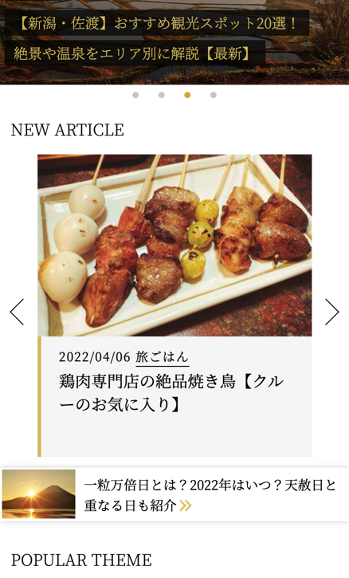
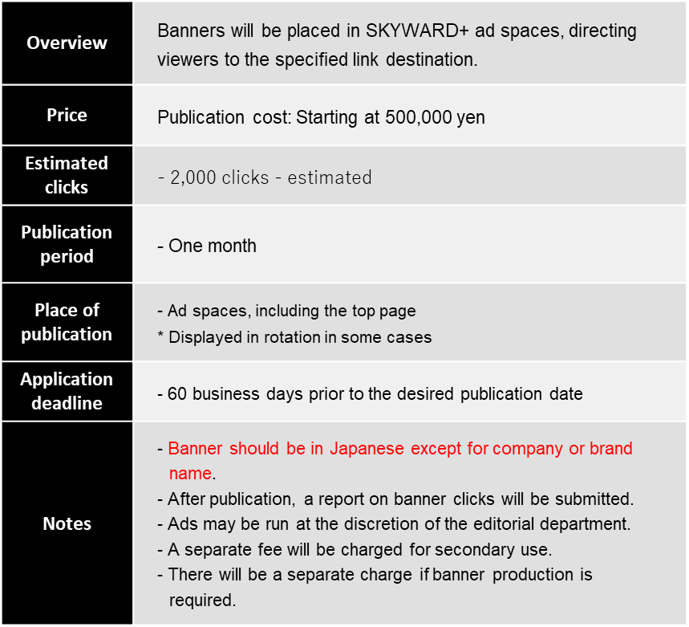
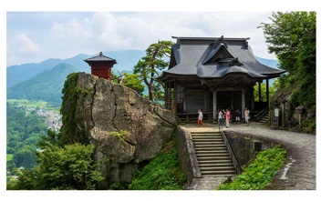
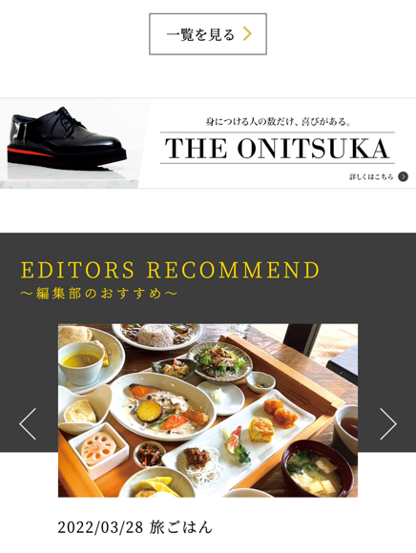
SKYWARD+ Advertising Menu
Banner Advertisement
Banner Advertisement
Directed to client-specified link
9:41 AM
An option that places a banner in a SKYWARD+ ad space, and directs the viewer to the client's specified link
*Please prepare Japanese site.
Designated link
E-Commerce website/portal site
2021/03/31 旅の＋ONE
山形の春を満喫！芭蕉ゆかりの地・山寺など名刹巡りとさくらんぼ & 美食の旅
Designated link
Company website
*
Designated link
Landing page
etc.
* An example of the use of ad space for another article within the website

Slide 25
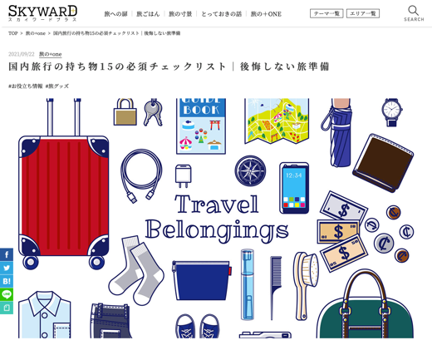
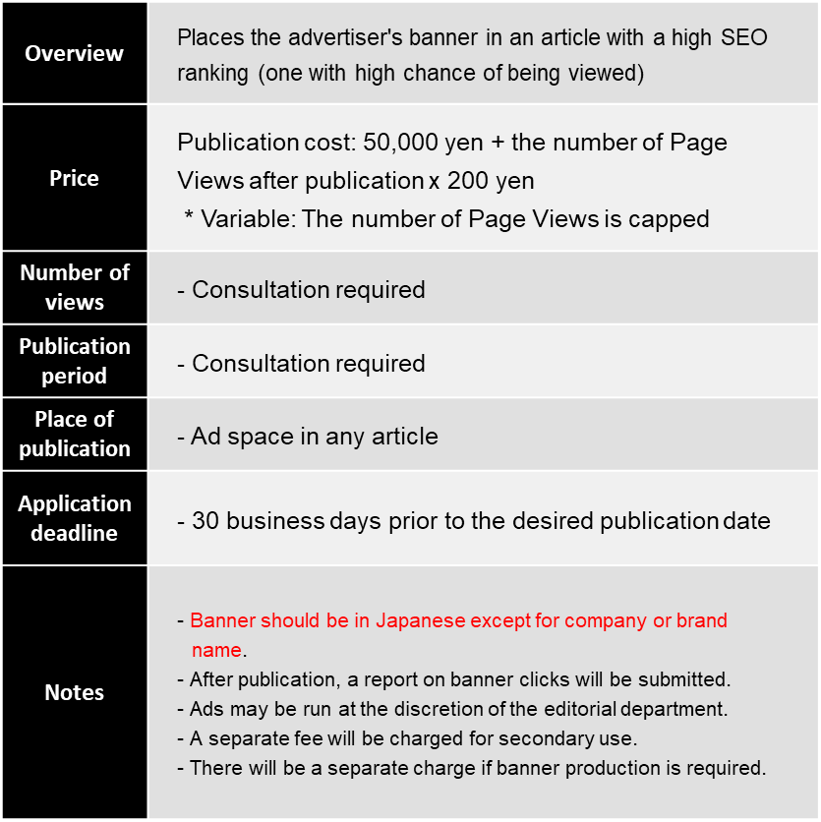
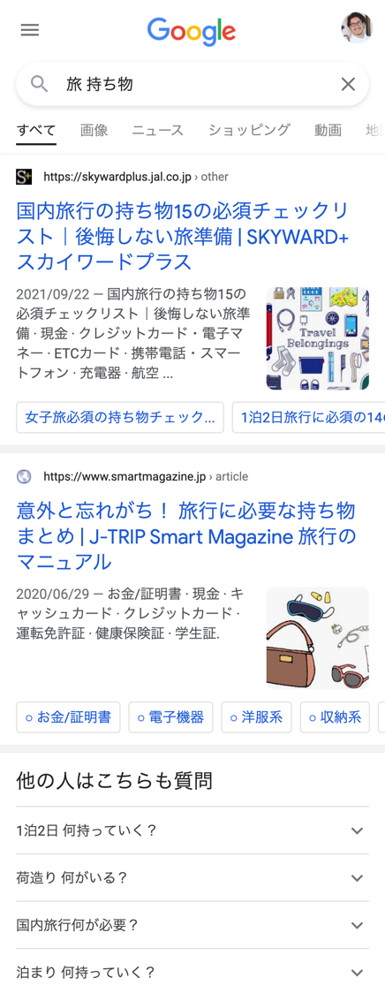
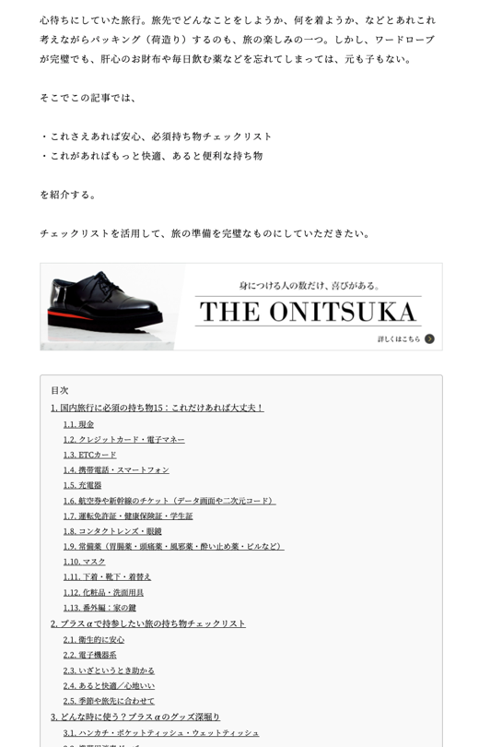
Ads linked to SEO search high-ranking articles
SKYWARD+ Advertising Menu
Ads linked to SEO search high-ranking articles
An option that places a banner in a SKYWARD+ article that appears at high ranks in search results and directs the viewer to a specified link *Please prepare Japanese site.
9:41 AM
9:41 AM
*
* An example of the use of ad space for another article within the website

Slide 26
Distribution flow for each SKYWARD+ advertising product
Steps to advertisement placement
Advertisement products
Steps to distribution
Consigned banner production
JAL Brand Communications creates a banner
- Banner Advertisement
- Ads linked to SEO search high ranking articles
Inquiry / acceptance or
rejection
of ad
Meeting and orientation
Publication and distribution
Contract
Report submission
Client creates a banner
One week after submitting the completed package

Slide 27
JAL Brand Communications Co., Ltd.
2-4-11 Higashi Shinagawa, Shinagawa-ku, Tokyo 140-8637
Nomura Tennozu Building
Email: jbc_ad@jal.com
CONTACT
We have a designated agent system for overseas customers For inquiries from overseas, please contact one of the designated agents below.
Inquiries Applications | •Americas (Eastern / Western US & Hawaii Islands) [NYC / Eastern US] World Media, Inc. / TEL: 1 212 244 5610 / www.worldmediaonline.com [HNL] PacRim Marketing Group Inc. / TEL: 1 808 949 4592 / www.pacrimmarketing.com [HNL] Lighthouse Hawaii / TEL: 1 808 926 0022 / lighthouse-hawaii.com •Europe (Europe) [LON] IMM International, UK Brand / TEL: 44 203 585 1300 / www.imm-international.com [PAR] Inflight Media Marketing France / TEL: 33 1 4013 7901 / www.imm-international.com [GVA] Inflight Media Marketing, AG / TEL: 41 22 310 80 51 / www.imm-international.com [ITA] Inflight Media Marketing International SARL / TEL: 39 02 46712521 / www.imm-international.com [ESP] IMM Spain / TEL:34 91 57 67 895 / www.imm-international.com | •Asia (excluding Japan) [SEL] First Media Service Corp. / TEL: 82 2 363 3591 [TPE] TOP TAIWAN MEDIA FACTORY / TEL: 886 2 2368 9128 / https://toptaiwanmedia.web.fc2.com [SHA] Jalux Shanghai Co., Ltd. / TEL: 86 21 34060663 / www.sh.jalux.com [HKG] IMM Asia HK Ltd. / TEL: 852 2639 3635 / www.imm-international.com [BKK] JPP Thailand Ltd. / TEL: 66 02 051 4694 [SIN] NewBase Content Pte. Ltd. / TEL: 65 9047 3181/ www.newbase360.com [SIN] Spafax Airline Network Pte. Ltd. / TEL: 65 6531 2682 / www.spafax.com [IDN] Jet Set Media / TEL: 65 8189 4783 [BOM] Mediascope Representation India LLP / TEL: 91 22 68468500 / https://mediascope.co.in/

